Slide 1
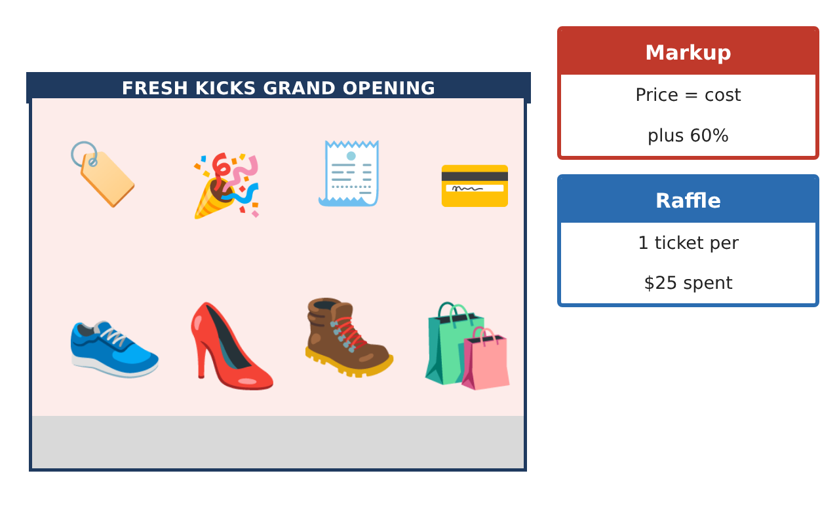
PRE-ALGEBRA (7TH) · UNIT 6: RATIOS, PROPORTIONS, AND PERCENTAGES
Sneaker Store Manager
Use rates, proportions, and percents to run a sneaker store for a week.
CP2 Project
2–3 class periods
Name: ______________________________ Group: ______________________________

Slide 2
The Scenario
CP2
You just became the manager of Fresh Kicks Sneaker Store. You have to order shoes from suppliers, lay out the new store, run a grand-opening raffle, and set prices that bring customers in and still make a profit.
You will use ratios, proportions, and percents to make every decision.
Pre-Algebra (7th) · Unit 6: Ratios, Proportions, and Percentages · Sneaker Store Manager

Slide 3
Learning Goals & Timeline
CP2
Learning Goals
Timeline
• I can find unit rates and compare them.
• I can solve proportions.
• I can find percents, discounts, and simple probability.
Day 1
Best Supplier
Day 2
Scale Drawing
Day 3
Prices & Raffle
Final
Store Manager Report + reflection
Pre-Algebra (7th) · Unit 6: Ratios, Proportions, and Percentages · Sneaker Store Manager

Slide 4
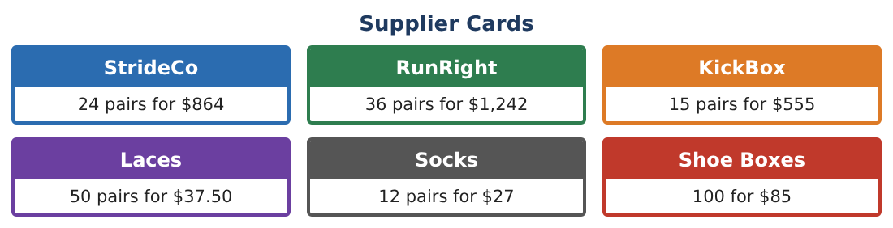
Part 1: Best Supplier
CP2
Day 1 · Use the Supplier Cards.
1. Find the price per pair for StrideCo.
Starter: $864 ÷ 24 = ___
2. Find the price per pair for RunRight and KickBox. Which supplier is cheapest?
3. Socks cost $27 for 12 pairs. How much do 30 pairs cost?
4. Laces cost $37.50 for 50. What is the cost per pair of laces?
Pre-Algebra (7th) · Unit 6: Ratios, Proportions, and Percentages · Sneaker Store Manager

Slide 5
Part 2: Scale Drawing
CP2
Day 2 · On the store plan, 1 inch = 4 feet.
5. The store is 12 inches long on the plan. How long is it really?
6. The checkout counter is 3¹⁄₂ in on the plan. How long is it?
7. A wall shelf is 20 ft long. How long should it be on the plan?
8. Draw a simple plan of the store with three labeled items and their real lengths.
Pre-Algebra (7th) · Unit 6: Ratios, Proportions, and Percentages · Sneaker Store Manager

Slide 6
Part 3: Prices & Raffle
CP2
Day 3 · The store adds 60% to the cost to set the price.
9. A pair costs the store $35. What is the price after a 60% markup?
10. The pair goes on sale for 25% off $56. What is the sale price?
11. The raffle has 200 tickets and 4 winning tickets. What is the probability of winning with 1 ticket? Write it as a fraction and a percent.
Pre-Algebra (7th) · Unit 6: Ratios, Proportions, and Percentages · Sneaker Store Manager

Slide 7
Final Product: Store Manager Report
CP2
Your final product must include:
☐ Unit price comparison
☐ Store scale drawing
☐ One markup and one discount
☐ Raffle probability
☐ Your manager report
Pre-Algebra (7th) · Unit 6: Ratios, Proportions, and Percentages · Sneaker Store Manager

Slide 8
Scoring Rubric
CP2
Criteria | 4 – Exceeds | 3 – Meets | 2 – Approaching | 1 – Beginning
Mathematical Accuracy | All calculations and solutions are correct; answers include units and are checked. | Nearly all work is correct; minor errors do not change conclusions. | Several errors; some conclusions are affected. | Many errors or missing work.
Reasoning & Justification | Clear, complete explanations connect every answer to the situation; uses precise vocabulary. | Explanations are mostly clear and connected to the situation. | Explanations are brief or partly unclear. | Little or no explanation.
Application & Design | Unit rates, proportions, scale, percents, and probability are used correctly to make store decisions. Goes beyond the minimum with a creative, realistic choice. | Unit rates, proportions, scale, percents, and probability are used correctly to make store decisions. | Design is incomplete or only partly uses the math from the unit. | Design is missing or unrelated to the unit math.
Communication & Presentation | Manager report includes the supplier choice, layout, pricing table, raffle analysis, and recommendations. Polished, organized, and visually engaging. | Manager report includes the supplier choice, layout, pricing table, raffle analysis, and recommendations. Organized and easy to follow. | Product is missing required parts or is hard to follow. | Product is mostly missing.
Pre-Algebra (7th) · Unit 6: Ratios, Proportions, and Percentages · Sneaker Store Manager

Slide 9
Reflection
CP2
R1. Why does a unit rate make comparing suppliers easier?
R2. Is 25% off and then 25% more the same price? Explain.
Pre-Algebra (7th) · Unit 6: Ratios, Proportions, and Percentages · Sneaker Store Manager

