Slide 1
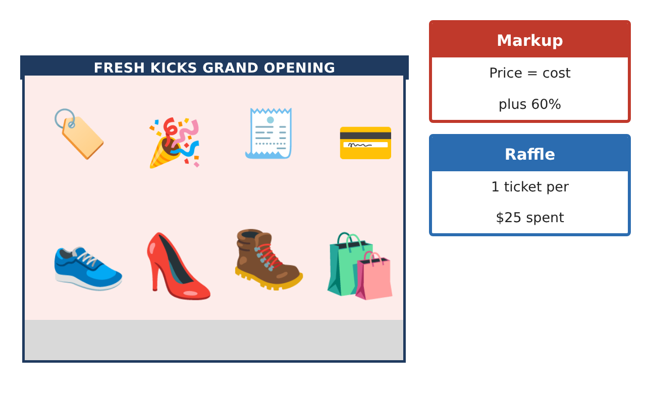
PRE-ALGEBRA (7TH) · UNIT 6: RATIOS, PROPORTIONS, AND PERCENTAGES
Sneaker Store Manager
Use rates, proportions, and percents to run a sneaker store for a week.
Honors Project
2–3 class periods
Name: ______________________________ Group: ______________________________

Slide 2
The Scenario
Honors
You just became the manager of Fresh Kicks Sneaker Store. You have to order shoes from suppliers, lay out the new store, run a grand-opening raffle, and set prices that bring customers in and still make a profit.
You will use ratios, proportions, and percents to make every decision.
Pre-Algebra (7th) · Unit 6: Ratios, Proportions, and Percentages · Sneaker Store Manager

Slide 3
Learning Goals & Timeline
Honors
Learning Goals
Timeline
• I can use unit rates and proportions to make purchasing decisions.
• I can use scale factors for length and area.
• I can analyze percent change, compound discounts, and probability.
Day 1
Purchasing Strategy
Day 2
Layout & Area
Day 3
Pricing Analysis
Final
Store Manager Report + reflection
Pre-Algebra (7th) · Unit 6: Ratios, Proportions, and Percentages · Sneaker Store Manager

Slide 4
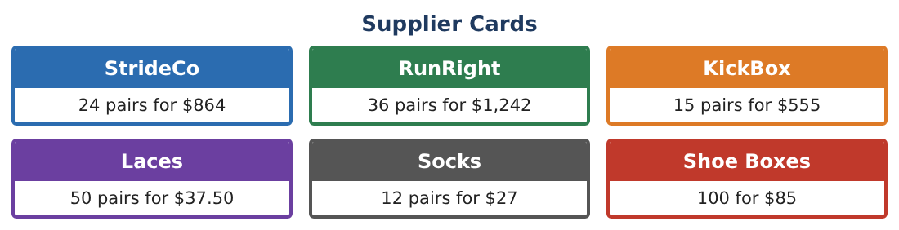
Part 1: Purchasing Strategy
Honors
Day 1 · Use the Supplier Cards. Budget $7,000 for exactly 200 pairs.
1. Find the cheapest way to buy at least 200 pairs if each supplier only sells full packs. Show the cost.
2. Using a 4% bulk discount on orders over $7,000, does the cheapest option fit the budget?
3. Find the cost per pair for that order after the discount.
4. Shoe boxes come in packs of 100 for $85. How many packs are needed for 204 pairs, and what do they cost? What would 204 boxes cost at the same unit rate?
Pre-Algebra (7th) · Unit 6: Ratios, Proportions, and Percentages · Sneaker Store Manager

Slide 5
Part 2: Layout & Area
Honors
Day 2 · Plan scale 1 in = 4 ft. Store plan is 12 in by 7¹⁄₂ in.
5. Find the real area and the area on the plan. What is the ratio of real area to plan area (in sq ft per sq in)?
6. The owner wants a second store with every length 1.25 times as long. Find its area and the percent increase in area.
7. A circular display has a 3 ft radius in store 1. In the larger store it is scaled by 1.25. What is the percent increase in its area?
8. Explain why area increases by more than 25% when lengths increase by 25%.
Pre-Algebra (7th) · Unit 6: Ratios, Proportions, and Percentages · Sneaker Store Manager

Slide 6
Part 3: Pricing Analysis
Honors
Day 3 · Markup 60% over cost.
9. A $35 pair is marked up 60%, discounted 30%, then given an extra 10% off at checkout. Find the final price and the single equivalent discount from $56.
10. The raffle: 300 tickets, 5 prizes drawn without replacement. You hold 12 tickets. Find the probability that the first two drawings are both yours.
11. Recommend a grand-opening price for the $34.50 pair so that the store earns at least a 20% profit on cost after a 30% discount. Show your inequality.
Pre-Algebra (7th) · Unit 6: Ratios, Proportions, and Percentages · Sneaker Store Manager

Slide 7
Final Product: Store Manager Report
Honors
Your final product must include:
☐ Purchasing plan with packs, budget, and discount
☐ Layout with length and area scale factors
☐ Compound discount analysis
☐ Raffle probability without replacement
☐ Pricing recommendation with justification
Pre-Algebra (7th) · Unit 6: Ratios, Proportions, and Percentages · Sneaker Store Manager

Slide 8
Scoring Rubric
Honors
Criteria | 4 – Exceeds | 3 – Meets | 2 – Approaching | 1 – Beginning
Mathematical Accuracy | All calculations and solutions are correct; answers include units and are checked. | Nearly all work is correct; minor errors do not change conclusions. | Several errors; some conclusions are affected. | Many errors or missing work.
Reasoning & Justification | Clear, complete explanations connect every answer to the situation; uses precise vocabulary. | Explanations are mostly clear and connected to the situation. | Explanations are brief or partly unclear. | Little or no explanation.
Application & Design | Unit rates, proportions, scale, percents, and probability are used correctly to make store decisions. Goes beyond the minimum with a creative, realistic choice. | Unit rates, proportions, scale, percents, and probability are used correctly to make store decisions. | Design is incomplete or only partly uses the math from the unit. | Design is missing or unrelated to the unit math.
Communication & Presentation | Manager report includes the supplier choice, layout, pricing table, raffle analysis, and recommendations. Polished, organized, and visually engaging. | Manager report includes the supplier choice, layout, pricing table, raffle analysis, and recommendations. Organized and easy to follow. | Product is missing required parts or is hard to follow. | Product is mostly missing.
Pre-Algebra (7th) · Unit 6: Ratios, Proportions, and Percentages · Sneaker Store Manager

Slide 9
Reflection
Honors
R1. Why are two successive discounts not the same as adding the percents?
R2. How does probability change when tickets are not replaced?
Pre-Algebra (7th) · Unit 6: Ratios, Proportions, and Percentages · Sneaker Store Manager

