Slide 1
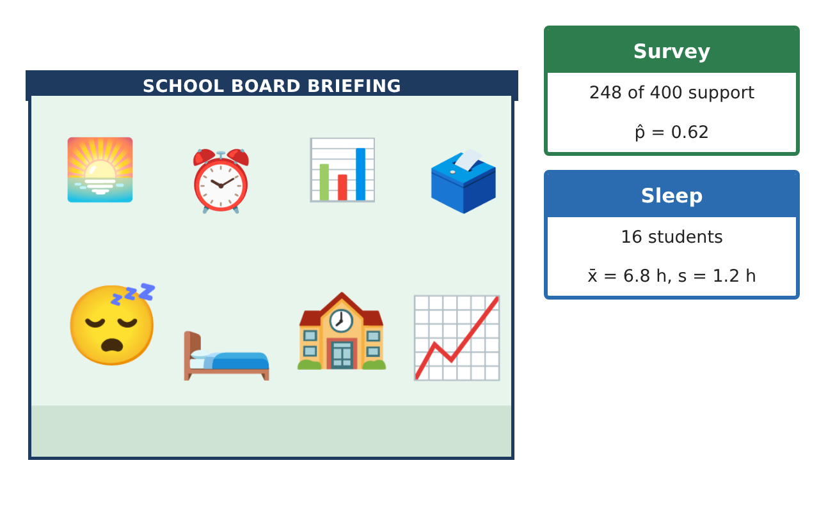
STATISTICS · UNIT 4: STATISTICAL INFERENCE
The Later Start Investigation
Use confidence intervals and significance tests to advise the school board on a later start time.
CP1 Project
2–3 class periods
Name: ______________________________ Group: ______________________________

Slide 2
The Scenario
CP1
The school board is considering starting school 45 minutes later. Board members want to know whether most students support it and whether students are really short on sleep.
Your team will collect evidence with confidence intervals and significance tests and present a recommendation with the right amount of certainty.
Statistics · Unit 4: Statistical Inference · The Later Start Investigation

Slide 3
Learning Goals & Timeline
CP1
Learning Goals
Timeline
• I can construct and interpret z-intervals for a proportion and t-intervals for a mean.
• I can carry out one-sample z- and t-tests with conditions.
• I can explain Type I and Type II errors and choose a sample size.
Day 1
Estimate Support
Day 2
Are Students Short on Sleep?
Day 3
Errors and Grades
Final
Report to the School Board + reflection
Statistics · Unit 4: Statistical Inference · The Later Start Investigation

Slide 4
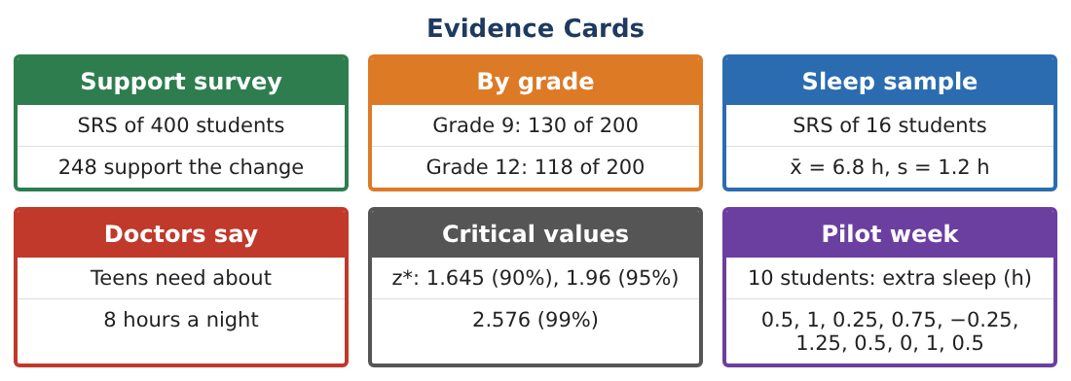
Part 1: Estimate Support
CP1
Day 1 · Use the Support survey card (SRS of 400, 248 support).
1. Check the conditions (Random, 10%, Large Counts) for a one-proportion z-interval.
2. Construct and interpret a 95% confidence interval.
3. How large a sample is needed for a margin of error of at most 3% at 95% confidence (use p̂ = 0.5)?
4. Test H₀: p = 0.5 vs Hₐ: p > 0.5 at α = 0.05. Give z, the p-value, and a conclusion.
Statistics · Unit 4: Statistical Inference · The Later Start Investigation

Slide 5
Part 2: Are Students Short on Sleep?
CP1
Day 2 · Use the Sleep sample card (n = 16, x̄ = 6.8 h, s = 1.2 h).
5. Construct a 95% t-interval for the mean sleep of all students (df = 15, t* ≈ 2.131).
6. Test H₀: μ = 8 vs Hₐ: μ < 8. Find t and the p-value.
7. Write a conclusion in context. What condition about the data must you check?
Statistics · Unit 4: Statistical Inference · The Later Start Investigation

Slide 6
Part 3: Errors and Grades
CP1
Day 3 · Use the By grade card.
8. Describe a Type I and a Type II error for the sleep test.
9. Find p̂ for each grade and the difference p̂₉ − p̂₁₂.
10. Construct a 95% confidence interval for p₉ − p₁₂ and interpret it.
11. How would increasing α from 0.05 to 0.10 affect the chances of each error?
Statistics · Unit 4: Statistical Inference · The Later Start Investigation

Slide 7
Final Product: Report to the School Board
CP1
Your final product must include:
☐ One-proportion interval, sample size, and test
☐ Mean sleep interval and t-test
☐ Errors in context
☐ Comparison of grades
☐ Report to the school board
Statistics · Unit 4: Statistical Inference · The Later Start Investigation

Slide 8
Scoring Rubric
CP1
Criteria | 4 – Exceeds | 3 – Meets | 2 – Approaching | 1 – Beginning
Mathematical Accuracy | All calculations and solutions are correct; answers include units and are checked. | Nearly all work is correct; minor errors do not change conclusions. | Several errors; some conclusions are affected. | Many errors or missing work.
Reasoning & Justification | Clear, complete explanations connect every answer to the situation; uses precise vocabulary. | Explanations are mostly clear and connected to the situation. | Explanations are brief or partly unclear. | Little or no explanation.
Application & Design | Intervals and tests are chosen, carried out, and interpreted correctly and support the recommendation. Goes beyond the minimum with a creative, realistic choice. | Intervals and tests are chosen, carried out, and interpreted correctly and support the recommendation. | Design is incomplete or only partly uses the math from the unit. | Design is missing or unrelated to the unit math.
Communication & Presentation | Report states the evidence, uncertainty, and limits of the study clearly for a non-statistician. Polished, organized, and visually engaging. | Report states the evidence, uncertainty, and limits of the study clearly for a non-statistician. Organized and easy to follow. | Product is missing required parts or is hard to follow. | Product is mostly missing.
Statistics · Unit 4: Statistical Inference · The Later Start Investigation

Slide 9
Reflection
CP1
R1. Why do we use t instead of z for the sleep data?
R2. Why does the grade comparison not prove the grades feel the same?
Statistics · Unit 4: Statistical Inference · The Later Start Investigation

