Slide 1
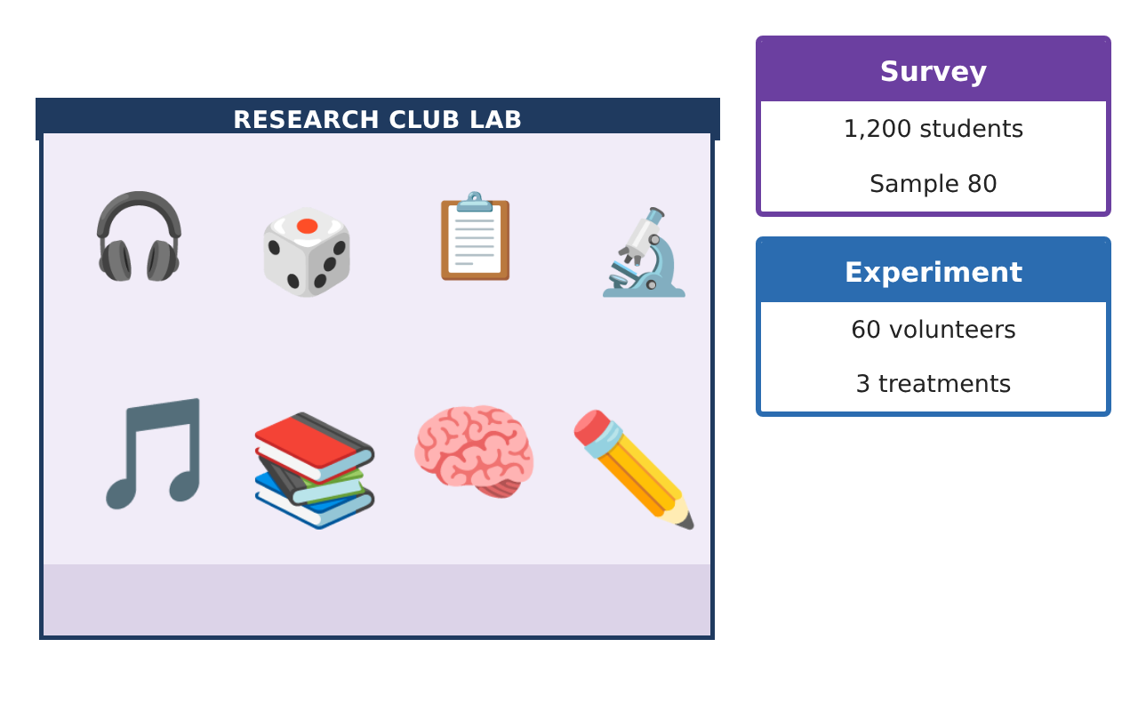
STATISTICS · UNIT 2: SAMPLING AND EXPERIMENTATION
The Study Music Experiment
Design a survey and a randomized experiment to find out whether music helps students study.
CP2 Project
2–3 class periods
Name: ______________________________ Group: ______________________________

Slide 2
The Scenario
CP2
Many students study with music on. Some teachers think it hurts focus; students say it helps. The school’s research club wants a real answer, not opinions.
Your team will first survey the school about study habits, then design an experiment that tests whether music actually changes how many vocabulary words students remember.
Statistics · Unit 2: Sampling and Experimentation · The Study Music Experiment

Slide 3
Learning Goals & Timeline
CP2
Learning Goals
Timeline
• I can tell a population from a sample and choose a random sample.
• I can spot bias in how data are collected.
• I can tell an experiment from an observational study and name its parts.
Day 1
Who Do We Ask?
Day 2
Watch for Bias
Day 3
Plan the Experiment
Final
Study Design Proposal + reflection
Statistics · Unit 2: Sampling and Experimentation · The Study Music Experiment

Slide 4
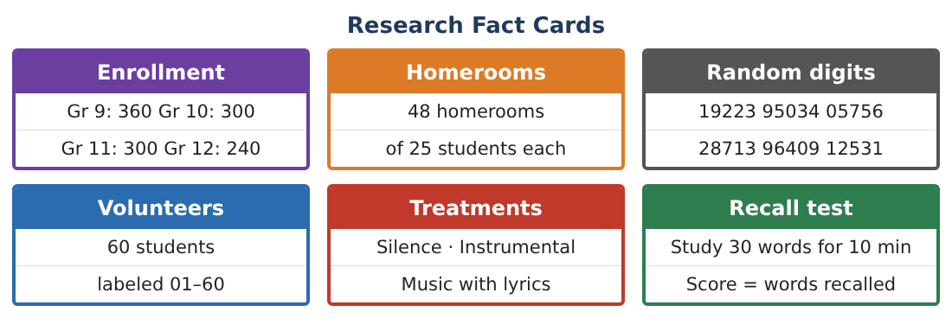
Part 1: Who Do We Ask?
CP2
Day 1 · The research club wants to know what percent of the school’s 1,200 students study with music.
1. What is the population? Why not just take a census?
Starter: The population is …
2. Ana suggests asking her 25 friends in the band. Why is this a bad sample?
3. Label the volunteers 01–60. Use the random digits 19223 95034 05756 to choose 5 students. Skip numbers over 60 and repeats.
Starter: Read the digits in pairs: 19, 22, …
4. Explain how to take a stratified sample of 80 students by grade with the same fraction from each grade.
Statistics · Unit 2: Sampling and Experimentation · The Study Music Experiment

Slide 5
Part 2: Watch for Bias
CP2
Day 2 · A survey question and its results can be misleading.
5. “Don’t you agree that music helps you focus?” What kind of bias does this question create? Rewrite it.
6. Surveys are emailed; only 30 of 80 reply. What kind of bias could this cause?
7. Students without school email are left out. Name this bias.
Statistics · Unit 2: Sampling and Experimentation · The Study Music Experiment

Slide 6
Part 3: Plan the Experiment
CP2
Day 3 · The club will test whether music changes how many of 30 words students recall.
8. Why is this an experiment and not an observational study?
9. Name the explanatory variable, the response variable, and the treatments.
10. Explain how to randomly assign the 60 volunteers to 3 groups of 20.
11. Why should the silence group be part of the experiment?
Statistics · Unit 2: Sampling and Experimentation · The Study Music Experiment

Slide 7
Final Product: Study Design Proposal
CP2
Your final product must include:
☐ Population and a random sample
☐ Stratified sample counts
☐ Bias checklist for the survey
☐ Experiment plan with treatments and random assignment
☐ Study design proposal poster
Statistics · Unit 2: Sampling and Experimentation · The Study Music Experiment

Slide 8
Scoring Rubric
CP2
Criteria | 4 – Exceeds | 3 – Meets | 2 – Approaching | 1 – Beginning
Mathematical Accuracy | All calculations and solutions are correct; answers include units and are checked. | Nearly all work is correct; minor errors do not change conclusions. | Several errors; some conclusions are affected. | Many errors or missing work.
Reasoning & Justification | Clear, complete explanations connect every answer to the situation; uses precise vocabulary. | Explanations are mostly clear and connected to the situation. | Explanations are brief or partly unclear. | Little or no explanation.
Application & Design | Sampling and experiment designs use randomization correctly and address bias and confounding. Goes beyond the minimum with a creative, realistic choice. | Sampling and experiment designs use randomization correctly and address bias and confounding. | Design is incomplete or only partly uses the math from the unit. | Design is missing or unrelated to the unit math.
Communication & Presentation | Proposal includes a clear diagram, a bias plan, and a correct scope of inference. Polished, organized, and visually engaging. | Proposal includes a clear diagram, a bias plan, and a correct scope of inference. Organized and easy to follow. | Product is missing required parts or is hard to follow. | Product is mostly missing.
Statistics · Unit 2: Sampling and Experimentation · The Study Music Experiment

Slide 9
Reflection
CP2
R1. Why does choosing the sample at random help?
R2. If students who study with music get lower grades, does that prove music hurts? Explain.
Statistics · Unit 2: Sampling and Experimentation · The Study Music Experiment

