Slide 1
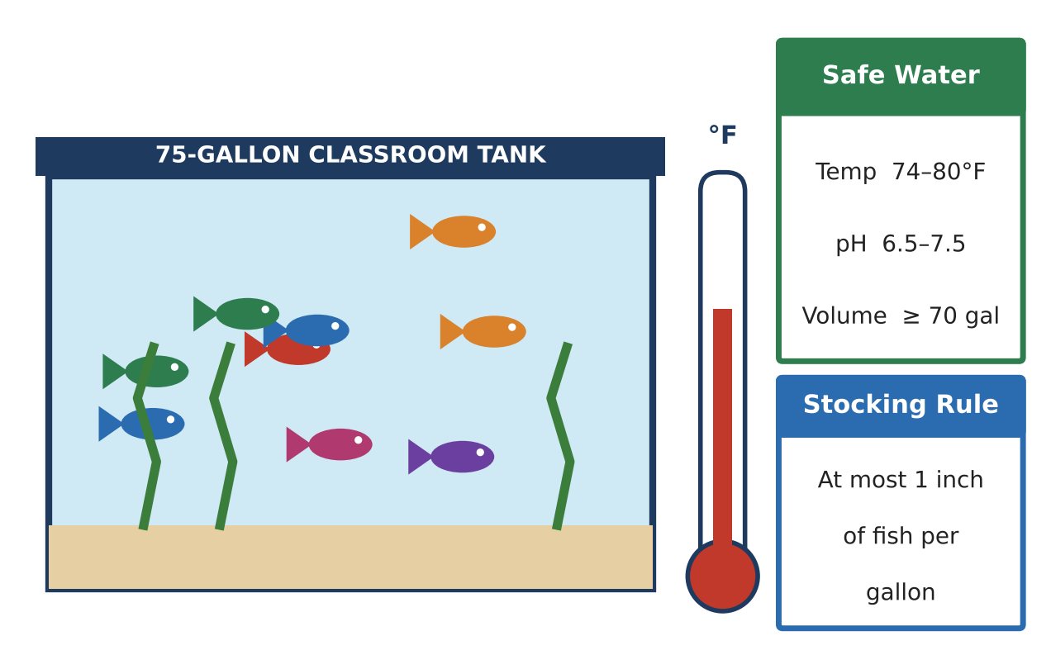
ALGEBRA 1 · UNIT 3: LINEAR INEQUALITIES
Aquarium Keeper
Keep a classroom aquarium safe using compound inequalities.
Honors Project
2–3 class periods
Name: ______________________ Group: ______________________

Slide 2
The Scenario
Honors
The science department is setting up a 75-gallon tropical fish tank, and your group is in charge of keeping the fish alive. Every species has a safe temperature range, the water needs the right pH, and too many fish in one tank makes the water dirty.
You will turn every rule into an inequality, find the conditions where all of your fish can live together, and write a care plan that the next class can follow.
Algebra 1 · Unit 3: Linear Inequalities · Aquarium Keeper

Slide 3
Learning Goals & Timeline
Honors
Learning Goals
Timeline
• I can describe ranges with compound and absolute value inequalities.
• I can choose parameters (like a thermostat setting) so that a tolerance stays inside a safe range.
• I can combine several constraints to justify a design.
Day 1
Ranges as Distances
Day 2
Thermostats, Cooling & Stocking
Day 3
Engineer a Community Tank
Final
Aquarium Care Plan + reflection
Algebra 1 · Unit 3: Linear Inequalities · Aquarium Keeper

Slide 4
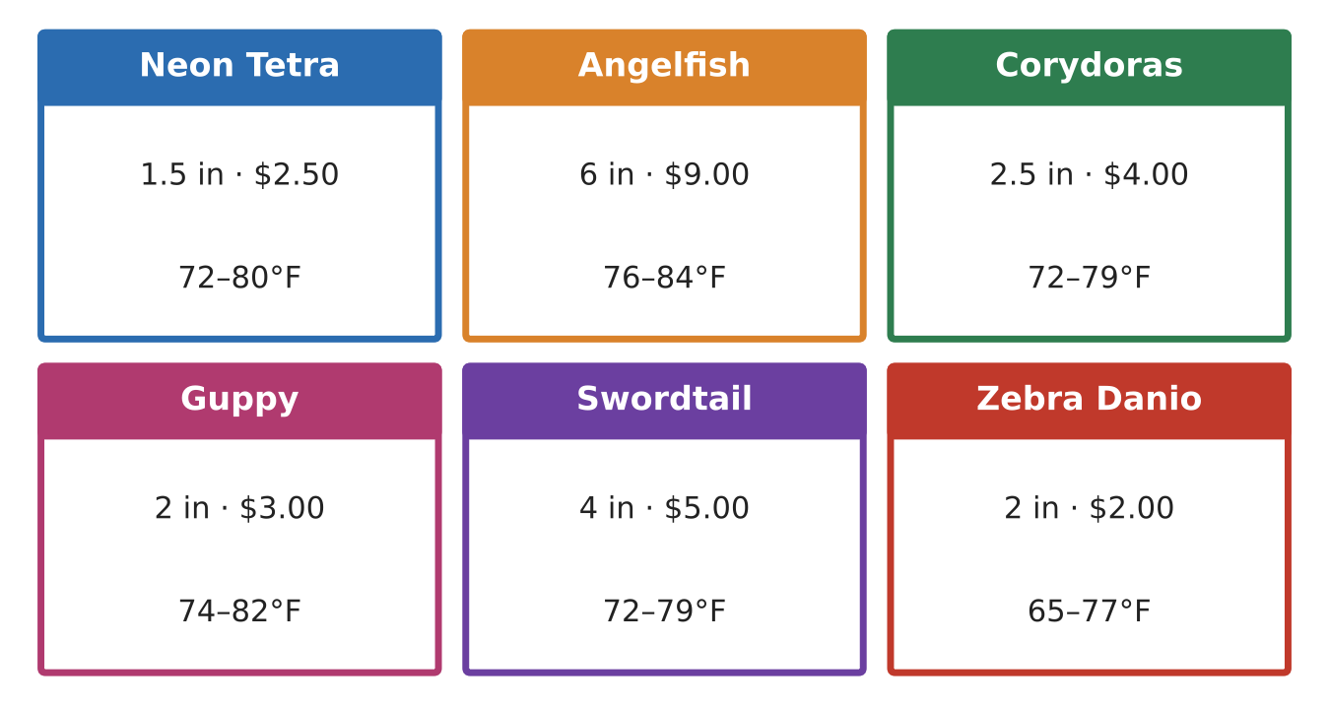
Part 1: Ranges as Distances
Honors
Day 1 · Use the Safe Water card and the fish cards.
1. Write the safe ranges for neon tetras (72–80°F) and angelfish (76–84°F) as absolute value inequalities.
2. Find the overlap of the two ranges. Write it as a compound inequality and as an absolute value inequality.
3. Convert the overlap to Celsius using F = 1.8C + 32 (round to the nearest hundredth). Then write it as an absolute value inequality in C.
4. The safe pH range is 6.5 to 7.5. Write it as an absolute value inequality. A test reads 7.6. By how much is it outside the range?
Algebra 1 · Unit 3: Linear Inequalities · Aquarium Keeper

Slide 5
Part 2: Thermostats, Cooling & Stocking
Honors
Day 2 · Use the overlap range 76 ≤ T ≤ 80 for all questions.
5. The thermostat keeps the water within 0.8°F of its setting s, so |T − s| ≤ 0.8. Find every setting s that keeps the water safe. Explain your reasoning.
6. If the power goes out at night, the water cools 0.4°F per hour starting from 79°F. After how many hours is the water unsafe?
7. The tank loses 0.6 gallon per day and must stay at least 70 gallons. Find the longest whole number of days between refills.
8. The tank has 2 angelfish (6 in each) and 6 corydoras (2.5 in each). Tetras must be added in a school of at least 6. The fish budget is $120 (only corydoras and tetras are bought now). Write one compound inequality for the number of tetras that meets all three rules.
Algebra 1 · Unit 3: Linear Inequalities · Aquarium Keeper

Slide 6
Part 3: Engineer a Community Tank
Honors
Day 3 · Use at least four species. Budget: $180.
9. Write each species' range as an absolute value inequality. Find the overlap of all of them and the thermostat settings that keep a 0.8°F tolerance safe.
10. Write and solve stocking and budget inequalities. Choose final counts and prove they satisfy every constraint.
11. Write a care plan that explains what to do if the power goes out, using an inequality to give a time limit.
Algebra 1 · Unit 3: Linear Inequalities · Aquarium Keeper

Slide 7
Final Product: Aquarium Care Plan
Honors
Your final product must include:
☐ Species list with absolute value ranges
☐ Overlap and thermostat settings with justification
☐ Stocking, budget, and schooling constraints with final counts
☐ Power-outage time limit
☐ Complete care plan
Algebra 1 · Unit 3: Linear Inequalities · Aquarium Keeper

Slide 8
Scoring Rubric
Honors
Criteria | 4 – Exceeds | 3 – Meets | 2 – Approaching | 1 – Beginning
Mathematical Accuracy | All calculations and solutions are correct; answers include units and are checked. | Nearly all work is correct; minor errors do not change conclusions. | Several errors; some conclusions are affected. | Many errors or missing work.
Reasoning & Justification | Clear, complete explanations connect every answer to the situation; uses precise vocabulary. | Explanations are mostly clear and connected to the situation. | Explanations are brief or partly unclear. | Little or no explanation.
Application & Design | Chosen fish share a common temperature range and the stocking and budget inequalities are satisfied. Goes beyond the minimum with a creative, realistic choice. | Chosen fish share a common temperature range and the stocking and budget inequalities are satisfied. | Design is incomplete or only partly uses the math from the unit. | Design is missing or unrelated to the unit math.
Communication & Presentation | Care plan includes the fish list, every safe range as an inequality, graphs of the overlap, and a maintenance schedule. Polished, organized, and visually engaging. | Care plan includes the fish list, every safe range as an inequality, graphs of the overlap, and a maintenance schedule. Organized and easy to follow. | Product is missing required parts or is hard to follow. | Product is mostly missing.
Algebra 1 · Unit 3: Linear Inequalities · Aquarium Keeper

Slide 9
Reflection
Honors
R1. Explain how the center and radius of an absolute value inequality relate to the endpoints of a range.
R2. Why does a thermostat tolerance shrink the set of safe settings?
Algebra 1 · Unit 3: Linear Inequalities · Aquarium Keeper

