Slide 1
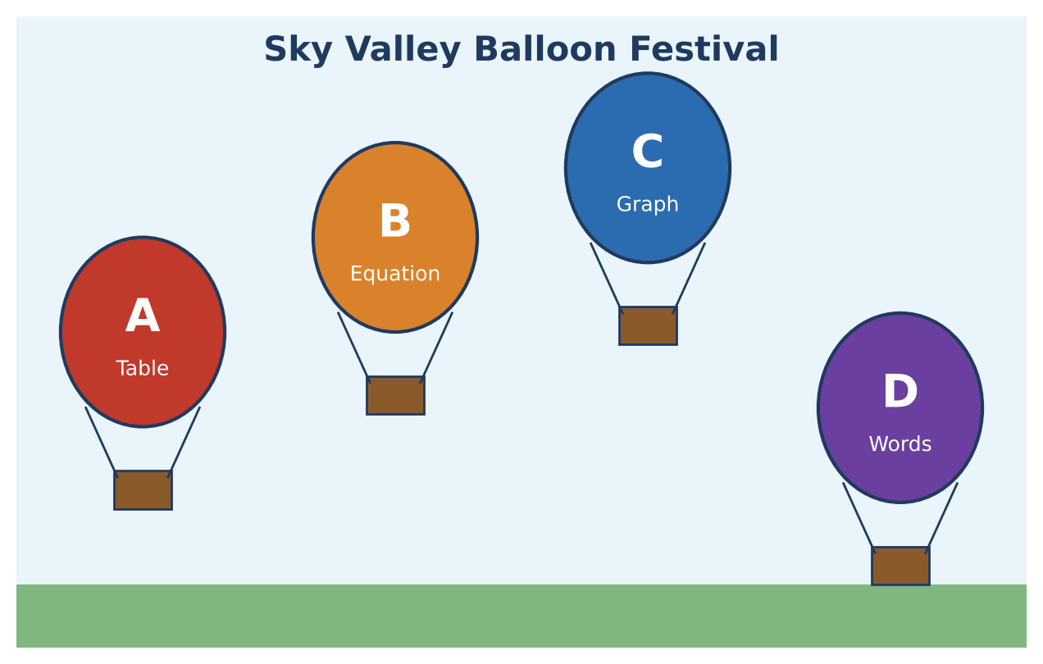
ALGEBRA 1 · UNIT 5: LINEAR FUNCTIONS AND GRAPHING
Balloon Festival
Compare four hot air balloons shown in four different ways.
Honors Project
2–3 class periods
Name: ______________________ Group: ______________________

Slide 2
The Scenario
Honors
Welcome to the Sky Valley Balloon Festival! Four balloons are in the air, and the judges have data on each one, but every judge recorded it in a different way: a table, an equation, a graph, and a description.
Your team is the festival's data crew. You will turn all four into equations, compare the balloons, predict what happens next, and then enter a balloon of your own.
Algebra 1 · Unit 5: Linear Functions and Graphing · Balloon Festival

Slide 3
Learning Goals & Timeline
Honors
Learning Goals
Timeline
• I can move fluently among tables, graphs, equations (all forms), and words.
• I can derive and use a general formula for when two linear models are equal.
• I can use inequalities to describe every design that meets the rules.
Day 1
Read the Judges' Data
Day 2
General Meeting Times
Day 3
Design Within the Rules
Final
Festival Flight Report + reflection
Algebra 1 · Unit 5: Linear Functions and Graphing · Balloon Festival

Slide 4
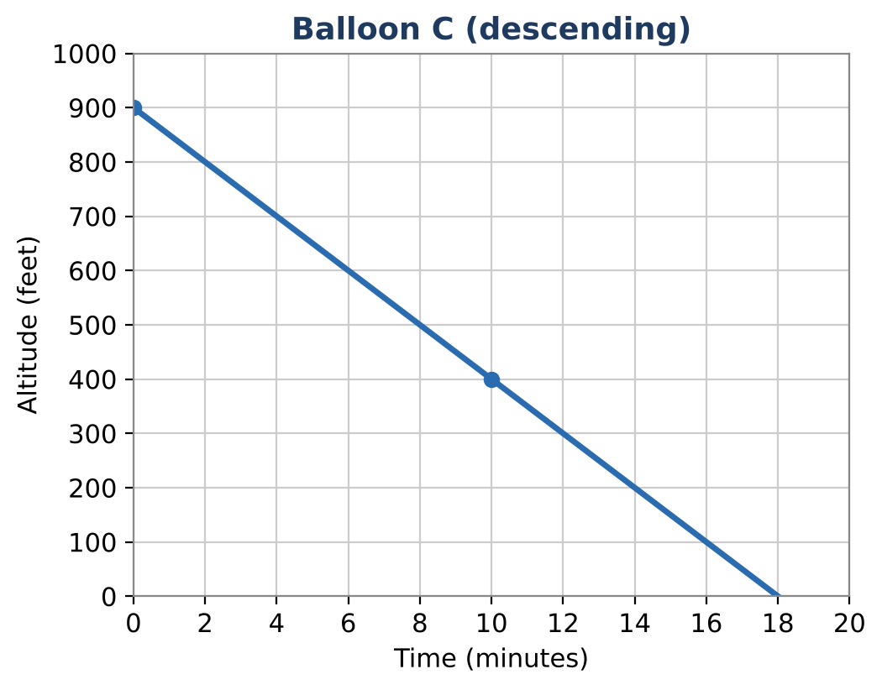
Part 1: Read the Judges' Data
Honors
Day 1 · Write each balloon in slope-intercept form (t in minutes, y in feet).
1. Balloons A (table), C (graph), and D ("launched from a hill 75 feet above the field, rising 80 feet per minute").
2. Balloon E was at 420 feet at 3 minutes and at 700 feet at 7 minutes.
3. Balloon F is given in standard form: 150t − 3y = −600. Rewrite it in slope-intercept form and interpret.
4. Convert Balloon A's rate to feet per second. Write A's equation with time s in seconds.
Time t (min) | 0 | 2 | 4 | 6
Altitude (ft) | 150 | 270 | 390 | 510
Algebra 1 · Unit 5: Linear Functions and Graphing · Balloon Festival

Slide 5
Part 2: General Meeting Times
Honors
Day 2 · Two balloons follow y = m₁t + b₁ and y = m₂t + b₂.
5. Derive a formula for the time t when they have the same altitude. When does the formula fail, and what does that mean?
6. Use your formula to find when A meets B, and when D meets B.
7. Do Balloons C and F ever meet? Do Balloons B and a new balloon y = 45t + 200 ever meet? Explain using slopes.
8. Wind pushes Balloon A east 300 feet per minute. Write the horizontal distance x as a function of t, then write A's altitude y as a function of x. Interpret the slope.
Algebra 1 · Unit 5: Linear Functions and Graphing · Balloon Festival

Slide 6
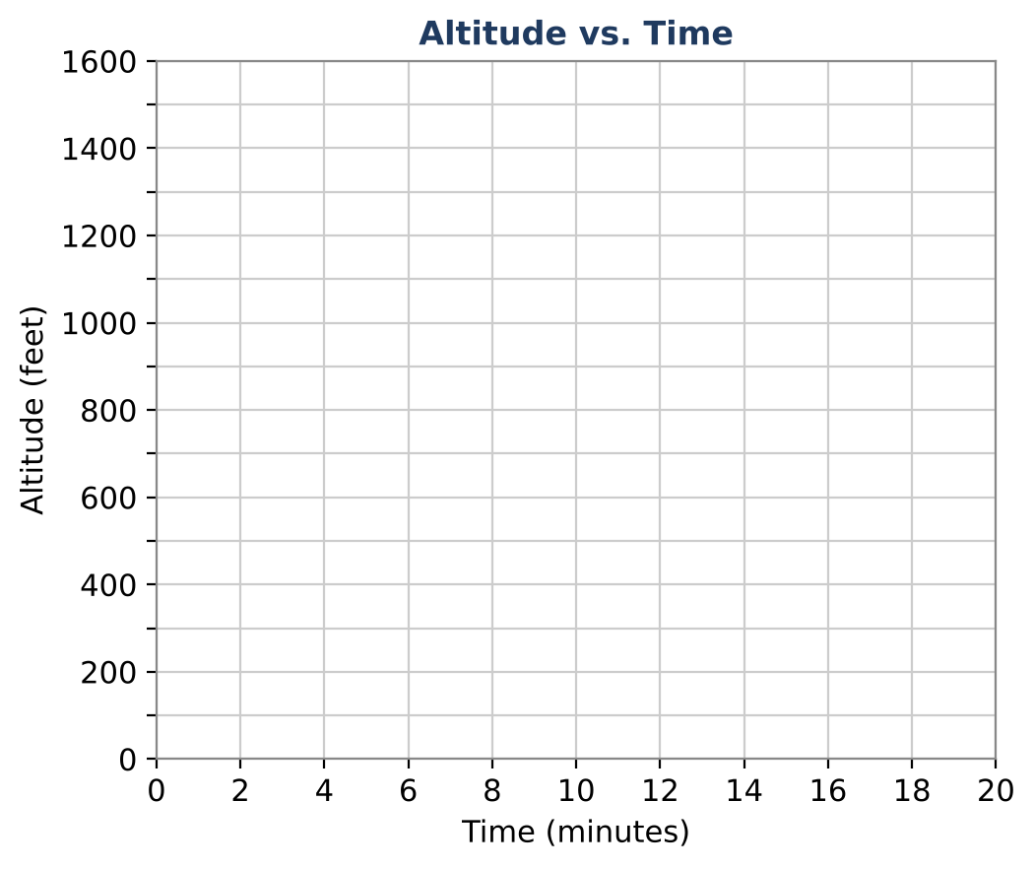
Part 3: Design Within the Rules
Honors
Day 3 · Rule: your balloon must start between 100 and 200 feet and be at 1,000 feet at some time between 8 and 10 minutes.
9. Write the rate m in terms of the starting altitude b and the time T when the balloon reaches 1,000 feet.
10. Find the smallest and largest possible rates that follow the rule. Write the result as a compound inequality.
11. Choose a design, show it meets every rule, and graph it with A, B, and D. Will your balloon meet each of them? When?
Algebra 1 · Unit 5: Linear Functions and Graphing · Balloon Festival

Slide 7
Final Product: Festival Flight Report
Honors
Your final product must include:
☐ Equations for Balloons A–F (including the converted forms)
☐ The general meeting-time formula with explanation
☐ The drift model y as a function of x
☐ The compound inequality for possible rates
☐ Your design with a complete flight report
Algebra 1 · Unit 5: Linear Functions and Graphing · Balloon Festival

Slide 8
Scoring Rubric
Honors
Criteria | 4 – Exceeds | 3 – Meets | 2 – Approaching | 1 – Beginning
Mathematical Accuracy | All calculations and solutions are correct; answers include units and are checked. | Nearly all work is correct; minor errors do not change conclusions. | Several errors; some conclusions are affected. | Many errors or missing work.
Reasoning & Justification | Clear, complete explanations connect every answer to the situation; uses precise vocabulary. | Explanations are mostly clear and connected to the situation. | Explanations are brief or partly unclear. | Little or no explanation.
Application & Design | Your balloon meets the festival rules, with an equation, table, and graph that match. Goes beyond the minimum with a creative, realistic choice. | Your balloon meets the festival rules, with an equation, table, and graph that match. | Design is incomplete or only partly uses the math from the unit. | Design is missing or unrelated to the unit math.
Communication & Presentation | Flight report shows all balloons as equations and graphs, answers the judges' questions, and presents your balloon. Polished, organized, and visually engaging. | Flight report shows all balloons as equations and graphs, answers the judges' questions, and presents your balloon. Organized and easy to follow. | Product is missing required parts or is hard to follow. | Product is mostly missing.
Algebra 1 · Unit 5: Linear Functions and Graphing · Balloon Festival

Slide 9
Reflection
Honors
R1. Why does your meeting-time formula fail when the slopes are equal? Connect to parallel lines.
R2. How did changing variables (t to x) change the slope but not the starting altitude?
Algebra 1 · Unit 5: Linear Functions and Graphing · Balloon Festival

