Slide 1
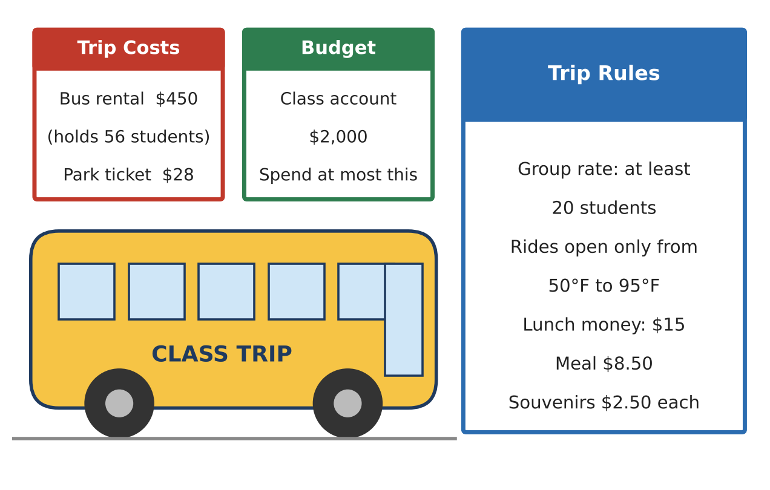
ALGEBRA 1 · UNIT 3: LINEAR INEQUALITIES
Class Trip Planner
Use inequalities to plan a field trip that fits the budget and the rules.
CP2 Project
2–3 class periods
Name: ______________________ Group: ______________________

Slide 2
The Scenario
CP2
Your class gets to take an end-of-year trip, but the principal will approve it only if the plan follows every rule and stays within the class budget.
You must figure out how many students can go, how much fundraising is needed, and when the trip can happen. Each rule is a constraint, and each constraint is an inequality.
Algebra 1 · Unit 3: Linear Inequalities · Class Trip Planner

Slide 3
Learning Goals & Timeline
CP2
Learning Goals
Timeline
• I can write an inequality from a real rule.
• I can solve and graph inequalities and explain my answer.
• I can use a compound inequality to describe a range of values.
Day 1
Stay Within the Budget
Day 2
Follow the Rules
Day 3
Plan Your Own Trip
Final
Trip Proposal + reflection
Algebra 1 · Unit 3: Linear Inequalities · Class Trip Planner

Slide 4
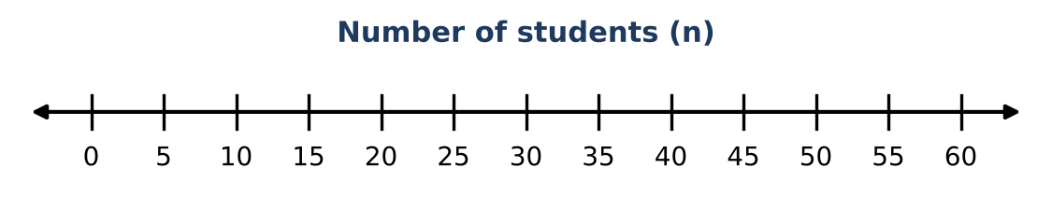
Part 1: Stay Within the Budget
CP2
Day 1 · Use the Trip Costs and Budget cards.
1. Write an expression for the total cost of the trip if n students go.
2. The class can spend at most $2,000. Write an inequality using your expression.
3. Solve your inequality. What is the greatest number of students who can go? Explain why you round down.
4. Show your solution on the number line.
5. Check: find the total cost for 55 students and for 56 students. Which one is over budget?
Algebra 1 · Unit 3: Linear Inequalities · Class Trip Planner

Slide 5
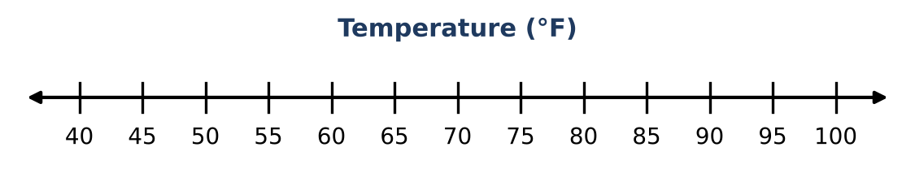
Part 2: Follow the Rules
CP2
Day 2 · Use the Trip Rules card.
6. The group rate needs at least 20 students. Combine this with your budget answer to write a compound inequality for n.
7. Rides are open only from 50°F to 95°F. Write a compound inequality for the temperature T when rides are open, and graph it.
8. Write an inequality for the temperatures when rides are closed.
9. Each student has $15 for lunch. The meal costs $8.50 and souvenirs cost $2.50 each. Write and solve an inequality for the number of souvenirs s a student can buy.
Algebra 1 · Unit 3: Linear Inequalities · Class Trip Planner

Slide 6
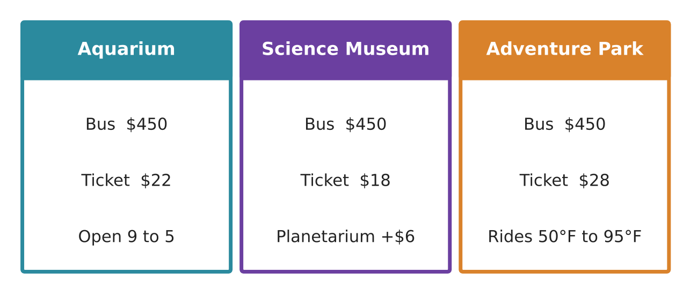
Part 3: Plan Your Own Trip
CP2
Day 3 · Choose a destination card. The budget is still $2,000.
10. Which destination did you choose? Write an inequality for the number of students who can go, and solve it.
11. Write a compound inequality that includes the group-rate rule (at least 20) and your budget answer.
12. Write 2–3 sentences to the principal explaining why your trip should be approved.
Algebra 1 · Unit 3: Linear Inequalities · Class Trip Planner

Slide 7
Final Product: Trip Proposal
CP2
Your final product must include:
☐ Destination name and picture
☐ The budget inequality, solved, with a number line
☐ The compound inequality for group size
☐ One more rule (temperature, lunch, or time) written as an inequality
☐ Your message to the principal
Algebra 1 · Unit 3: Linear Inequalities · Class Trip Planner

Slide 8
Scoring Rubric
CP2
Criteria | 4 – Exceeds | 3 – Meets | 2 – Approaching | 1 – Beginning
Mathematical Accuracy | All calculations and solutions are correct; answers include units and are checked. | Nearly all work is correct; minor errors do not change conclusions. | Several errors; some conclusions are affected. | Many errors or missing work.
Reasoning & Justification | Clear, complete explanations connect every answer to the situation; uses precise vocabulary. | Explanations are mostly clear and connected to the situation. | Explanations are brief or partly unclear. | Little or no explanation.
Application & Design | Every constraint is written and solved correctly, and the final group size satisfies all of them. Goes beyond the minimum with a creative, realistic choice. | Every constraint is written and solved correctly, and the final group size satisfies all of them. | Design is incomplete or only partly uses the math from the unit. | Design is missing or unrelated to the unit math.
Communication & Presentation | Proposal shows the destination, every constraint as an inequality, graphs, and a final recommendation. Polished, organized, and visually engaging. | Proposal shows the destination, every constraint as an inequality, graphs, and a final recommendation. Organized and easy to follow. | Product is missing required parts or is hard to follow. | Product is mostly missing.
Algebra 1 · Unit 3: Linear Inequalities · Class Trip Planner

Slide 9
Reflection
CP2
R1. Why did we round down for the budget but would round up for a minimum, like "at least 20"?
R2. What is one inequality you see in your own life (phone data, money, time)?
Algebra 1 · Unit 3: Linear Inequalities · Class Trip Planner

