Slide 1
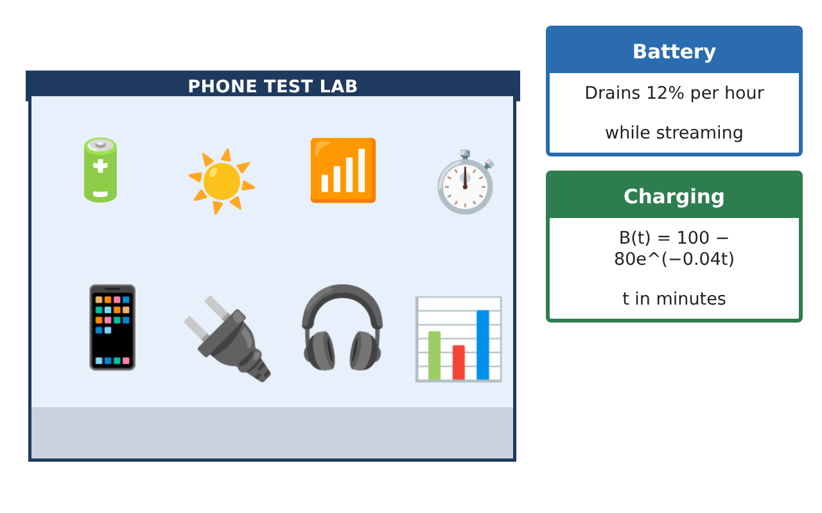
CALCULUS · UNIT 1: PRECALCULUS REVIEW
Phone Battery Lab
Review function families by modeling a phone’s battery, charging, and app data.
CP2 Project
2–3 class periods
Name: ______________________________ Group: ______________________________

Slide 2
The Scenario
CP2
A phone company wants a student lab to test its new phone. The battery drains while streaming, charges quickly at first and then slowly, the screen brightness follows the sunlight, and the data plan has a price that changes after a limit.
You will use the function families you need for calculus to model the phone and answer the company’s questions.
Calculus · Unit 1: Precalculus Review · Phone Battery Lab

Slide 3
Learning Goals & Timeline
CP2
Learning Goals
Timeline
• I can write and use linear and exponential models.
• I can evaluate piecewise functions and compositions.
• I can use logarithms to solve for time.
Day 1
Battery Models
Day 2
Plans & Conversions
Day 3
Charging & Brightness
Final
Battery Lab Report + reflection
Calculus · Unit 1: Precalculus Review · Phone Battery Lab

Slide 4
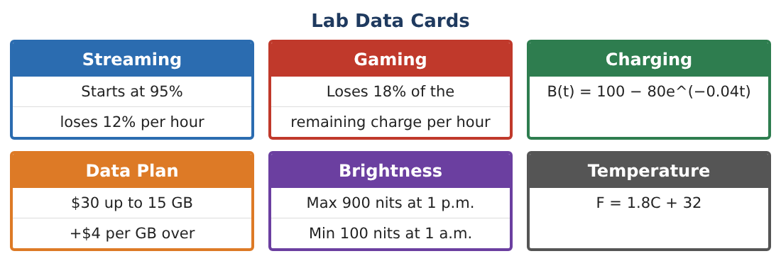
Part 1: Battery Models
CP2
Day 1 · Use the Lab Data Cards. t is in hours.
1. Write a linear model for streaming: S(t) = 95 − 12t. When is the battery at 20%?
2. Write an exponential model for gaming starting at 95%.
Starter: G(t) = 95(1 − ___)ᵗ
3. Find G(3) and S(3). Which drains faster in the first 3 hours?
4. What is the domain of S in this context?
Calculus · Unit 1: Precalculus Review · Phone Battery Lab

Slide 5
Part 2: Plans & Conversions
CP2
Day 2 · Data plan: $30 up to 15 GB, then $4 per GB over 15.
5. Write the cost as a piecewise function P(g).
6. Find P(12) and P(20).
7. The phone’s temperature is 35°C. Use F = 1.8C + 32 to convert. Then find the inverse function C(F).
8. Is P(g) one-to-one? Explain.
Calculus · Unit 1: Precalculus Review · Phone Battery Lab

Slide 6
Part 3: Charging & Brightness
CP2
Day 3 · B(t) = 100 − 80e^(−0.04t), t in minutes.
9. Find B(0), B(30), and B(60).
10. Solve B(t) = 90 using logarithms.
11. Brightness has a maximum 900 at 1 p.m. and a minimum 100 at 1 a.m. Find the midline, amplitude, and period.
Calculus · Unit 1: Precalculus Review · Phone Battery Lab

Slide 7
Final Product: Battery Lab Report
CP2
Your final product must include:
☐ Battery models with graphs
☐ Piecewise data plan
☐ Conversion and inverse
☐ Charging time with logarithms
☐ Lab report
Calculus · Unit 1: Precalculus Review · Phone Battery Lab

Slide 8
Scoring Rubric
CP2
Criteria | 4 – Exceeds | 3 – Meets | 2 – Approaching | 1 – Beginning
Mathematical Accuracy | All calculations and solutions are correct; answers include units and are checked. | Nearly all work is correct; minor errors do not change conclusions. | Several errors; some conclusions are affected. | Many errors or missing work.
Reasoning & Justification | Clear, complete explanations connect every answer to the situation; uses precise vocabulary. | Explanations are mostly clear and connected to the situation. | Explanations are brief or partly unclear. | Little or no explanation.
Application & Design | Models for battery, charging, plans, and brightness are built and used correctly. Goes beyond the minimum with a creative, realistic choice. | Models for battery, charging, plans, and brightness are built and used correctly. | Design is incomplete or only partly uses the math from the unit. | Design is missing or unrelated to the unit math.
Communication & Presentation | Lab report includes models, graphs, calculations, and conclusions. Polished, organized, and visually engaging. | Lab report includes models, graphs, calculations, and conclusions. Organized and easy to follow. | Product is missing required parts or is hard to follow. | Product is mostly missing.
Calculus · Unit 1: Precalculus Review · Phone Battery Lab

Slide 9
Reflection
CP2
R1. How can you tell from a table whether data is linear or exponential?
R2. Why does the charging model level off at 100?
Calculus · Unit 1: Precalculus Review · Phone Battery Lab

