Slide 1
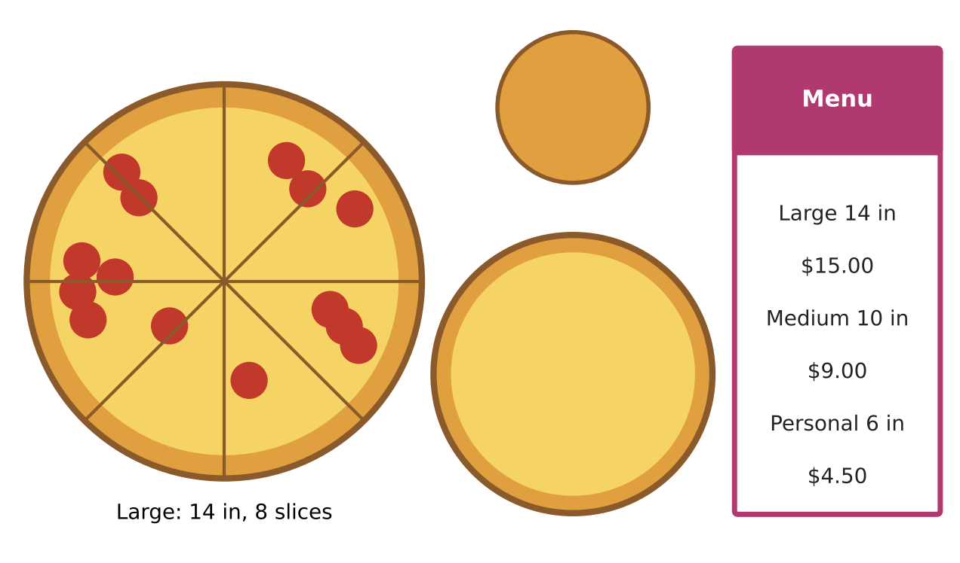
GEOMETRY · UNIT 9: CIRCLES
Pizza Parlor Geometry
Use circle area, arcs, sectors, and angles to price and slice pizza.
CP1 Project
2–3 class periods
Name: ______________________ Group: ______________________

Slide 2
The Scenario
CP1
Slice of Pi Pizzeria wants to update its menu, and customers keep asking: is two mediums really more pizza than one large?
Every question on the menu is a circle question: area, crust length, slice size, and delivery range. You will answer them and design a fair menu.
Geometry · Unit 9: Circles · Pizza Parlor Geometry

Slide 3
Learning Goals & Timeline
CP1
Learning Goals
Timeline
• I can find arc lengths, sector areas, and central angles.
• I can use inscribed angles, chords, and tangents.
• I can write and use the equation of a circle.
Day 1
Value & Slices
Day 2
Cutting & Boxing
Day 3
Design a Menu
Final
Pizza Menu Proposal + reflection
Geometry · Unit 9: Circles · Pizza Parlor Geometry

Slide 4
Part 1: Value & Slices
CP1
Day 1 · Use the menu.
1. Compare one large with two mediums using exact areas and price per square inch.
2. A customer wants a 30 in² slice from a large pizza. What central angle should the cut have?
3. A slice of a large pizza has a crust (arc) length of 7 in. Find its central angle and area.
Geometry · Unit 9: Circles · Pizza Parlor Geometry

Slide 5
Part 2: Cutting & Boxing
CP1
Day 2 · Use circle theorems.
4. A straight cut is made 3 in from the center of a large pizza. How long is the cut (the chord)?
5. Three points on the crust form a triangle. One angle of the triangle intercepts an arc of 100°. What is that angle?
6. A large pizza fits exactly in a square box. Each side of the box is tangent to the crust. How long is each side? Explain using tangents.
7. The delivery zone is a circle centered at the shop (0, 0) with radius 5 miles. Write its equation. Is a house at (3, 4.5) in the zone?
Geometry · Unit 9: Circles · Pizza Parlor Geometry

Slide 6
Part 3: Design a Menu
CP1
Day 3 · Design three sizes and a delivery zone.
8. Choose sizes and prices with a nearly equal price per square inch.
9. Decide how many slices each size gets so that every slice is between 15 and 25 in². Show sector areas.
10. Write the equation of your delivery zone and test two addresses.
Geometry · Unit 9: Circles · Pizza Parlor Geometry

Slide 7
Final Product: Pizza Menu Proposal
CP1
Your final product must include:
☐ Menu with sizes, prices, and slice counts
☐ Sector area table
☐ Delivery zone equation and tests
☐ Answers to the cutting and boxing questions
Geometry · Unit 9: Circles · Pizza Parlor Geometry

Slide 8
Scoring Rubric
CP1
Criteria | 4 – Exceeds | 3 – Meets | 2 – Approaching | 1 – Beginning
Mathematical Accuracy | All calculations and solutions are correct; answers include units and are checked. | Nearly all work is correct; minor errors do not change conclusions. | Several errors; some conclusions are affected. | Many errors or missing work.
Reasoning & Justification | Clear, complete explanations connect every answer to the situation; uses precise vocabulary. | Explanations are mostly clear and connected to the situation. | Explanations are brief or partly unclear. | Little or no explanation.
Application & Design | Prices are fair (similar price per square inch) and every circle calculation is correct. Goes beyond the minimum with a creative, realistic choice. | Prices are fair (similar price per square inch) and every circle calculation is correct. | Design is incomplete or only partly uses the math from the unit. | Design is missing or unrelated to the unit math.
Communication & Presentation | Menu proposal shows each size's area, price per square inch, slice sizes, and a pricing recommendation. Polished, organized, and visually engaging. | Menu proposal shows each size's area, price per square inch, slice sizes, and a pricing recommendation. Organized and easy to follow. | Product is missing required parts or is hard to follow. | Product is mostly missing.
Geometry · Unit 9: Circles · Pizza Parlor Geometry

Slide 9
Reflection
CP1
R1. Why is an inscribed angle half its intercepted arc?
R2. How does the circle equation come from the Pythagorean Theorem?
Geometry · Unit 9: Circles · Pizza Parlor Geometry

