Slide 1
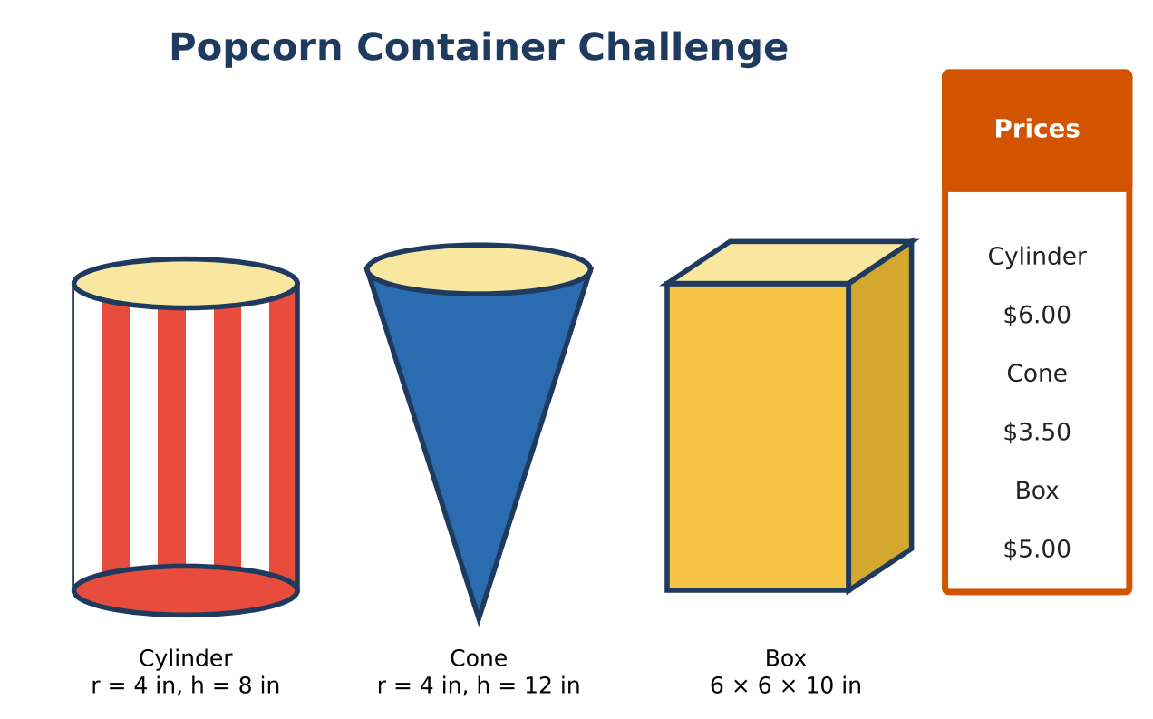
GEOMETRY · UNIT 10: AREA, SURFACE AREA AND VOLUME
Popcorn Container Challenge
Compare volume and surface area to design the best popcorn container.
CP1 Project
2–3 class periods
Name: ______________________ Group: ______________________

Slide 2
The Scenario
CP1
The movie theater is choosing a new popcorn container. The manager wants the best value for customers and the least cardboard for the environment.
You will compare three containers, explore how volume changes when dimensions change, and design and pitch your own container.
Geometry · Unit 10: Area, Surface Area and Volume · Popcorn Container Challenge

Slide 3
Learning Goals & Timeline
CP1
Learning Goals
Timeline
• I can find volume and surface area of prisms, cylinders, pyramids, cones, and spheres.
• I can use scale factors for similar solids.
• I can design and justify a container.
Day 1
Which Holds the Most?
Day 2
Scale & Value
Day 3
Design a Container
Final
Container Design Pitch + reflection
Geometry · Unit 10: Area, Surface Area and Volume · Popcorn Container Challenge

Slide 4
Part 1: Which Holds the Most?
CP1
Day 1 · Use the container cards.
1. Find the volume of each container. Rank them.
2. A new upside-down square pyramid container has an 8-in base and a 9-in height. Find its volume.
3. Popcorn balls have a radius of 1.5 in. Find the volume of one ball. About how many would fill the cylinder by volume?
4. Find the cone's slant height and lateral (side) area.
Geometry · Unit 10: Area, Surface Area and Volume · Popcorn Container Challenge

Slide 5
Part 2: Scale & Value
CP1
Day 2 · Similar containers have all dimensions multiplied by the same scale factor k.
5. A "jumbo" cylinder doubles the radius but keeps the height. How many times as much popcorn does it hold?
6. A "mega" box is similar to the box with scale factor 1.5. Find its volume and how many times larger it is.
7. The theater wants the mega box priced fairly (same price per cubic inch as the box). What should it cost?
8. The cylinder's label wraps around its side. Find the label's area.
Geometry · Unit 10: Area, Surface Area and Volume · Popcorn Container Challenge

Slide 6
Part 3: Design a Container
CP1
Day 3 · Design a container that holds 300 to 320 in³ and uses less cardboard than the box.
9. Choose a shape and dimensions and show the volume is in range.
10. Find the surface area and compare with the box.
11. Sketch a net with dimensions.
Geometry · Unit 10: Area, Surface Area and Volume · Popcorn Container Challenge

Slide 7
Final Product: Container Design Pitch
CP1
Your final product must include:
☐ Net or model of your container
☐ Volume, surface area, and scale calculations
☐ Fair price for a similar container
☐ Pitch comparing all containers
Geometry · Unit 10: Area, Surface Area and Volume · Popcorn Container Challenge

Slide 8
Scoring Rubric
CP1
Criteria | 4 – Exceeds | 3 – Meets | 2 – Approaching | 1 – Beginning
Mathematical Accuracy | All calculations and solutions are correct; answers include units and are checked. | Nearly all work is correct; minor errors do not change conclusions. | Several errors; some conclusions are affected. | Many errors or missing work.
Reasoning & Justification | Clear, complete explanations connect every answer to the situation; uses precise vocabulary. | Explanations are mostly clear and connected to the situation. | Explanations are brief or partly unclear. | Little or no explanation.
Application & Design | Design meets the volume target and uses less material than at least one other container, with correct formulas. Goes beyond the minimum with a creative, realistic choice. | Design meets the volume target and uses less material than at least one other container, with correct formulas. | Design is incomplete or only partly uses the math from the unit. | Design is missing or unrelated to the unit math.
Communication & Presentation | Pitch includes a net or model, volume and surface area, price per cubic inch, and a comparison with the other containers. Polished, organized, and visually engaging. | Pitch includes a net or model, volume and surface area, price per cubic inch, and a comparison with the other containers. Organized and easy to follow. | Product is missing required parts or is hard to follow. | Product is mostly missing.
Geometry · Unit 10: Area, Surface Area and Volume · Popcorn Container Challenge

Slide 9
Reflection
CP1
R1. Why does doubling the radius make the volume four times as large?
R2. How do scale factors affect area and volume differently?
Geometry · Unit 10: Area, Surface Area and Volume · Popcorn Container Challenge

