Slide 1
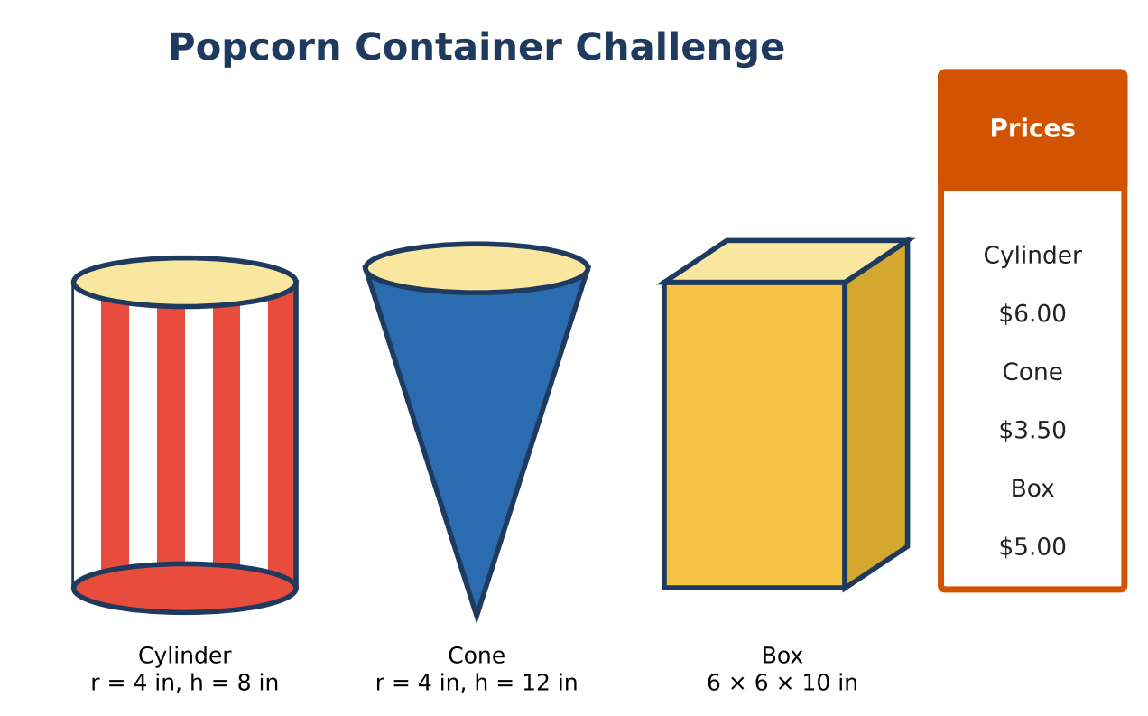
GEOMETRY · UNIT 10: AREA, SURFACE AREA AND VOLUME
Popcorn Container Challenge
Compare volume and surface area to design the best popcorn container.
Honors Project
2–3 class periods
Name: ______________________ Group: ______________________

Slide 2
The Scenario
Honors
The movie theater is choosing a new popcorn container. The manager wants the best value for customers and the least cardboard for the environment.
You will compare three containers, explore how volume changes when dimensions change, and design and pitch your own container.
Geometry · Unit 10: Area, Surface Area and Volume · Popcorn Container Challenge

Slide 3
Learning Goals & Timeline
Honors
Learning Goals
Timeline
• I can justify volume formulas with Cavalieri's principle.
• I can optimize a design for a fixed volume.
• I can write a mathematical argument for a design.
Day 1
Volumes & Cavalieri
Day 2
Optimize
Day 3
Design & Prove
Final
Container Design Pitch + reflection
Geometry · Unit 10: Area, Surface Area and Volume · Popcorn Container Challenge

Slide 4
Part 1: Volumes & Cavalieri
Honors
Day 1 · Exact answers.
1. Find the exact volumes of all three containers.
2. Explain with Cavalieri's principle why a slanted (oblique) cylinder with r = 4 and height 8 holds the same amount as the straight one.
3. A hemisphere bowl and a cone have the same radius r and the cone's height is r. Show the bowl holds twice as much.
Geometry · Unit 10: Area, Surface Area and Volume · Popcorn Container Challenge

Slide 5
Part 2: Optimize
Honors
Day 2 · Design an open-top cylinder that holds exactly 400 in³ with the least cardboard.
4. Write h in terms of r. Then write the surface area S(r) = πr² + 2πrh in terms of r only.
5. Make a table of S(r) for r = 3, 4, 5, 6, 7. Which r gives the least cardboard?
6. The best design has r = h. Find this r to the nearest hundredth and the surface area.
7. How much cardboard does the best design save compared with the current cylinder (which holds 402 in³)?
Geometry · Unit 10: Area, Surface Area and Volume · Popcorn Container Challenge

Slide 6
Part 3: Design & Prove
Honors
Day 3 · Design a container of your own shape that holds 400 in³.
8. Optimize one dimension using a table or graph.
9. Compare your design with the optimal cylinder.
10. Write a pitch that uses your math to persuade the manager.
Geometry · Unit 10: Area, Surface Area and Volume · Popcorn Container Challenge

Slide 7
Final Product: Container Design Pitch
Honors
Your final product must include:
☐ Exact volumes and Cavalieri argument
☐ Optimization table and best cylinder
☐ Original optimized design
☐ Pitch
Geometry · Unit 10: Area, Surface Area and Volume · Popcorn Container Challenge

Slide 8
Scoring Rubric
Honors
Criteria | 4 – Exceeds | 3 – Meets | 2 – Approaching | 1 – Beginning
Mathematical Accuracy | All calculations and solutions are correct; answers include units and are checked. | Nearly all work is correct; minor errors do not change conclusions. | Several errors; some conclusions are affected. | Many errors or missing work.
Reasoning & Justification | Clear, complete explanations connect every answer to the situation; uses precise vocabulary. | Explanations are mostly clear and connected to the situation. | Explanations are brief or partly unclear. | Little or no explanation.
Application & Design | Design meets the volume target and uses less material than at least one other container, with correct formulas. Goes beyond the minimum with a creative, realistic choice. | Design meets the volume target and uses less material than at least one other container, with correct formulas. | Design is incomplete or only partly uses the math from the unit. | Design is missing or unrelated to the unit math.
Communication & Presentation | Pitch includes a net or model, volume and surface area, price per cubic inch, and a comparison with the other containers. Polished, organized, and visually engaging. | Pitch includes a net or model, volume and surface area, price per cubic inch, and a comparison with the other containers. Organized and easy to follow. | Product is missing required parts or is hard to follow. | Product is mostly missing.
Geometry · Unit 10: Area, Surface Area and Volume · Popcorn Container Challenge

Slide 9
Reflection
Honors
R1. Why does an open-top cylinder use the least material when r = h?
R2. How could the theater use your math to save money?
Geometry · Unit 10: Area, Surface Area and Volume · Popcorn Container Challenge

