Slide 1
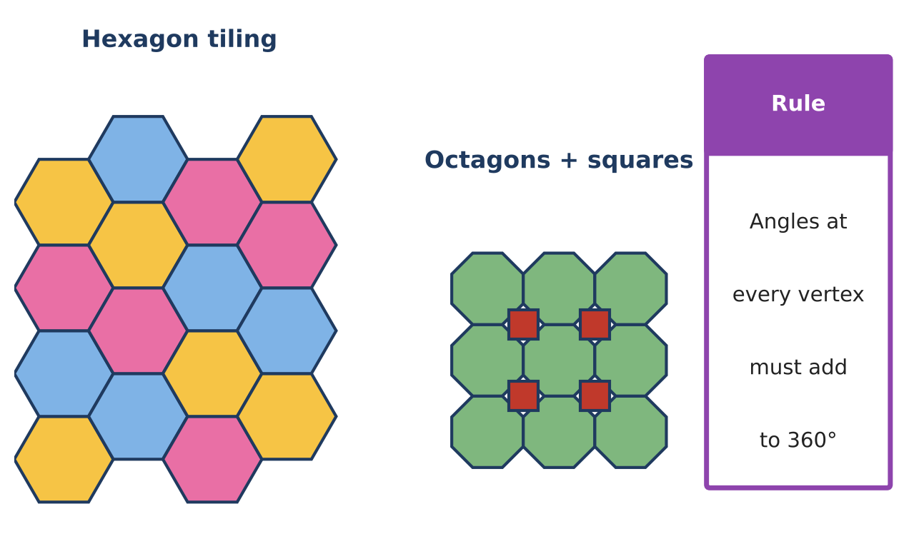
GEOMETRY · UNIT 7: QUADRILATERALS AND POLYGONS
Tile & Quilt Designer
Use polygon angles and quadrilateral properties to design tilings and quilt blocks.
CP1 Project
2–3 class periods
Name: ______________________ Group: ______________________

Slide 2
The Scenario
CP1
A local quilting guild and a tile store are teaming up for a community art wall. They want student designs built from polygons that fit together with no gaps or overlaps.
Whether polygons fit depends on their angles, and quilt blocks depend on the properties of quadrilaterals. You will test the math behind good patterns and then design your own.
Geometry · Unit 7: Quadrilaterals and Polygons · Tile & Quilt Designer

Slide 3
Learning Goals & Timeline
CP1
Learning Goals
Timeline
• I can use polygon angle sums and exterior angles.
• I can use properties of special quadrilaterals with algebra.
• I can prove a quadrilateral's type using coordinates.
Day 1
Which Shapes Tile?
Day 2
Prove the Quilt Block
Day 3
Design Your Pattern
Final
Pattern Design Board + reflection
Geometry · Unit 7: Quadrilaterals and Polygons · Tile & Quilt Designer

Slide 4
Part 1: Which Shapes Tile?
CP1
Day 1 · Use angle sums.
1. Write a formula for each interior angle of a regular n-gon. Use it to explain why only triangles, squares, and hexagons tile alone.
2. A regular polygon has interior angles of 150°. How many sides does it have?
3. Can regular pentagons and regular decagons tile together with one pentagon and two decagons at each vertex? Check the angles.
Geometry · Unit 7: Quadrilaterals and Polygons · Tile & Quilt Designer

Slide 5
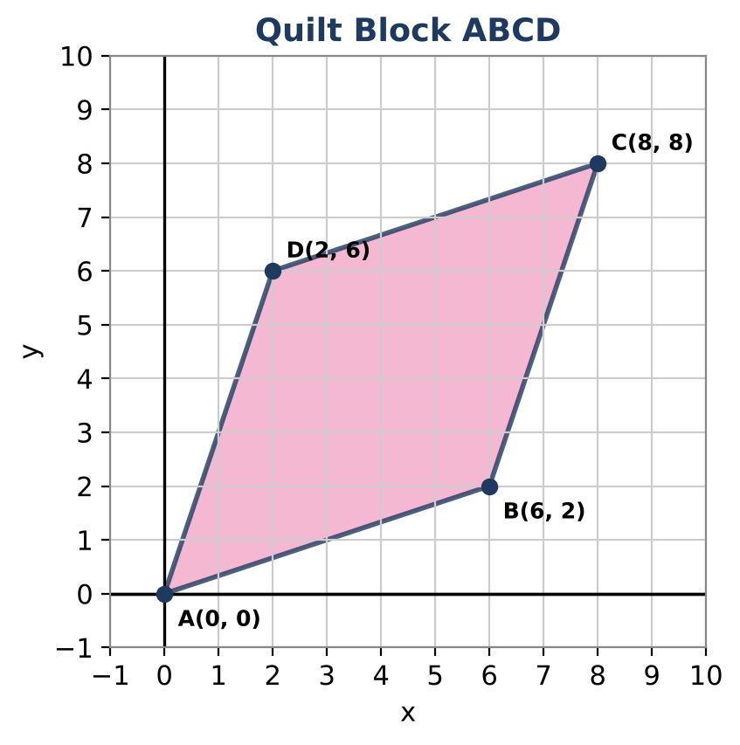
Part 2: Prove the Quilt Block
CP1
Day 2 · Quilt block ABCD has A(0, 0), B(6, 2), C(8, 8), and D(2, 6).
4. Use slopes to show ABCD is a parallelogram.
5. Use side lengths to show it is a rhombus.
6. Is it a square? Use slopes of adjacent sides to decide. Then show the diagonals are perpendicular.
7. A kite piece has two congruent opposite angles of 110° and a third angle of 50°. Find the fourth angle.
Geometry · Unit 7: Quadrilaterals and Polygons · Tile & Quilt Designer

Slide 6
Part 3: Design Your Pattern
CP1
Day 3 · Design a quilt block on a coordinate grid.
8. Draw a block with at least two different quadrilaterals. Give the coordinates of every vertex.
9. Prove the type of one quadrilateral with slopes and distances.
10. Show that your block (or tile) fits with copies of itself at every vertex.
Geometry · Unit 7: Quadrilaterals and Polygons · Tile & Quilt Designer

Slide 7
Final Product: Pattern Design Board
CP1
Your final product must include:
☐ Tessellation analysis
☐ Coordinate proof for ABCD
☐ Your coordinate quilt block with a proof
☐ Artist statement
Geometry · Unit 7: Quadrilaterals and Polygons · Tile & Quilt Designer

Slide 8
Scoring Rubric
CP1
Criteria | 4 – Exceeds | 3 – Meets | 2 – Approaching | 1 – Beginning
Mathematical Accuracy | All calculations and solutions are correct; answers include units and are checked. | Nearly all work is correct; minor errors do not change conclusions. | Several errors; some conclusions are affected. | Many errors or missing work.
Reasoning & Justification | Clear, complete explanations connect every answer to the situation; uses precise vocabulary. | Explanations are mostly clear and connected to the situation. | Explanations are brief or partly unclear. | Little or no explanation.
Application & Design | Pattern tiles the plane (angles at each vertex add to 360°) and uses at least one quadrilateral property correctly. Goes beyond the minimum with a creative, realistic choice. | Pattern tiles the plane (angles at each vertex add to 360°) and uses at least one quadrilateral property correctly. | Design is incomplete or only partly uses the math from the unit. | Design is missing or unrelated to the unit math.
Communication & Presentation | Design board shows the pattern, the angle check at a vertex, and the quadrilateral properties used. Polished, organized, and visually engaging. | Design board shows the pattern, the angle check at a vertex, and the quadrilateral properties used. Organized and easy to follow. | Product is missing required parts or is hard to follow. | Product is mostly missing.
Geometry · Unit 7: Quadrilaterals and Polygons · Tile & Quilt Designer

Slide 9
Reflection
CP1
R1. What is the difference between a rhombus and a square in terms of slopes?
R2. How do angle sums decide whether shapes tile?
Geometry · Unit 7: Quadrilaterals and Polygons · Tile & Quilt Designer

