Slide 1
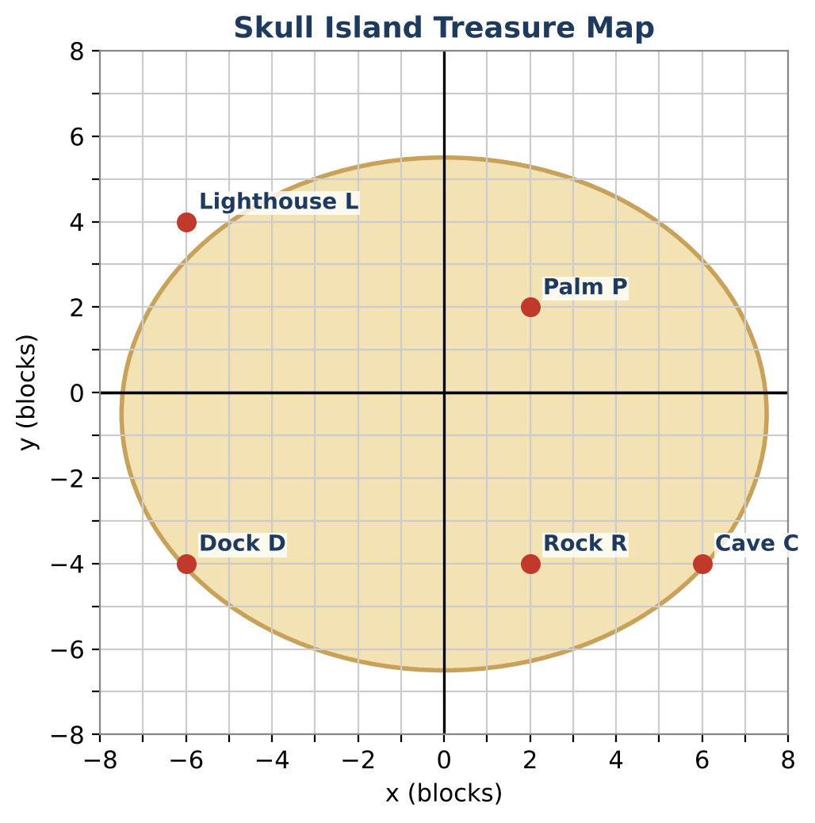
GEOMETRY · UNIT 1: FOUNDATIONS OF GEOMETRY
Treasure Map Navigator
Use distance, midpoint, and angle relationships to find buried treasure.
CP1 Project
2–3 class periods
Name: ______________________ Group: ______________________

Slide 2
The Scenario
CP1
A pirate's map of Skull Island has turned up in the school library. The landmarks sit on a coordinate grid where each unit is one block.
Each clue uses a geometry idea: distance, midpoint, segment addition, or angle relationships. Solve the clues to find the treasure, then make a map of your own.
Geometry · Unit 1: Foundations of Geometry · Treasure Map Navigator

Slide 3
Learning Goals & Timeline
CP1
Learning Goals
Timeline
• I can use the distance and midpoint formulas.
• I can solve for unknowns with segment addition, angle addition, and angle bisectors.
• I can use angle pair relationships to find measures.
Day 1
Distance & Midpoint Clues
Day 2
Segment & Angle Clues
Day 3
Design Your Own Map
Final
Treasure Map & Clue Set + reflection
Geometry · Unit 1: Foundations of Geometry · Treasure Map Navigator

Slide 4
Part 1: Distance & Midpoint Clues
CP1
Day 1 · Use the map and the coordinate table.
1. Find DP, PC, and DC. Give exact answers and decimals to the nearest hundredth.
2. Find the perimeter of the triangle formed by the Dock, the Palm, and the Cave.
3. The Cave is the midpoint of the Palm and a hidden spot X. Find the coordinates of X.
4. Find the midpoint of the Lighthouse and the Cave. Which landmark is closest to it?
Location | Coordinates
Dock D | (−6, −4)
Palm P | (2, 2)
Cave C | (6, −4)
Lighthouse L | (−6, 4)
Rock R | (2, −4)
Geometry · Unit 1: Foundations of Geometry · Treasure Map Navigator

Slide 5
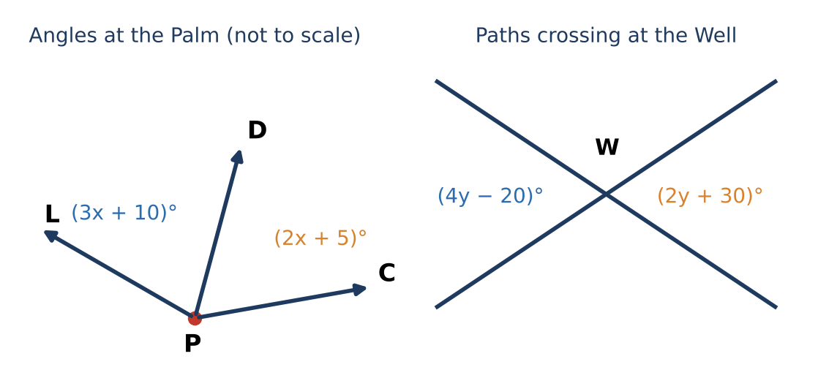
Part 2: Segment & Angle Clues
CP1
Day 2 · Write and solve an equation for each clue.
5. D, R, and C are collinear with R between D and C. DR = 2x + 2, RC = x + 1, and DC = 12. Find DR and RC. Do these match the map?
6. Ray PD bisects ∠LPC. m∠LPD = (5x − 4)° and m∠DPC = (3x + 12)°. Find m∠LPC.
7. Two straight paths cross at the Well. One angle is (4y − 20)° and its vertical angle is (2y + 30)°. Find all four angles formed.
8. Two angles at the Rock are complementary. One is 18° more than twice the other. Find both.
Geometry · Unit 1: Foundations of Geometry · Treasure Map Navigator

Slide 6
Part 3: Design Your Own Map
CP1
Day 3 · Design a map whose treasure can only be found by solving every clue.
9. Place five landmarks and write a clue that uses "the midpoint of A and B is C, find B".
10. Write a segment addition clue and an angle bisector clue with algebra.
11. Write the answer key. Trade with a partner and record any clue they found unclear.
Geometry · Unit 1: Foundations of Geometry · Treasure Map Navigator

Slide 7
Final Product: Treasure Map & Clue Set
CP1
Your final product must include:
☐ Labeled map with coordinates
☐ Clues using distance, midpoint (including a missing endpoint), segment addition, and an angle bisector
☐ Complete answer key
☐ Partner feedback and revision
Geometry · Unit 1: Foundations of Geometry · Treasure Map Navigator

Slide 8
Scoring Rubric
CP1
Criteria | 4 – Exceeds | 3 – Meets | 2 – Approaching | 1 – Beginning
Mathematical Accuracy | All calculations and solutions are correct; answers include units and are checked. | Nearly all work is correct; minor errors do not change conclusions. | Several errors; some conclusions are affected. | Many errors or missing work.
Reasoning & Justification | Clear, complete explanations connect every answer to the situation; uses precise vocabulary. | Explanations are mostly clear and connected to the situation. | Explanations are brief or partly unclear. | Little or no explanation.
Application & Design | Original clues correctly use distance, midpoint, and angle relationships and lead to one location. Goes beyond the minimum with a creative, realistic choice. | Original clues correctly use distance, midpoint, and angle relationships and lead to one location. | Design is incomplete or only partly uses the math from the unit. | Design is missing or unrelated to the unit math.
Communication & Presentation | Map and clue set show labeled coordinates, every clue, and a complete answer key. Polished, organized, and visually engaging. | Map and clue set show labeled coordinates, every clue, and a complete answer key. Organized and easy to follow. | Product is missing required parts or is hard to follow. | Product is mostly missing.
Geometry · Unit 1: Foundations of Geometry · Treasure Map Navigator

Slide 9
Reflection
CP1
R1. How can you find a missing endpoint if you know the midpoint?
R2. What is the difference between a bisector and a midpoint?
Geometry · Unit 1: Foundations of Geometry · Treasure Map Navigator

