Slide 1
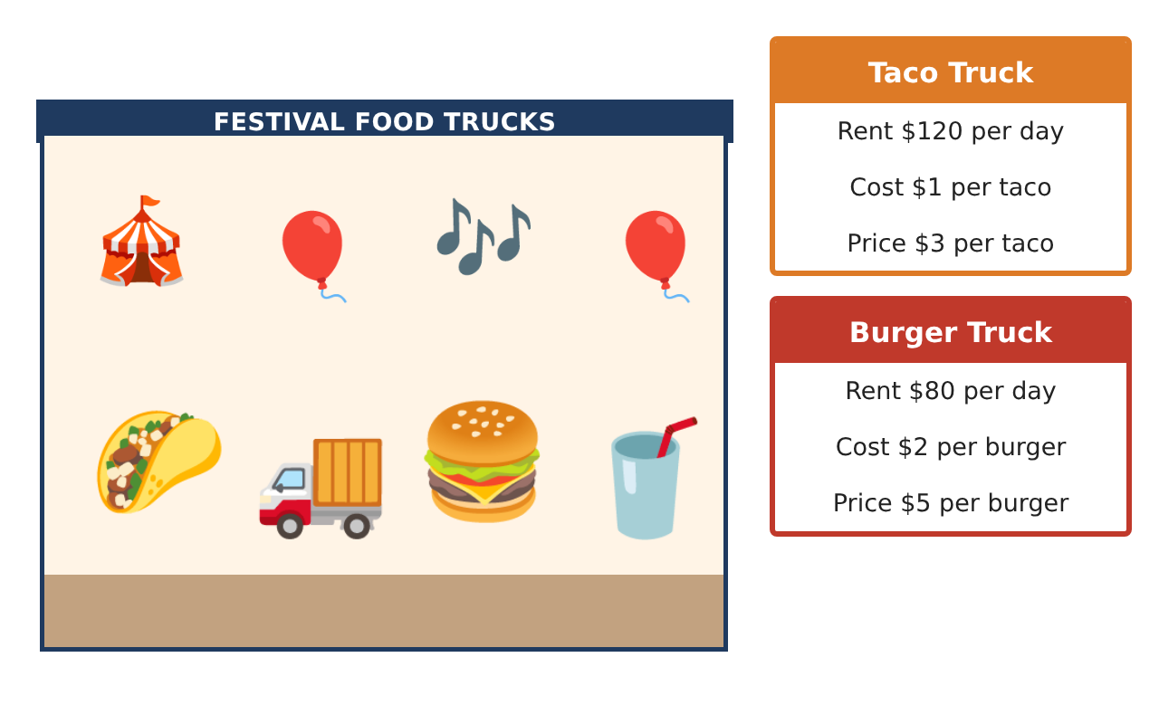
PRE-ALGEBRA (8TH) · UNIT 4: SYSTEMS OF LINEAR EQUATIONS
Food Truck Face-Off
Use systems of equations to compare food trucks and find break-even points.
CP1 Project
2–3 class periods
Name: ______________________________ Group: ______________________________

Slide 2
The Scenario
CP1
Two food trucks want a spot at the spring festival: a taco truck and a burger truck. Each truck has a daily rental fee and a cost for each item it makes, and the festival committee wants to know which truck will do better.
You will write and solve systems of equations to compare costs, solve customer orders, and recommend a plan.
Pre-Algebra (8th) · Unit 4: Systems of Linear Equations · Food Truck Face-Off

Slide 3
Learning Goals & Timeline
CP1
Learning Goals
Timeline
• I can write and solve systems by graphing, substitution, and elimination.
• I can recognize systems with no solution or infinitely many solutions.
• I can use systems to compare profits and make a recommendation.
Day 1
Costs & Break-Even
Day 2
Orders & Elimination
Day 3
Profit Showdown
Final
Food Truck Business Report + reflection
Pre-Algebra (8th) · Unit 4: Systems of Linear Equations · Food Truck Face-Off

Slide 4
Part 1: Costs & Break-Even
CP1
Day 1 · Use the truck cards. Let x be the number of items.
1. Solve the cost system y = x + 120 and y = 2x + 80 by substitution, and interpret the solution.
2. Find each truck's break-even point (revenue = cost).
3. Graph both cost lines. For how many items is the taco truck's cost lower?
Pre-Algebra (8th) · Unit 4: Systems of Linear Equations · Food Truck Face-Off

Slide 5
Part 2: Orders & Elimination
CP1
Day 2 · Solve each system.
4. A group buys 14 items for $54 (tacos $3, burgers $5). How many of each?
5. Solve by elimination: 4t + 3b = 39 and 2t + 5b = 37.
6. How many solutions does each system have? (a) y = 3x + 2 and 6x − 2y = −4 (b) y = 2x + 1 and y = 2x − 5
Pre-Algebra (8th) · Unit 4: Systems of Linear Equations · Food Truck Face-Off

Slide 6
Part 3: Profit Showdown
CP1
Day 3 · Profit = price − cost per item, times the number sold, minus rent.
7. Write each truck's profit equation and decide whether the profits are ever equal for the same number of items.
8. The taco truck sells 3 tacos for every burger the burger truck sells. If the burger truck sells b burgers, for which b does the taco truck earn more?
9. Write a recommendation to the committee using your results.
Pre-Algebra (8th) · Unit 4: Systems of Linear Equations · Food Truck Face-Off

Slide 7
Final Product: Food Truck Business Report
CP1
Your final product must include:
☐ Cost and break-even analysis
☐ Solved orders by substitution and elimination
☐ Examples of no-solution and infinite-solution systems
☐ Profit comparison with an inequality
☐ Business report with a recommendation
Pre-Algebra (8th) · Unit 4: Systems of Linear Equations · Food Truck Face-Off

Slide 8
Scoring Rubric
CP1
Criteria | 4 – Exceeds | 3 – Meets | 2 – Approaching | 1 – Beginning
Mathematical Accuracy | All calculations and solutions are correct; answers include units and are checked. | Nearly all work is correct; minor errors do not change conclusions. | Several errors; some conclusions are affected. | Many errors or missing work.
Reasoning & Justification | Clear, complete explanations connect every answer to the situation; uses precise vocabulary. | Explanations are mostly clear and connected to the situation. | Explanations are brief or partly unclear. | Little or no explanation.
Application & Design | Systems are set up and solved correctly with all methods, and solution types are identified. Goes beyond the minimum with a creative, realistic choice. | Systems are set up and solved correctly with all methods, and solution types are identified. | Design is incomplete or only partly uses the math from the unit. | Design is missing or unrelated to the unit math.
Communication & Presentation | Business report explains costs, break-even points, and the recommendation with supporting work. Polished, organized, and visually engaging. | Business report explains costs, break-even points, and the recommendation with supporting work. Organized and easy to follow. | Product is missing required parts or is hard to follow. | Product is mostly missing.
Pre-Algebra (8th) · Unit 4: Systems of Linear Equations · Food Truck Face-Off

Slide 9
Reflection
CP1
R1. What do parallel lines mean in a business setting?
R2. When is elimination faster than substitution?
Pre-Algebra (8th) · Unit 4: Systems of Linear Equations · Food Truck Face-Off

