Slide 1
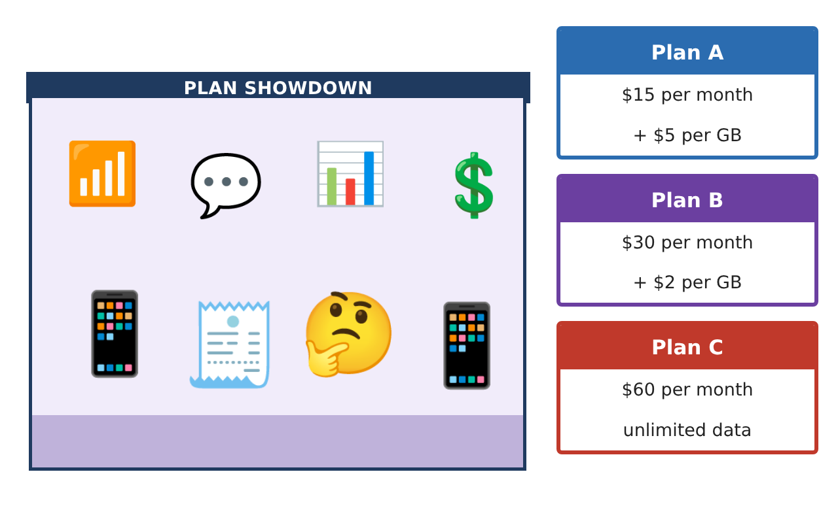
PRE-ALGEBRA (8TH) · UNIT 2: EQUATIONS AND EXPRESSIONS
Phone Plan Showdown
Write and solve equations to find the best cell phone plan for any customer.
CP1 Project
2–3 class periods
Name: ______________________________ Group: ______________________________

Slide 2
The Scenario
CP1
A phone store has hired you to help customers choose a plan. Each plan has a monthly fee and a price per gigabyte of data, and customers want to know which plan is cheapest for them.
You will write expressions and solve equations to compare the plans and build a guide that any customer can use.
Pre-Algebra (8th) · Unit 2: Equations and Expressions · Phone Plan Showdown

Slide 3
Learning Goals & Timeline
CP1
Learning Goals
Timeline
• I can write and simplify expressions using the distributive property and like terms.
• I can solve multi-step equations with variables on both sides.
• I can tell when an equation has one, no, or infinitely many solutions.
Day 1
Plans as Expressions
Day 2
Solving Equations
Day 3
Special Cases & Recommendations
Final
Plan Comparison Guide + reflection
Pre-Algebra (8th) · Unit 2: Equations and Expressions · Phone Plan Showdown

Slide 4
Part 1: Plans as Expressions
CP1
Day 1 · Let g be the GB used each month.
1. Write expressions for the monthly cost of Plans A, B, and C.
2. A family has 3 lines on Plan A, each using g GB, plus a $10 family fee. Write and simplify the total cost.
3. A customer uses g GB in month 1 and 3 more GB in month 2. Write and simplify the two-month cost on Plan A.
Pre-Algebra (8th) · Unit 2: Equations and Expressions · Phone Plan Showdown

Slide 5
Part 2: Solving Equations
CP1
Day 2 · Show each step.
4. Solve 15 + 5g = 30 + 2g and explain what the solution means.
5. Solve 3(g − 2) + 4 = 2g + 7.
6. The family's Plan A bill was $160. How many GB did each line use?
Pre-Algebra (8th) · Unit 2: Equations and Expressions · Phone Plan Showdown

Slide 6
Part 3: Special Cases & Recommendations
CP1
Day 3 · Compare all three plans.
7. How many solutions does each equation have? Explain. (a) 2(5g + 15) = 10g + 30 (b) 5g + 15 = 5g + 20
8. For which amounts of data is Plan B the cheapest of all three plans?
9. A customer averages 12 GB each month. Which plan do you recommend? Show the costs.
Pre-Algebra (8th) · Unit 2: Equations and Expressions · Phone Plan Showdown

Slide 7
Final Product: Plan Comparison Guide
CP1
Your final product must include:
☐ Simplified cost expressions, including the family plan
☐ Solutions to every equation with steps
☐ Ranges of data where each plan is cheapest
☐ A customer guide (table or graph) with recommendations
☐ An example of a no-solution and an infinite-solution equation from the plans
Pre-Algebra (8th) · Unit 2: Equations and Expressions · Phone Plan Showdown

Slide 8
Scoring Rubric
CP1
Criteria | 4 – Exceeds | 3 – Meets | 2 – Approaching | 1 – Beginning
Mathematical Accuracy | All calculations and solutions are correct; answers include units and are checked. | Nearly all work is correct; minor errors do not change conclusions. | Several errors; some conclusions are affected. | Many errors or missing work.
Reasoning & Justification | Clear, complete explanations connect every answer to the situation; uses precise vocabulary. | Explanations are mostly clear and connected to the situation. | Explanations are brief or partly unclear. | Little or no explanation.
Application & Design | Expressions and equations model the plans correctly, solutions are correct, and solution types are explained. Goes beyond the minimum with a creative, realistic choice. | Expressions and equations model the plans correctly, solutions are correct, and solution types are explained. | Design is incomplete or only partly uses the math from the unit. | Design is missing or unrelated to the unit math.
Communication & Presentation | Customer guide clearly states which plan is best for each amount of data and why. Polished, organized, and visually engaging. | Customer guide clearly states which plan is best for each amount of data and why. Organized and easy to follow. | Product is missing required parts or is hard to follow. | Product is mostly missing.
Pre-Algebra (8th) · Unit 2: Equations and Expressions · Phone Plan Showdown

Slide 9
Reflection
CP1
R1. What does it mean in context when an equation has no solution?
R2. How did combining like terms help you compare plans?
Pre-Algebra (8th) · Unit 2: Equations and Expressions · Phone Plan Showdown

