Slide 1
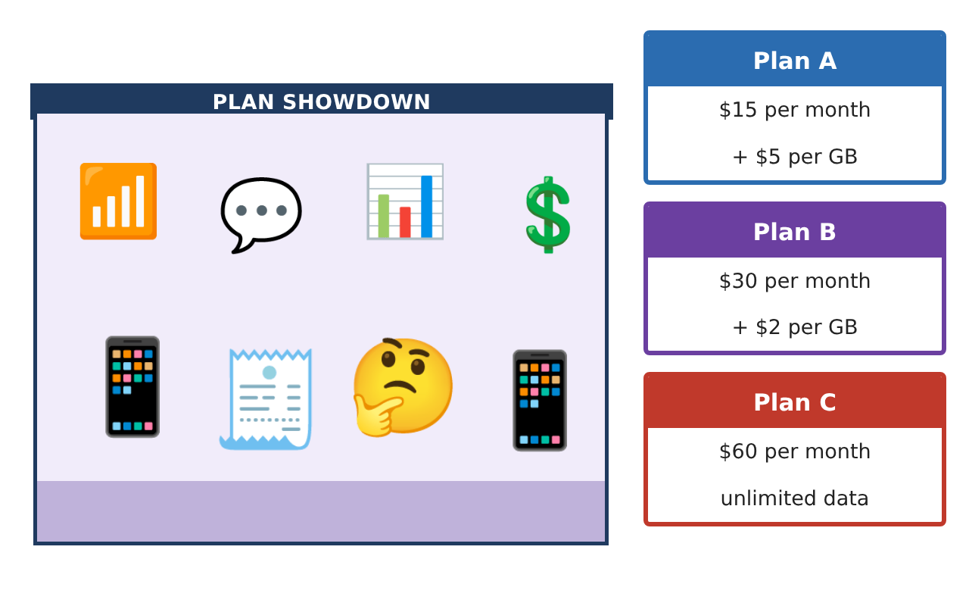
PRE-ALGEBRA (8TH) · UNIT 2: EQUATIONS AND EXPRESSIONS
Phone Plan Showdown
Write and solve equations to find the best cell phone plan for any customer.
CP2 Project
2–3 class periods
Name: ______________________________ Group: ______________________________

Slide 2
The Scenario
CP2
A phone store has hired you to help customers choose a plan. Each plan has a monthly fee and a price per gigabyte of data, and customers want to know which plan is cheapest for them.
You will write expressions and solve equations to compare the plans and build a guide that any customer can use.
Pre-Algebra (8th) · Unit 2: Equations and Expressions · Phone Plan Showdown

Slide 3
Learning Goals & Timeline
CP2
Learning Goals
Timeline
• I can write an expression for a cost that has a fixed part and a rate.
• I can solve two-step equations.
• I can solve an equation with the variable on both sides to compare two plans.
Day 1
Write the Costs
Day 2
Solve for the Data
Day 3
Which Plan Wins?
Final
Plan Comparison Guide + reflection
Pre-Algebra (8th) · Unit 2: Equations and Expressions · Phone Plan Showdown

Slide 4
Part 1: Write the Costs
CP2
Day 1 · Let g be the number of gigabytes (GB) used in a month.
1. Write an expression for the monthly cost of Plan A and of Plan B.
Starter: Plan A: ___ + ___g
2. Find the cost of each plan for a customer who uses 4 GB.
3. Simplify 3(5g + 2) − 4g.
Pre-Algebra (8th) · Unit 2: Equations and Expressions · Phone Plan Showdown

Slide 5
Part 2: Solve for the Data
CP2
Day 2 · Work backward from a bill.
4. A Plan A bill was $50. How many GB were used? Solve 15 + 5g = 50.
Starter: 15 + 5g = 50 → 5g = ___ → g = ___
5. A Plan B bill was $46. How many GB were used?
6. Solve 2(x + 4) = 18.
Pre-Algebra (8th) · Unit 2: Equations and Expressions · Phone Plan Showdown

Slide 6
Part 3: Which Plan Wins?
CP2
Day 3 · Compare the plans.
7. For how many GB do Plans A and B cost the same? Solve 15 + 5g = 30 + 2g. What is the cost?
8. Which plan is cheaper for 3 GB? For 8 GB?
9. At how many GB does Plan B cost the same as Plan C ($60)?
Pre-Algebra (8th) · Unit 2: Equations and Expressions · Phone Plan Showdown

Slide 7
Final Product: Plan Comparison Guide
CP2
Your final product must include:
☐ Cost expressions for every plan
☐ Bills solved backward to find the data used
☐ Break-even points for A vs B and B vs C
☐ A recommendation chart: which plan for light, medium, and heavy users
☐ A short ad for your favorite plan
Pre-Algebra (8th) · Unit 2: Equations and Expressions · Phone Plan Showdown

Slide 8
Scoring Rubric
CP2
Criteria | 4 – Exceeds | 3 – Meets | 2 – Approaching | 1 – Beginning
Mathematical Accuracy | All calculations and solutions are correct; answers include units and are checked. | Nearly all work is correct; minor errors do not change conclusions. | Several errors; some conclusions are affected. | Many errors or missing work.
Reasoning & Justification | Clear, complete explanations connect every answer to the situation; uses precise vocabulary. | Explanations are mostly clear and connected to the situation. | Explanations are brief or partly unclear. | Little or no explanation.
Application & Design | Expressions and equations model the plans correctly, solutions are correct, and solution types are explained. Goes beyond the minimum with a creative, realistic choice. | Expressions and equations model the plans correctly, solutions are correct, and solution types are explained. | Design is incomplete or only partly uses the math from the unit. | Design is missing or unrelated to the unit math.
Communication & Presentation | Customer guide clearly states which plan is best for each amount of data and why. Polished, organized, and visually engaging. | Customer guide clearly states which plan is best for each amount of data and why. Organized and easy to follow. | Product is missing required parts or is hard to follow. | Product is mostly missing.
Pre-Algebra (8th) · Unit 2: Equations and Expressions · Phone Plan Showdown

Slide 9
Reflection
CP2
R1. What does the solution of 15 + 5g = 30 + 2g mean for a customer?
R2. Why do you do the same thing to both sides of an equation?
Pre-Algebra (8th) · Unit 2: Equations and Expressions · Phone Plan Showdown

