Slide 1
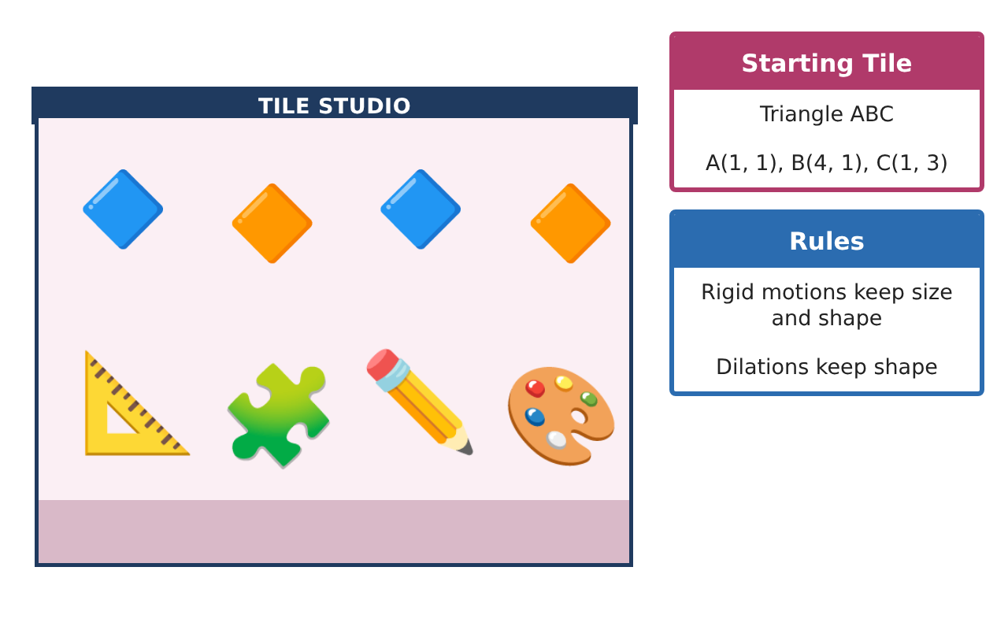
PRE-ALGEBRA (8TH) · UNIT 6: CONGRUENCE AND SIMILARITY
Tile Pattern Studio
Design floor tile patterns with transformations, similarity, and angle facts.
CP2 Project
2–3 class periods
Name: ______________________________ Group: ______________________________

Slide 2
The Scenario
CP2
A community center is redoing its lobby floor and wants a tile pattern designed by students. The pattern starts with one right-triangle tile that is moved around a grid.
You will use transformations, similarity, and angle relationships to build a pattern that fits perfectly and to measure things you cannot reach.
Pre-Algebra (8th) · Unit 6: Congruence and Similarity · Tile Pattern Studio

Slide 3
Learning Goals & Timeline
CP2
Learning Goals
Timeline
• I can translate, reflect, and rotate a figure on a coordinate grid.
• I can dilate a figure and explain why the image is similar.
• I can use angle facts about triangles and parallel lines.
Day 1
Slide and Flip
Day 2
Turn and Grow
Day 3
Angle Facts
Final
Tile Design Portfolio + reflection
Pre-Algebra (8th) · Unit 6: Congruence and Similarity · Tile Pattern Studio

Slide 4
Part 1: Slide and Flip
CP2
Day 1 · Tile ABC: A(1, 1), B(4, 1), C(1, 3).
1. Translate the tile 5 units right and 2 units up. Give the new coordinates.
Starter: (x, y) → (x + 5, y + 2)
2. Reflect the original tile over the y-axis. Give the new coordinates.
3. Are the new tiles congruent to the original? Explain.
Pre-Algebra (8th) · Unit 6: Congruence and Similarity · Tile Pattern Studio

Slide 5
Part 2: Turn and Grow
CP2
Day 2 · Use the original tile.
4. Rotate the tile 90° counterclockwise about the origin. Use (x, y) → (−y, x).
5. Dilate the tile by a scale factor of 2 from the origin.
6. Side AB is 3 units long. How long is A′B′ after the dilation? Is the new tile congruent or similar?
Pre-Algebra (8th) · Unit 6: Congruence and Similarity · Tile Pattern Studio

Slide 6
Part 3: Angle Facts
CP2
Day 3 · Use the triangle angle sum and parallel lines.
7. The tile has a 90° angle and a 34° angle. Find the third angle.
8. Grout lines form parallel lines cut by a transversal. One angle is 115°. Find a corresponding angle and a same-side interior angle.
9. Design a pattern using at least two different transformations of the tile. Describe each move.
Pre-Algebra (8th) · Unit 6: Congruence and Similarity · Tile Pattern Studio

Slide 7
Final Product: Tile Design Portfolio
CP2
Your final product must include:
☐ Coordinates for each transformed tile
☐ A dilated tile with side lengths
☐ Angle calculations for the pattern
☐ Your tile pattern on grid paper
☐ A description of every transformation used
Pre-Algebra (8th) · Unit 6: Congruence and Similarity · Tile Pattern Studio

Slide 8
Scoring Rubric
CP2
Criteria | 4 – Exceeds | 3 – Meets | 2 – Approaching | 1 – Beginning
Mathematical Accuracy | All calculations and solutions are correct; answers include units and are checked. | Nearly all work is correct; minor errors do not change conclusions. | Several errors; some conclusions are affected. | Many errors or missing work.
Reasoning & Justification | Clear, complete explanations connect every answer to the situation; uses precise vocabulary. | Explanations are mostly clear and connected to the situation. | Explanations are brief or partly unclear. | Little or no explanation.
Application & Design | Transformations, dilations, similarity, and angle relationships are applied correctly. Goes beyond the minimum with a creative, realistic choice. | Transformations, dilations, similarity, and angle relationships are applied correctly. | Design is incomplete or only partly uses the math from the unit. | Design is missing or unrelated to the unit math.
Communication & Presentation | Portfolio shows coordinates, rules, measurements, and a clear final design. Polished, organized, and visually engaging. | Portfolio shows coordinates, rules, measurements, and a clear final design. Organized and easy to follow. | Product is missing required parts or is hard to follow. | Product is mostly missing.
Pre-Algebra (8th) · Unit 6: Congruence and Similarity · Tile Pattern Studio

Slide 9
Reflection
CP2
R1. Which transformations make a congruent figure? Which make a similar figure?
R2. How do parallel lines help you find angles in the pattern?
Pre-Algebra (8th) · Unit 6: Congruence and Similarity · Tile Pattern Studio

