Slide 1
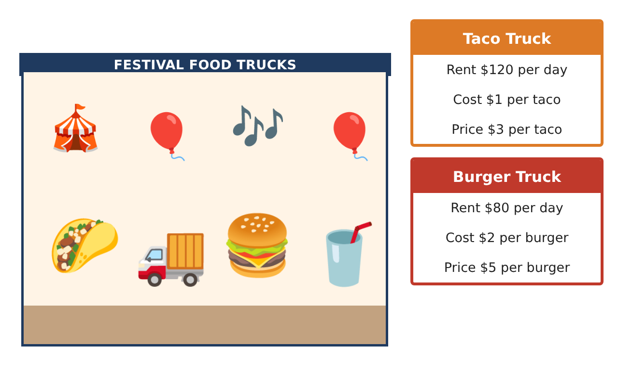
PRE-ALGEBRA (8TH) · UNIT 4: SYSTEMS OF LINEAR EQUATIONS
Food Truck Face-Off
Use systems of equations to compare food trucks and find break-even points.
CP2 Project
2–3 class periods
Name: ______________________________ Group: ______________________________

Slide 2
The Scenario
CP2
Two food trucks want a spot at the spring festival: a taco truck and a burger truck. Each truck has a daily rental fee and a cost for each item it makes, and the festival committee wants to know which truck will do better.
You will write and solve systems of equations to compare costs, solve customer orders, and recommend a plan.
Pre-Algebra (8th) · Unit 4: Systems of Linear Equations · Food Truck Face-Off

Slide 3
Learning Goals & Timeline
CP2
Learning Goals
Timeline
• I can write equations for two situations and find where they are equal.
• I can solve a system by substitution.
• I can solve a system by elimination and check the solution.
Day 1
Cost Lines
Day 2
Customer Orders
Day 3
Elimination & Profit
Final
Food Truck Business Report + reflection
Pre-Algebra (8th) · Unit 4: Systems of Linear Equations · Food Truck Face-Off

Slide 4
Part 1: Cost Lines
CP2
Day 1 · Taco truck: $120 rent + $1 per taco. Burger truck: $80 rent + $2 per burger. Let x be the number of items made.
1. Write a cost equation for each truck.
Starter: Taco: y = ___x + ___
2. Complete a table for x = 0, 20, 40, 60. Where are the costs equal?
3. Solve the system by substitution to check: x + 120 = 2x + 80.
Pre-Algebra (8th) · Unit 4: Systems of Linear Equations · Food Truck Face-Off

Slide 5
Part 2: Customer Orders
CP2
Day 2 · Tacos cost $3 and burgers cost $5. A group buys 10 items for $38.
4. Write a system for the number of tacos t and burgers b.
5. Solve the system by substitution.
6. Check your answer in both equations.
Pre-Algebra (8th) · Unit 4: Systems of Linear Equations · Food Truck Face-Off

Slide 6
Part 3: Elimination & Profit
CP2
Day 3 · Use elimination and the price cards.
7. Solve by elimination: 2t + 3b = 21 and 2t + b = 11.
8. Each truck sells 50 items. Find each truck's profit (sales minus costs).
9. Which truck would you choose for the festival? Use your numbers.
Pre-Algebra (8th) · Unit 4: Systems of Linear Equations · Food Truck Face-Off

Slide 7
Final Product: Food Truck Business Report
CP2
Your final product must include:
☐ Cost equations and a table showing where they meet
☐ Solved customer order with a check
☐ An elimination solution
☐ Profit for each truck
☐ A recommendation to the festival committee
Pre-Algebra (8th) · Unit 4: Systems of Linear Equations · Food Truck Face-Off

Slide 8
Scoring Rubric
CP2
Criteria | 4 – Exceeds | 3 – Meets | 2 – Approaching | 1 – Beginning
Mathematical Accuracy | All calculations and solutions are correct; answers include units and are checked. | Nearly all work is correct; minor errors do not change conclusions. | Several errors; some conclusions are affected. | Many errors or missing work.
Reasoning & Justification | Clear, complete explanations connect every answer to the situation; uses precise vocabulary. | Explanations are mostly clear and connected to the situation. | Explanations are brief or partly unclear. | Little or no explanation.
Application & Design | Systems are set up and solved correctly with all methods, and solution types are identified. Goes beyond the minimum with a creative, realistic choice. | Systems are set up and solved correctly with all methods, and solution types are identified. | Design is incomplete or only partly uses the math from the unit. | Design is missing or unrelated to the unit math.
Communication & Presentation | Business report explains costs, break-even points, and the recommendation with supporting work. Polished, organized, and visually engaging. | Business report explains costs, break-even points, and the recommendation with supporting work. Organized and easy to follow. | Product is missing required parts or is hard to follow. | Product is mostly missing.
Pre-Algebra (8th) · Unit 4: Systems of Linear Equations · Food Truck Face-Off

Slide 9
Reflection
CP2
R1. What does the point (40, 160) mean for the two trucks?
R2. How do you check a solution to a system?
Pre-Algebra (8th) · Unit 4: Systems of Linear Equations · Food Truck Face-Off

