Slide 1
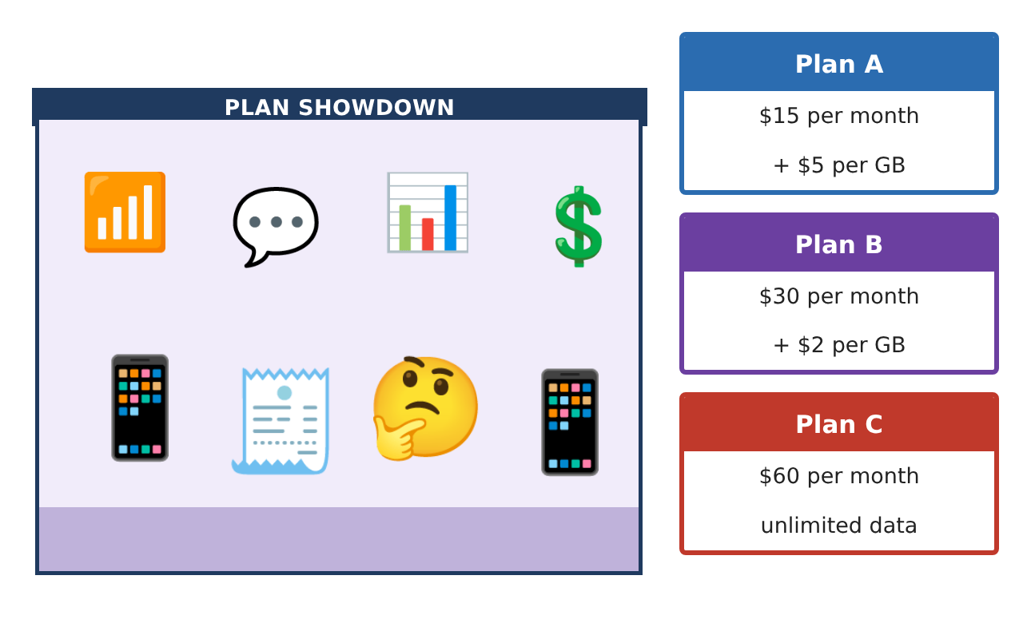
PRE-ALGEBRA (8TH) · UNIT 2: EQUATIONS AND EXPRESSIONS
Phone Plan Showdown
Write and solve equations to find the best cell phone plan for any customer.
Honors Project
2–3 class periods
Name: ______________________________ Group: ______________________________

Slide 2
The Scenario
Honors
A phone store has hired you to help customers choose a plan. Each plan has a monthly fee and a price per gigabyte of data, and customers want to know which plan is cheapest for them.
You will write expressions and solve equations to compare the plans and build a guide that any customer can use.
Pre-Algebra (8th) · Unit 2: Equations and Expressions · Phone Plan Showdown

Slide 3
Learning Goals & Timeline
Honors
Learning Goals
Timeline
• I can model tiered pricing with expressions.
• I can solve and analyze multi-step equations, including equations with parameters.
• I can design a plan and prove when it beats another plan.
Day 1
Tiered Plans
Day 2
Equation Analysis
Day 3
Design a Plan
Final
Plan Comparison Guide + reflection
Pre-Algebra (8th) · Unit 2: Equations and Expressions · Phone Plan Showdown

Slide 4
Part 1: Tiered Plans
Honors
Day 1 · Plan D: $10 per month plus $6 per GB for the first 5 GB and $3 per GB after that.
1. Write a simplified expression for the cost of Plan D when g > 5.
2. Write an expression for the average cost per GB on Plan B.
3. Write and simplify an expression for how much more Plan A costs than Plan B over a year for g GB each month.
Pre-Algebra (8th) · Unit 2: Equations and Expressions · Phone Plan Showdown

Slide 5
Part 2: Equation Analysis
Honors
Day 2 · Show each step.
4. When do Plans D and B cost the same? Check that your answer fits the condition g ≥ 5.
5. Solve ¹⁄₃(6g − 9) + 2 = 2(g − 1) + 1. What kind of solution set is it?
6. For what value of k does 4g + k = 4g + 12 have infinitely many solutions? For which values does it have no solution?
Pre-Algebra (8th) · Unit 2: Equations and Expressions · Phone Plan Showdown

Slide 6
Part 3: Design a Plan
Honors
Day 3 · Create a plan that competes with Plan B.
7. For how many GB is the average cost per GB on Plan B exactly $5?
8. Design a plan that costs more than Plan A at 2 GB but less than Plan B from 8 GB to 12 GB. Show the costs at 2, 8, and 12 GB.
9. Use algebra to prove whether your plan is cheaper than Plan B for every amount of data.
Pre-Algebra (8th) · Unit 2: Equations and Expressions · Phone Plan Showdown

Slide 7
Final Product: Plan Comparison Guide
Honors
Your final product must include:
☐ Tiered-plan expression and average-cost expression
☐ Equation solutions with solution-type analysis
☐ Parameter analysis (values of k)
☐ Your designed plan with a cost table
☐ A written proof comparing your plan with Plan B
Pre-Algebra (8th) · Unit 2: Equations and Expressions · Phone Plan Showdown

Slide 8
Scoring Rubric
Honors
Criteria | 4 – Exceeds | 3 – Meets | 2 – Approaching | 1 – Beginning
Mathematical Accuracy | All calculations and solutions are correct; answers include units and are checked. | Nearly all work is correct; minor errors do not change conclusions. | Several errors; some conclusions are affected. | Many errors or missing work.
Reasoning & Justification | Clear, complete explanations connect every answer to the situation; uses precise vocabulary. | Explanations are mostly clear and connected to the situation. | Explanations are brief or partly unclear. | Little or no explanation.
Application & Design | Expressions and equations model the plans correctly, solutions are correct, and solution types are explained. Goes beyond the minimum with a creative, realistic choice. | Expressions and equations model the plans correctly, solutions are correct, and solution types are explained. | Design is incomplete or only partly uses the math from the unit. | Design is missing or unrelated to the unit math.
Communication & Presentation | Customer guide clearly states which plan is best for each amount of data and why. Polished, organized, and visually engaging. | Customer guide clearly states which plan is best for each amount of data and why. Organized and easy to follow. | Product is missing required parts or is hard to follow. | Product is mostly missing.
Pre-Algebra (8th) · Unit 2: Equations and Expressions · Phone Plan Showdown

Slide 9
Reflection
Honors
R1. Why does the coefficient of g decide whether two plans can ever cost the same?
R2. How is the average cost per GB different from the price per GB?
Pre-Algebra (8th) · Unit 2: Equations and Expressions · Phone Plan Showdown

