Slide 1
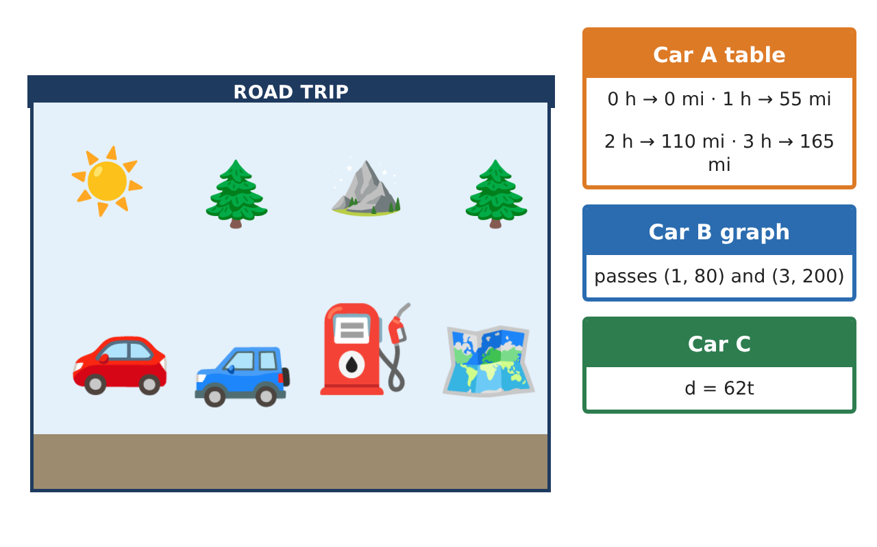
PRE-ALGEBRA (8TH) · UNIT 3: LINEAR AND FUNCTIONAL RELATIONSHIPS
Road Trip Rate Lab
Compare cars on a road trip using tables, graphs, and equations.
CP1 Project
2–3 class periods
Name: ______________________________ Group: ______________________________

Slide 2
The Scenario
CP1
Your class is planning a road trip to a national park, and three family cars are going. Each car's speed is given a different way: one with a table, one with a graph, and one with an equation.
You will compare the cars, write functions for distance and fuel, and plan when everyone will arrive and how much the gas will cost.
Pre-Algebra (8th) · Unit 3: Linear and Functional Relationships · Road Trip Rate Lab

Slide 3
Learning Goals & Timeline
CP1
Learning Goals
Timeline
• I can find and interpret the rate of change and initial value of a linear function.
• I can compare functions given in different forms.
• I can solve problems with linear functions and identify nonlinear functions.
Day 1
Three Representations
Day 2
Catching Up
Day 3
Plan the Trip
Final
Road Trip Plan + reflection
Pre-Algebra (8th) · Unit 3: Linear and Functional Relationships · Road Trip Rate Lab

Slide 4
Part 1: Three Representations
CP1
Day 1 · Use the car cards.
1. Write a function for Car A from the table. Is it proportional? Explain.
2. Car B's graph passes through (1, 80) and (3, 200). Find the slope and y-intercept, and write the function.
3. Order the cars from fastest to slowest.
Pre-Algebra (8th) · Unit 3: Linear and Functional Relationships · Road Trip Rate Lab

Slide 5
Part 2: Catching Up
CP1
Day 2 · Use your functions.
4. When does Car C catch Car B? How far have they driven?
5. The gas left is g(d) = 14 − d⁄30. What is the slope, and what does it mean?
6. Is f(t) = t² + 3 a linear function? Use a table to explain.
Pre-Algebra (8th) · Unit 3: Linear and Functional Relationships · Road Trip Rate Lab

Slide 6
Part 3: Plan the Trip
CP1
Day 3 · The park is 500 miles away. Gas costs $3.60 per gallon.
7. Car A drives 55 mph and makes one 1.5-hour stop. How long is the trip, to the nearest tenth of an hour?
8. How much does gas cost for the 500-mile trip at 30 miles per gallon?
9. Write a function for gas cost c per mile driven d, and interpret its slope.
Pre-Algebra (8th) · Unit 3: Linear and Functional Relationships · Road Trip Rate Lab

Slide 7
Final Product: Road Trip Plan
CP1
Your final product must include:
☐ Functions for every car, with slopes and intercepts interpreted
☐ Catch-up time and distance
☐ Gas and cost functions
☐ Total trip time and cost
☐ A comparison chart: table, graph, and equation for each car
Pre-Algebra (8th) · Unit 3: Linear and Functional Relationships · Road Trip Rate Lab

Slide 8
Scoring Rubric
CP1
Criteria | 4 – Exceeds | 3 – Meets | 2 – Approaching | 1 – Beginning
Mathematical Accuracy | All calculations and solutions are correct; answers include units and are checked. | Nearly all work is correct; minor errors do not change conclusions. | Several errors; some conclusions are affected. | Many errors or missing work.
Reasoning & Justification | Clear, complete explanations connect every answer to the situation; uses precise vocabulary. | Explanations are mostly clear and connected to the situation. | Explanations are brief or partly unclear. | Little or no explanation.
Application & Design | Rates, functions, and comparisons are correct and interpreted in context. Goes beyond the minimum with a creative, realistic choice. | Rates, functions, and comparisons are correct and interpreted in context. | Design is incomplete or only partly uses the math from the unit. | Design is missing or unrelated to the unit math.
Communication & Presentation | Trip plan shows each car's function, arrival time, and cost with clear labels. Polished, organized, and visually engaging. | Trip plan shows each car's function, arrival time, and cost with clear labels. Organized and easy to follow. | Product is missing required parts or is hard to follow. | Product is mostly missing.
Pre-Algebra (8th) · Unit 3: Linear and Functional Relationships · Road Trip Rate Lab

Slide 9
Reflection
CP1
R1. How can you compare two functions when one is a graph and one is an equation?
R2. How can you tell from a table that a function is nonlinear?
Pre-Algebra (8th) · Unit 3: Linear and Functional Relationships · Road Trip Rate Lab

