Slide 1
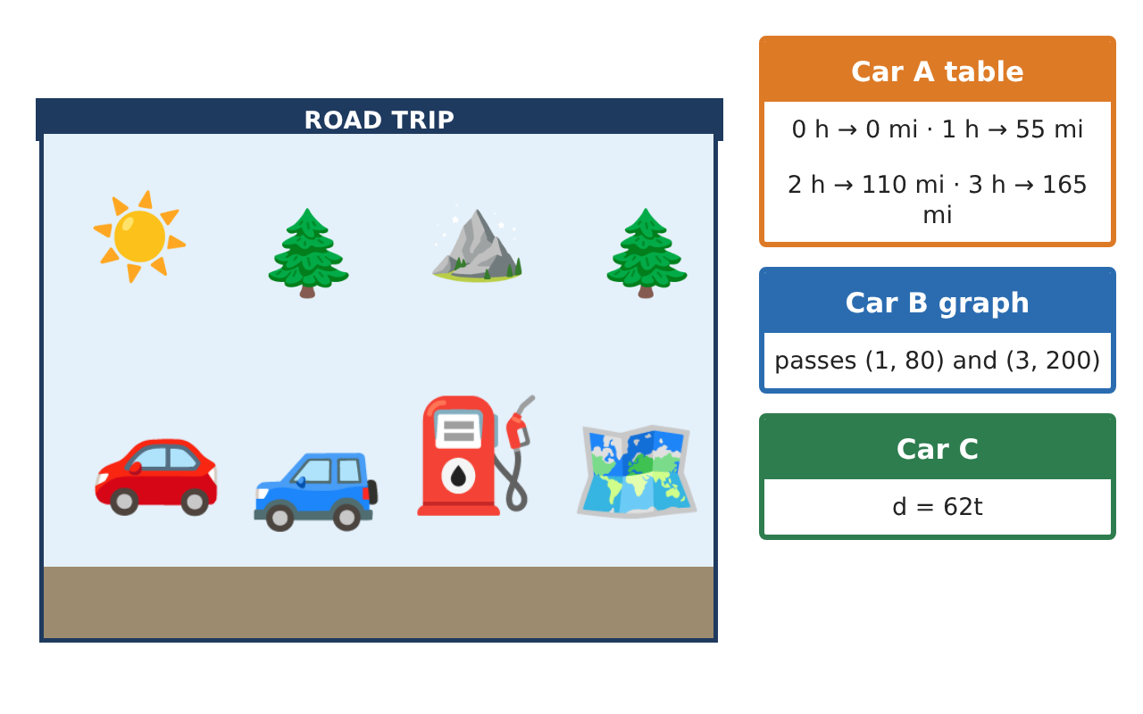
PRE-ALGEBRA (8TH) · UNIT 3: LINEAR AND FUNCTIONAL RELATIONSHIPS
Road Trip Rate Lab
Compare cars on a road trip using tables, graphs, and equations.
CP2 Project
2–3 class periods
Name: ______________________________ Group: ______________________________

Slide 2
The Scenario
CP2
Your class is planning a road trip to a national park, and three family cars are going. Each car's speed is given a different way: one with a table, one with a graph, and one with an equation.
You will compare the cars, write functions for distance and fuel, and plan when everyone will arrive and how much the gas will cost.
Pre-Algebra (8th) · Unit 3: Linear and Functional Relationships · Road Trip Rate Lab

Slide 3
Learning Goals & Timeline
CP2
Learning Goals
Timeline
• I can find a rate of change (slope) from a table, a graph, or an equation.
• I can write and use a linear function y = mx + b.
• I can tell whether a relationship is linear.
Day 1
Car A from a Table
Day 2
Comparing Cars
Day 3
Gas and Patterns
Final
Road Trip Plan + reflection
Pre-Algebra (8th) · Unit 3: Linear and Functional Relationships · Road Trip Rate Lab

Slide 4
Part 1: Car A from a Table
CP2
Day 1 · Car A: 0 h → 0 miles, 1 h → 55 miles, 2 h → 110 miles, 3 h → 165 miles.
1. What is Car A's rate of change (speed)?
Starter: Change in miles ÷ change in hours = ___
2. Write an equation for Car A's distance d after t hours.
3. How far does Car A go in 4.5 hours?
Pre-Algebra (8th) · Unit 3: Linear and Functional Relationships · Road Trip Rate Lab

Slide 5
Part 2: Comparing Cars
CP2
Day 2 · Car B starts 20 miles ahead and drives 60 mph: d = 60t + 20. Car C: d = 62t.
4. Which car is faster, Car A or Car C? How do you know?
5. How far from the start is Car B after 3 hours?
6. What do the 60 and the 20 mean in d = 60t + 20?
Pre-Algebra (8th) · Unit 3: Linear and Functional Relationships · Road Trip Rate Lab

Slide 6
Part 3: Gas and Patterns
CP2
Day 3 · Each car has a 14-gallon tank and gets 30 miles per gallon.
7. Gas left after d miles is g = 14 − d⁄30. How much gas is left after 150 miles?
8. How many miles can a car go before the tank is empty?
9. A square tile with side s has area A: s = 1, 2, 3 → A = 1, 4, 9. Is this relationship linear? Explain.
Pre-Algebra (8th) · Unit 3: Linear and Functional Relationships · Road Trip Rate Lab

Slide 7
Final Product: Road Trip Plan
CP2
Your final product must include:
☐ Rates for Cars A, B, and C
☐ An equation for each car
☐ Distance after different times
☐ Gas-remaining function and range of the tank
☐ A trip poster that compares the cars
Pre-Algebra (8th) · Unit 3: Linear and Functional Relationships · Road Trip Rate Lab

Slide 8
Scoring Rubric
CP2
Criteria | 4 – Exceeds | 3 – Meets | 2 – Approaching | 1 – Beginning
Mathematical Accuracy | All calculations and solutions are correct; answers include units and are checked. | Nearly all work is correct; minor errors do not change conclusions. | Several errors; some conclusions are affected. | Many errors or missing work.
Reasoning & Justification | Clear, complete explanations connect every answer to the situation; uses precise vocabulary. | Explanations are mostly clear and connected to the situation. | Explanations are brief or partly unclear. | Little or no explanation.
Application & Design | Rates, functions, and comparisons are correct and interpreted in context. Goes beyond the minimum with a creative, realistic choice. | Rates, functions, and comparisons are correct and interpreted in context. | Design is incomplete or only partly uses the math from the unit. | Design is missing or unrelated to the unit math.
Communication & Presentation | Trip plan shows each car's function, arrival time, and cost with clear labels. Polished, organized, and visually engaging. | Trip plan shows each car's function, arrival time, and cost with clear labels. Organized and easy to follow. | Product is missing required parts or is hard to follow. | Product is mostly missing.
Pre-Algebra (8th) · Unit 3: Linear and Functional Relationships · Road Trip Rate Lab

Slide 9
Reflection
CP2
R1. How can you find a rate of change from a table?
R2. What does the y-intercept mean on a distance graph?
Pre-Algebra (8th) · Unit 3: Linear and Functional Relationships · Road Trip Rate Lab

