Slide 1
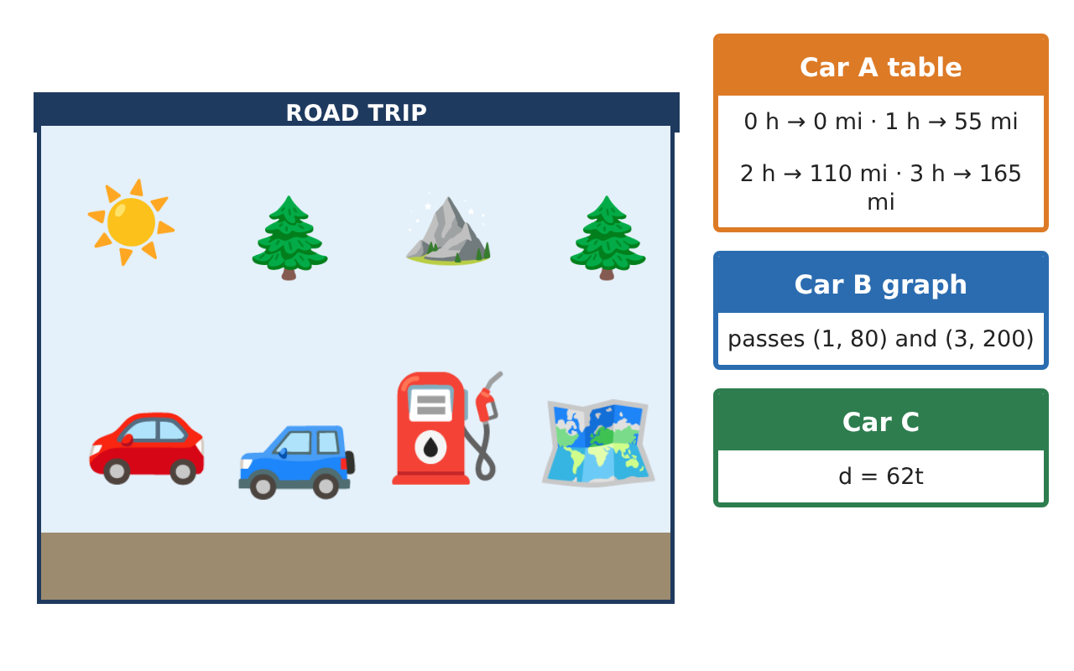
PRE-ALGEBRA (8TH) · UNIT 3: LINEAR AND FUNCTIONAL RELATIONSHIPS
Road Trip Rate Lab
Compare cars on a road trip using tables, graphs, and equations.
Honors Project
2–3 class periods
Name: ______________________________ Group: ______________________________

Slide 2
The Scenario
Honors
Your class is planning a road trip to a national park, and three family cars are going. Each car's speed is given a different way: one with a table, one with a graph, and one with an equation.
You will compare the cars, write functions for distance and fuel, and plan when everyone will arrive and how much the gas will cost.
Pre-Algebra (8th) · Unit 3: Linear and Functional Relationships · Road Trip Rate Lab

Slide 3
Learning Goals & Timeline
Honors
Learning Goals
Timeline
• I can build linear functions from two points and interpret them in context.
• I can solve catch-up and comparison problems with linear functions.
• I can distinguish linear and nonlinear models and reason about average rates.
Day 1
Building Functions
Day 2
Chases and Curves
Day 3
Average Speed
Final
Road Trip Plan + reflection
Pre-Algebra (8th) · Unit 3: Linear and Functional Relationships · Road Trip Rate Lab

Slide 4
Part 1: Building Functions
Honors
Day 1 · Use the car cards.
1. Car D was 130 miles from home after 2 hours and 310 miles after 5 hours. Write its function and interpret the initial value.
2. After how many hours is Car D 50 miles ahead of Car A (d = 55t)?
3. f(x) = 2x − 3 and g is given by the table (0, 1), (1, 4), (2, 7). Which has the greater rate of change? The greater initial value?
Pre-Algebra (8th) · Unit 3: Linear and Functional Relationships · Road Trip Rate Lab

Slide 5
Part 2: Chases and Curves
Honors
Day 2 · Show your work.
4. Car C (62 mph) leaves 1.5 hours after Car A (55 mph) from the same place. When does Car C catch up, and how far have they gone?
5. Stopping distance is about d = 0.05v² feet at speed v mph. Find d at 20, 40, and 60 mph. Is the model linear?
6. Car A costs $0.12 per mile; Car E gets 24 mpg with gas at $3.36. Which costs more for 500 miles, and by how much?
Pre-Algebra (8th) · Unit 3: Linear and Functional Relationships · Road Trip Rate Lab

Slide 6
Part 3: Average Speed
Honors
Day 3 · Plan a trip with several legs.
7. A car drives 2 hours at 60 mph and 1 hour at 30 mph. What is its average speed?
8. Explain why the answer is not (60 + 30) ÷ 2 = 45 mph.
9. Design a three-leg trip of 500 miles that arrives in exactly 9 hours. Give each leg's speed and time.
Pre-Algebra (8th) · Unit 3: Linear and Functional Relationships · Road Trip Rate Lab

Slide 7
Final Product: Road Trip Plan
Honors
Your final product must include:
☐ Functions built from two points
☐ Catch-up and lead calculations
☐ Linear vs. nonlinear analysis
☐ Cost comparison of two cars
☐ A designed multi-leg trip with average speed
Pre-Algebra (8th) · Unit 3: Linear and Functional Relationships · Road Trip Rate Lab

Slide 8
Scoring Rubric
Honors
Criteria | 4 – Exceeds | 3 – Meets | 2 – Approaching | 1 – Beginning
Mathematical Accuracy | All calculations and solutions are correct; answers include units and are checked. | Nearly all work is correct; minor errors do not change conclusions. | Several errors; some conclusions are affected. | Many errors or missing work.
Reasoning & Justification | Clear, complete explanations connect every answer to the situation; uses precise vocabulary. | Explanations are mostly clear and connected to the situation. | Explanations are brief or partly unclear. | Little or no explanation.
Application & Design | Rates, functions, and comparisons are correct and interpreted in context. Goes beyond the minimum with a creative, realistic choice. | Rates, functions, and comparisons are correct and interpreted in context. | Design is incomplete or only partly uses the math from the unit. | Design is missing or unrelated to the unit math.
Communication & Presentation | Trip plan shows each car's function, arrival time, and cost with clear labels. Polished, organized, and visually engaging. | Trip plan shows each car's function, arrival time, and cost with clear labels. Organized and easy to follow. | Product is missing required parts or is hard to follow. | Product is mostly missing.
Pre-Algebra (8th) · Unit 3: Linear and Functional Relationships · Road Trip Rate Lab

Slide 9
Reflection
Honors
R1. Why does a constant rate of change make a function linear?
R2. When is average speed equal to the average of the speeds?
Pre-Algebra (8th) · Unit 3: Linear and Functional Relationships · Road Trip Rate Lab

