Slide 1
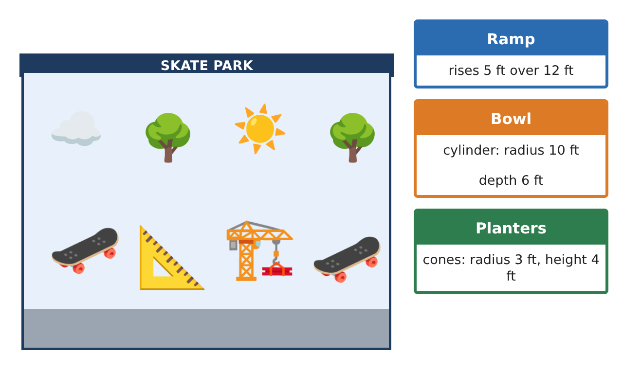
PRE-ALGEBRA (8TH) · UNIT 7: GEOMETRY
Skate Park Design
Use the Pythagorean Theorem, distance, and volume to design a skate park.
CP2 Project
2–3 class periods
Name: ______________________________ Group: ______________________________

Slide 2
The Scenario
CP2
The town is building a new skate park, and the design team wants student input. Ramps must have the right lengths, paths must be planned on the map, and the concrete must be ordered in the right amount.
You will use right triangles, the distance formula, and volume formulas to create a blueprint and a concrete order.
Pre-Algebra (8th) · Unit 7: Geometry · Skate Park Design

Slide 3
Learning Goals & Timeline
CP2
Learning Goals
Timeline
• I can use the Pythagorean Theorem to find a missing side of a right triangle.
• I can find the distance between two points on a coordinate map.
• I can find volumes of cylinders, cones, and spheres.
Day 1
Ramps and Rails
Day 2
Map Distances
Day 3
Concrete and Planters
Final
Skate Park Blueprint + reflection
Pre-Algebra (8th) · Unit 7: Geometry · Skate Park Design

Slide 4
Part 1: Ramps and Rails
CP2
Day 1 · Use a² + b² = c².
1. A ramp rises 5 feet over a run of 12 feet. How long is the ramp surface?
Starter: 5² + 12² = c² → c² = ___
2. A rail goes 8 feet across and 6 feet up. How long is the rail?
3. Is a triangle with sides 7, 24, and 25 feet a right triangle? Explain.
Pre-Algebra (8th) · Unit 7: Geometry · Skate Park Design

Slide 5
Part 2: Map Distances
CP2
Day 2 · Each grid unit on the map is 5 feet.
4. The entrance is at (1, 2) and the half-pipe is at (7, 10). How far apart are they in grid units and in feet?
5. Find the distance between the bench at (−2, 3) and the fountain at (4, −5) in grid units.
6. The park is a 60-foot by 80-foot rectangle. How long is the diagonal path across it?
Pre-Algebra (8th) · Unit 7: Geometry · Skate Park Design

Slide 6
Part 3: Concrete and Planters
CP2
Day 3 · Use π ≈ 3.14 or the π key. Round to the nearest tenth.
7. The bowl is a cylinder with radius 10 feet and depth 6 feet. Find its volume.
8. Each planter is a cone with radius 3 feet and height 4 feet. Find its volume.
9. Decorative concrete balls are spheres with radius 1 foot. Find the volume of one ball.
Pre-Algebra (8th) · Unit 7: Geometry · Skate Park Design

Slide 7
Final Product: Skate Park Blueprint
CP2
Your final product must include:
☐ Ramp and rail lengths
☐ Map distances in units and feet
☐ Volumes of the bowl, a planter, and a ball
☐ A labeled blueprint on grid paper
☐ A short presentation to the design team
Pre-Algebra (8th) · Unit 7: Geometry · Skate Park Design

Slide 8
Scoring Rubric
CP2
Criteria | 4 – Exceeds | 3 – Meets | 2 – Approaching | 1 – Beginning
Mathematical Accuracy | All calculations and solutions are correct; answers include units and are checked. | Nearly all work is correct; minor errors do not change conclusions. | Several errors; some conclusions are affected. | Many errors or missing work.
Reasoning & Justification | Clear, complete explanations connect every answer to the situation; uses precise vocabulary. | Explanations are mostly clear and connected to the situation. | Explanations are brief or partly unclear. | Little or no explanation.
Application & Design | Pythagorean Theorem, distance, and volume calculations are correct and used to make design decisions. Goes beyond the minimum with a creative, realistic choice. | Pythagorean Theorem, distance, and volume calculations are correct and used to make design decisions. | Design is incomplete or only partly uses the math from the unit. | Design is missing or unrelated to the unit math.
Communication & Presentation | Blueprint and concrete order are labeled with units and show all work. Polished, organized, and visually engaging. | Blueprint and concrete order are labeled with units and show all work. Organized and easy to follow. | Product is missing required parts or is hard to follow. | Product is mostly missing.
Pre-Algebra (8th) · Unit 7: Geometry · Skate Park Design

Slide 9
Reflection
CP2
R1. How do you know which side is the hypotenuse?
R2. How is the volume of a cone related to the volume of a cylinder with the same base and height?
Pre-Algebra (8th) · Unit 7: Geometry · Skate Park Design

