Slide 1
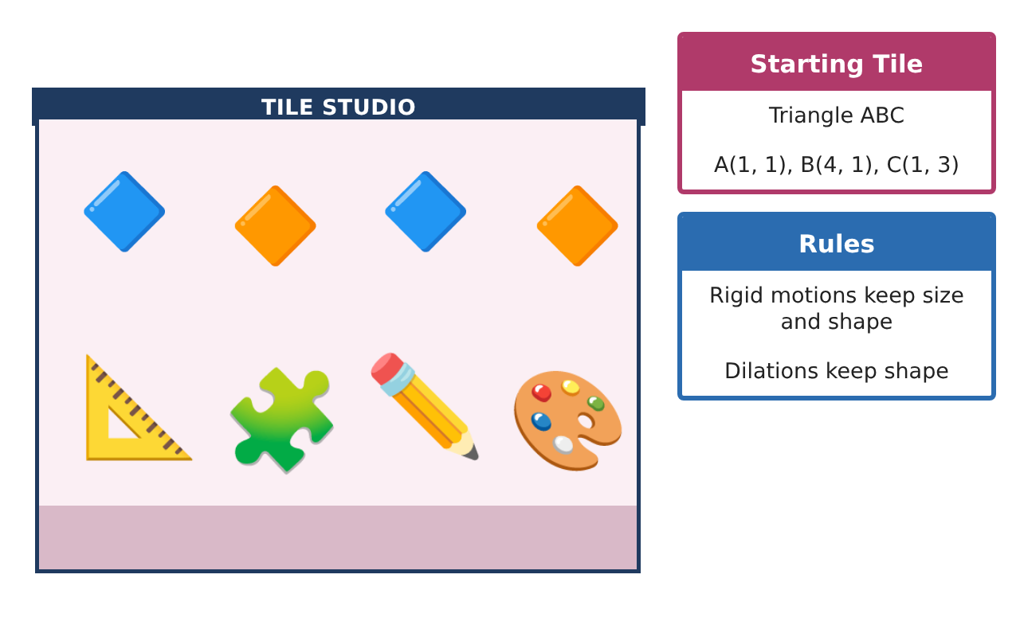
PRE-ALGEBRA (8TH) · UNIT 6: CONGRUENCE AND SIMILARITY
Tile Pattern Studio
Design floor tile patterns with transformations, similarity, and angle facts.
CP1 Project
2–3 class periods
Name: ______________________________ Group: ______________________________

Slide 2
The Scenario
CP1
A community center is redoing its lobby floor and wants a tile pattern designed by students. The pattern starts with one right-triangle tile that is moved around a grid.
You will use transformations, similarity, and angle relationships to build a pattern that fits perfectly and to measure things you cannot reach.
Pre-Algebra (8th) · Unit 6: Congruence and Similarity · Tile Pattern Studio

Slide 3
Learning Goals & Timeline
CP1
Learning Goals
Timeline
• I can describe sequences of transformations with coordinate rules.
• I can use dilations and similarity to find lengths and areas.
• I can use angle relationships to solve for unknown angles.
Day 1
Sequences of Moves
Day 2
Similar Tiles
Day 3
Solving with Angles
Final
Tile Design Portfolio + reflection
Pre-Algebra (8th) · Unit 6: Congruence and Similarity · Tile Pattern Studio

Slide 4
Part 1: Sequences of Moves
CP1
Day 1 · Tile ABC: A(1, 1), B(4, 1), C(1, 3).
1. Reflect the tile over the x-axis, then translate it 3 units left. Give the final coordinates.
2. Write the rule for a translation 5 right and 2 up.
3. Rotate the tile 180° about the origin.
Pre-Algebra (8th) · Unit 6: Congruence and Similarity · Tile Pattern Studio

Slide 5
Part 2: Similar Tiles
CP1
Day 2 · Use dilations and similarity.
4. Dilate the tile by 1.5 from the origin. Find the new coordinates and compare the areas.
5. Are triangles with sides 3, 4, 5 and 4.5, 6, 7.5 similar? Explain.
6. A 6-foot column casts a 4-foot shadow while a flagpole casts a 14-foot shadow. How tall is the flagpole?
Pre-Algebra (8th) · Unit 6: Congruence and Similarity · Tile Pattern Studio

Slide 6
Part 3: Solving with Angles
CP1
Day 3 · Use angle relationships.
7. A triangular tile has angles 47° and 68°. Find the third angle and the exterior angle next to it.
8. Alternate interior angles measure (3x + 10)° and (5x − 30)°. Find x and the angle.
9. Explain why two tiles with angles of 40° and 75° must be similar.
Pre-Algebra (8th) · Unit 6: Congruence and Similarity · Tile Pattern Studio

Slide 7
Final Product: Tile Design Portfolio
CP1
Your final product must include:
☐ Coordinates for a sequence of transformations
☐ Dilated tile with an area comparison
☐ An indirect measurement using similar triangles
☐ Angle equations solved
☐ Tile design portfolio with rules for every move
Pre-Algebra (8th) · Unit 6: Congruence and Similarity · Tile Pattern Studio

Slide 8
Scoring Rubric
CP1
Criteria | 4 – Exceeds | 3 – Meets | 2 – Approaching | 1 – Beginning
Mathematical Accuracy | All calculations and solutions are correct; answers include units and are checked. | Nearly all work is correct; minor errors do not change conclusions. | Several errors; some conclusions are affected. | Many errors or missing work.
Reasoning & Justification | Clear, complete explanations connect every answer to the situation; uses precise vocabulary. | Explanations are mostly clear and connected to the situation. | Explanations are brief or partly unclear. | Little or no explanation.
Application & Design | Transformations, dilations, similarity, and angle relationships are applied correctly. Goes beyond the minimum with a creative, realistic choice. | Transformations, dilations, similarity, and angle relationships are applied correctly. | Design is incomplete or only partly uses the math from the unit. | Design is missing or unrelated to the unit math.
Communication & Presentation | Portfolio shows coordinates, rules, measurements, and a clear final design. Polished, organized, and visually engaging. | Portfolio shows coordinates, rules, measurements, and a clear final design. Organized and easy to follow. | Product is missing required parts or is hard to follow. | Product is mostly missing.
Pre-Algebra (8th) · Unit 6: Congruence and Similarity · Tile Pattern Studio

Slide 9
Reflection
CP1
R1. Why does the area grow by the square of the scale factor?
R2. Why is AA enough to show triangles are similar?
Pre-Algebra (8th) · Unit 6: Congruence and Similarity · Tile Pattern Studio

