Slide 1
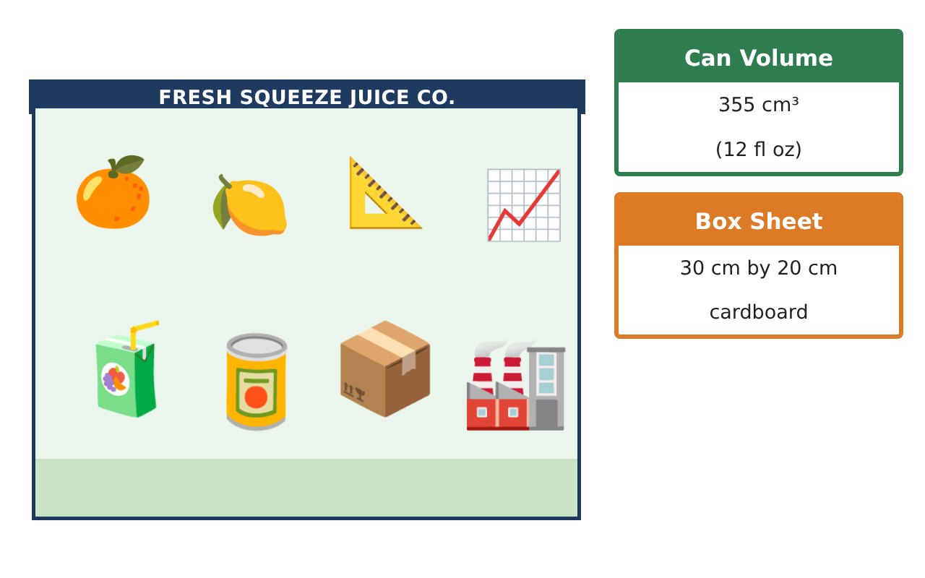
CALCULUS · UNIT 4: APPLICATIONS OF DERIVATIVES
Package Design Studio
Use optimization, related rates, and curve analysis to design packaging for a juice company.
CP1 Project
2–3 class periods
Name: ______________________________ Group: ______________________________

Slide 2
The Scenario
CP1
Fresh Squeeze Juice is launching a new drink and needs packaging that uses as little material as possible. The bottling plant fills cone-shaped tanks, and the marketing team wants to understand the sales curve.
You will use derivatives to design the package, control the filling process, and analyze sales.
Calculus · Unit 4: Applications of Derivatives · Package Design Studio

Slide 3
Learning Goals & Timeline
CP1
Learning Goals
Timeline
• I can solve optimization problems and justify extrema.
• I can solve related-rates problems.
• I can analyze a function with first and second derivatives.
Day 1
Optimize the Can
Day 2
Cone Tank
Day 3
Sales Analysis
Final
Design Proposal + reflection
Calculus · Unit 4: Applications of Derivatives · Package Design Studio

Slide 4
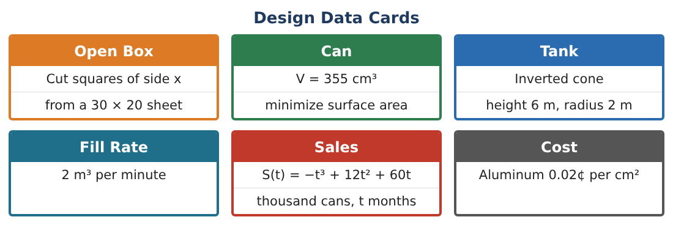
Part 1: Optimize the Can
CP1
Day 1 · A can holds 355 cm³. Minimize the surface area A = 2πr² + 2πrh.
1. Write h in terms of r and A as a function of r alone.
2. Find A′(r) and the critical point.
3. Find h and compare h with the diameter. Justify that this is a minimum.
4. Real cans have r ≈ 3.3 cm and h ≈ 10.4 cm. How much more aluminum do they use (in cm²)?
Calculus · Unit 4: Applications of Derivatives · Package Design Studio

Slide 5
Part 2: Cone Tank
CP1
Day 2 · Inverted cone: height 6 m, radius 2 m. Fill rate 2 m³/min.
5. Use similar triangles to write r in terms of h and V in terms of h.
6. Find dh⁄dt when h = 3 m.
7. Find how fast the radius of the juice surface is increasing at h = 3.
8. Find how fast the surface area of the juice top is increasing at h = 3.
Calculus · Unit 4: Applications of Derivatives · Package Design Studio

Slide 6
Part 3: Sales Analysis
CP1
Day 3 · S(t) = −t³ + 12t² + 60t, 0 ≤ t ≤ 12.
9. Find intervals of increase/decrease and concavity, and the inflection point.
10. Interpret the inflection point for the marketing team.
11. Use the MVT on [0, 10] to show that sales grew at exactly 80 thousand cans/month at some time. Find it.
Calculus · Unit 4: Applications of Derivatives · Package Design Studio

Slide 7
Final Product: Design Proposal
CP1
Your final product must include:
☐ Optimal can with justification and cost comparison
☐ Cone-tank related rates
☐ Full sales curve analysis
☐ MVT application
☐ Design proposal
Calculus · Unit 4: Applications of Derivatives · Package Design Studio

Slide 8
Scoring Rubric
CP1
Criteria | 4 – Exceeds | 3 – Meets | 2 – Approaching | 1 – Beginning
Mathematical Accuracy | All calculations and solutions are correct; answers include units and are checked. | Nearly all work is correct; minor errors do not change conclusions. | Several errors; some conclusions are affected. | Many errors or missing work.
Reasoning & Justification | Clear, complete explanations connect every answer to the situation; uses precise vocabulary. | Explanations are mostly clear and connected to the situation. | Explanations are brief or partly unclear. | Little or no explanation.
Application & Design | Optimization, related rates, and curve analysis are set up, solved, and justified correctly. Goes beyond the minimum with a creative, realistic choice. | Optimization, related rates, and curve analysis are set up, solved, and justified correctly. | Design is incomplete or only partly uses the math from the unit. | Design is missing or unrelated to the unit math.
Communication & Presentation | Proposal includes diagrams, derivative work, justifications, and recommendations. Polished, organized, and visually engaging. | Proposal includes diagrams, derivative work, justifications, and recommendations. Organized and easy to follow. | Product is missing required parts or is hard to follow. | Product is mostly missing.
Calculus · Unit 4: Applications of Derivatives · Package Design Studio

Slide 9
Reflection
CP1
R1. Why do real cans not use the optimal shape?
R2. What is the difference between where S is maximum and where S′ is maximum?
Calculus · Unit 4: Applications of Derivatives · Package Design Studio

