Slide 1
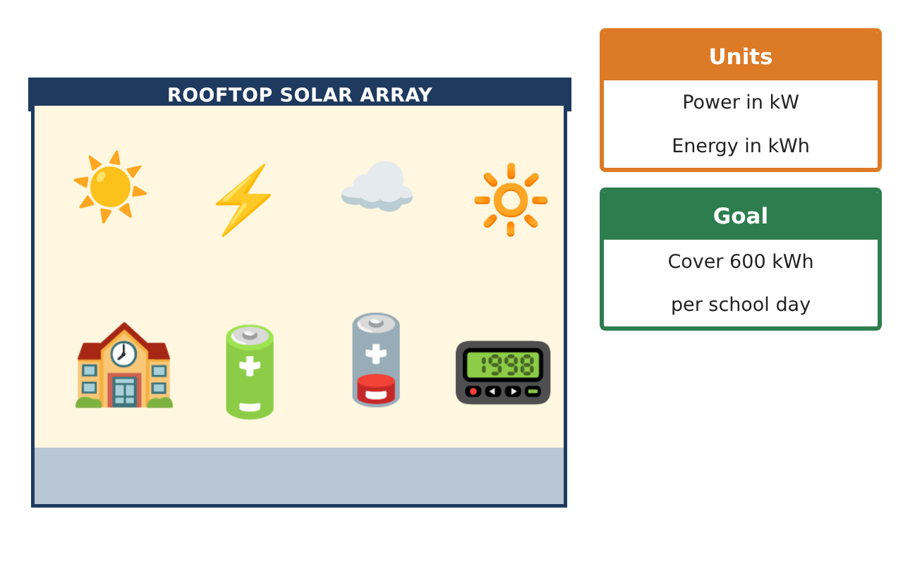
CALCULUS · UNIT 5: ANTIDERIVATIVES AND DEFINITE INTEGRALS
Solar Energy Audit
Use Riemann sums, antiderivatives, and definite integrals to measure a school’s solar energy.
CP2 Project
2–3 class periods
Name: ______________________________ Group: ______________________________

Slide 2
The Scenario
CP2
Your school installed solar panels on the roof. A meter records the power output (in kilowatts) every two hours, but the principal wants to know the total energy (in kilowatt-hours) produced each day.
Energy is the accumulation of power over time. You will estimate and calculate it with Riemann sums and integrals.
Calculus · Unit 5: Antiderivatives and Definite Integrals · Solar Energy Audit

Slide 3
Learning Goals & Timeline
CP2
Learning Goals
Timeline
• I can estimate accumulated energy with Riemann sums.
• I can find basic antiderivatives.
• I can evaluate a definite integral with an antiderivative.
Day 1
Estimate the Energy
Day 2
Antiderivatives
Day 3
Power Model
Final
Energy Audit Report + reflection
Calculus · Unit 5: Antiderivatives and Definite Integrals · Solar Energy Audit

Slide 4
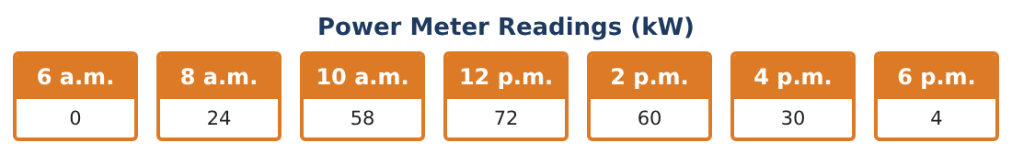
Part 1: Estimate the Energy
CP2
Day 1 · Use the Power Meter Readings. Each interval is 2 hours.
1. Find the left Riemann sum for 6 a.m. to 6 p.m.
Starter: 2 × (sum of the left readings)
2. Find the right Riemann sum.
3. Find the trapezoidal sum (average of left and right).
4. Is the school reaching its 600 kWh goal? By how much is it short?
Calculus · Unit 5: Antiderivatives and Definite Integrals · Solar Energy Audit

Slide 5
Part 2: Antiderivatives
CP2
Day 2 · Find each antiderivative.
5. ∫ 6x² dx
6. ∫ (4x − 3) dx
7. ∫ cos x dx
8. Why do we add + C?
Calculus · Unit 5: Antiderivatives and Definite Integrals · Solar Energy Audit

Slide 6
Part 3: Power Model
CP2
Day 3 · A model for the power is P(t) = 72 − 2(t − 6)² kW, where t is hours after 6 a.m. (0 ≤ t ≤ 12).
9. Find P(0), P(6), and P(12).
10. Evaluate ∫₀¹² P(t) dt = ∫₀¹² (72 − 2(t − 6)²) dt.
11. Compare the model with your trapezoidal estimate and recommend whether to add panels.
Calculus · Unit 5: Antiderivatives and Definite Integrals · Solar Energy Audit

Slide 7
Final Product: Energy Audit Report
CP2
Your final product must include:
☐ Left, right, and trapezoidal sums
☐ Antiderivatives with + C
☐ Definite integral of the power model
☐ Comparison with the goal
☐ Energy audit report
Calculus · Unit 5: Antiderivatives and Definite Integrals · Solar Energy Audit

Slide 8
Scoring Rubric
CP2
Criteria | 4 – Exceeds | 3 – Meets | 2 – Approaching | 1 – Beginning
Mathematical Accuracy | All calculations and solutions are correct; answers include units and are checked. | Nearly all work is correct; minor errors do not change conclusions. | Several errors; some conclusions are affected. | Many errors or missing work.
Reasoning & Justification | Clear, complete explanations connect every answer to the situation; uses precise vocabulary. | Explanations are mostly clear and connected to the situation. | Explanations are brief or partly unclear. | Little or no explanation.
Application & Design | Riemann sums, antiderivatives, and definite integrals are computed correctly and used to judge the energy goal. Goes beyond the minimum with a creative, realistic choice. | Riemann sums, antiderivatives, and definite integrals are computed correctly and used to judge the energy goal. | Design is incomplete or only partly uses the math from the unit. | Design is missing or unrelated to the unit math.
Communication & Presentation | Audit report includes data, sums, integrals, graphs, and a recommendation. Polished, organized, and visually engaging. | Audit report includes data, sums, integrals, graphs, and a recommendation. Organized and easy to follow. | Product is missing required parts or is hard to follow. | Product is mostly missing.
Calculus · Unit 5: Antiderivatives and Definite Integrals · Solar Energy Audit

Slide 9
Reflection
CP2
R1. Why does the area under a power graph give energy?
R2. Why are left and right sums different?
Calculus · Unit 5: Antiderivatives and Definite Integrals · Solar Energy Audit

