Slide 1
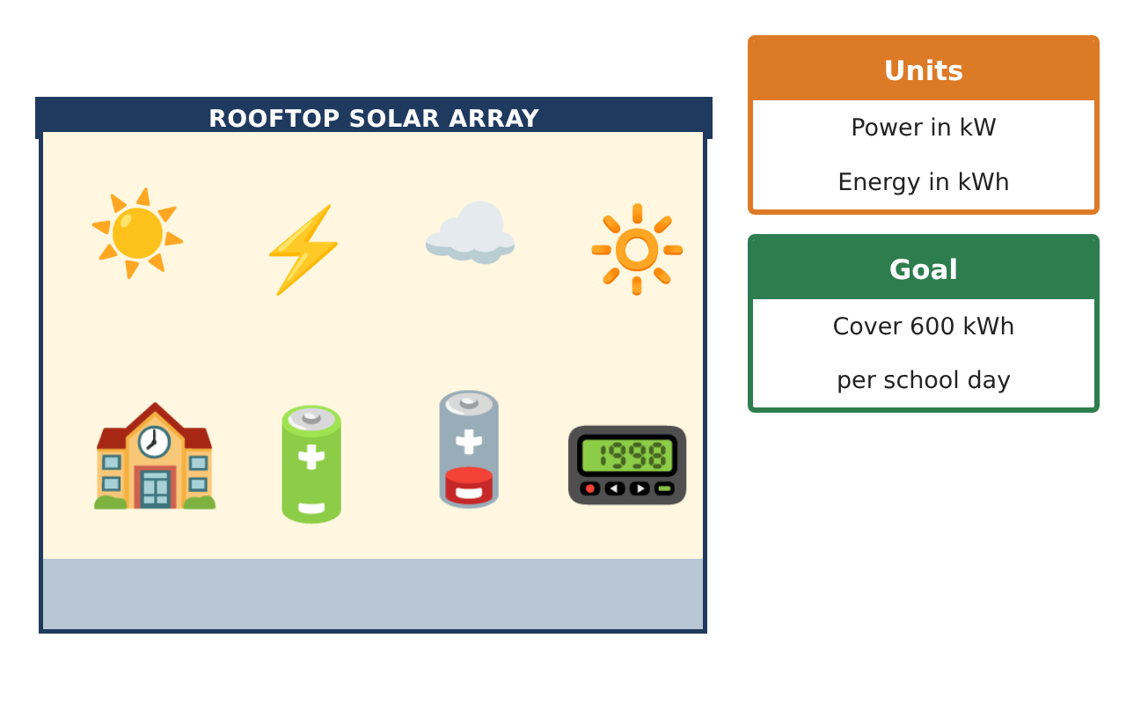
CALCULUS · UNIT 5: ANTIDERIVATIVES AND DEFINITE INTEGRALS
Solar Energy Audit
Use Riemann sums, antiderivatives, and definite integrals to measure a school’s solar energy.
Honors Project
2–3 class periods
Name: ______________________________ Group: ______________________________

Slide 2
The Scenario
Honors
Your school installed solar panels on the roof. A meter records the power output (in kilowatts) every two hours, but the principal wants to know the total energy (in kilowatt-hours) produced each day.
Energy is the accumulation of power over time. You will estimate and calculate it with Riemann sums and integrals.
Calculus · Unit 5: Antiderivatives and Definite Integrals · Solar Energy Audit

Slide 3
Learning Goals & Timeline
Honors
Learning Goals
Timeline
• I can analyze Riemann sums and their error.
• I can evaluate integrals using antiderivatives and u-substitution.
• I can build and compare integral models.
Day 1
Error Analysis
Day 2
Better Models
Day 3
Upgrade Analysis
Final
Energy Audit Report + reflection
Calculus · Unit 5: Antiderivatives and Definite Integrals · Solar Energy Audit

Slide 4
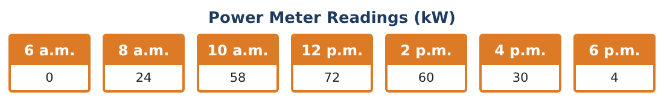
Part 1: Error Analysis
Honors
Day 1 · Use the Power Meter Readings and P(t) = −2t² + 24t.
1. Compute the trapezoidal sum with the data and with the model values at t = 0, 2, …, 12.
2. Find the exact integral of the model and the error of the model’s trapezoidal sum. Why is it an underestimate?
3. Write the limit of a right Riemann sum that equals ∫₀¹² (−2t² + 24t) dt.
4. Which data reading disagrees most with the model? What might explain it?
Calculus · Unit 5: Antiderivatives and Definite Integrals · Solar Energy Audit

Slide 5
Part 2: Better Models
Honors
Day 2 · A bell-shaped model: Q(t) = 72 sin(πt⁄12) kW.
5. Find ∫₀¹² 72 sin(πt⁄12) dt using substitution.
6. Compare Q with the data at 8 a.m. and 4 p.m. Which model fits better?
7. Find ∫ t e^(−t²) dt using u-substitution and explain each step.
8. Find the average power over the day using Q.
Calculus · Unit 5: Antiderivatives and Definite Integrals · Solar Energy Audit

Slide 6
Part 3: Upgrade Analysis
Honors
Day 3 · Goal: 600 kWh per day using model Q.
9. How many 4% panels are needed so the energy reaches 600 kWh?
10. Battery storage starts charging when power exceeds 40 kW. Find when Q(t) > 40 and the energy above 40 kW.
11. Write the audit report comparing the models, with error analysis and your recommendation.
Calculus · Unit 5: Antiderivatives and Definite Integrals · Solar Energy Audit

Slide 7
Final Product: Energy Audit Report
Honors
Your final product must include:
☐ Trapezoid error analysis
☐ Limit-of-sums definition
☐ Sine model with u-substitution
☐ Upgrade and storage analysis
☐ Audit report
Calculus · Unit 5: Antiderivatives and Definite Integrals · Solar Energy Audit

Slide 8
Scoring Rubric
Honors
Criteria | 4 – Exceeds | 3 – Meets | 2 – Approaching | 1 – Beginning
Mathematical Accuracy | All calculations and solutions are correct; answers include units and are checked. | Nearly all work is correct; minor errors do not change conclusions. | Several errors; some conclusions are affected. | Many errors or missing work.
Reasoning & Justification | Clear, complete explanations connect every answer to the situation; uses precise vocabulary. | Explanations are mostly clear and connected to the situation. | Explanations are brief or partly unclear. | Little or no explanation.
Application & Design | Riemann sums, antiderivatives, and definite integrals are computed correctly and used to judge the energy goal. Goes beyond the minimum with a creative, realistic choice. | Riemann sums, antiderivatives, and definite integrals are computed correctly and used to judge the energy goal. | Design is incomplete or only partly uses the math from the unit. | Design is missing or unrelated to the unit math.
Communication & Presentation | Audit report includes data, sums, integrals, graphs, and a recommendation. Polished, organized, and visually engaging. | Audit report includes data, sums, integrals, graphs, and a recommendation. Organized and easy to follow. | Product is missing required parts or is hard to follow. | Product is mostly missing.
Calculus · Unit 5: Antiderivatives and Definite Integrals · Solar Energy Audit

Slide 9
Reflection
Honors
R1. How does concavity tell you whether a trapezoidal sum over- or underestimates?
R2. Why choose one model over another when both are reasonable?
Calculus · Unit 5: Antiderivatives and Definite Integrals · Solar Energy Audit

