Slide 1
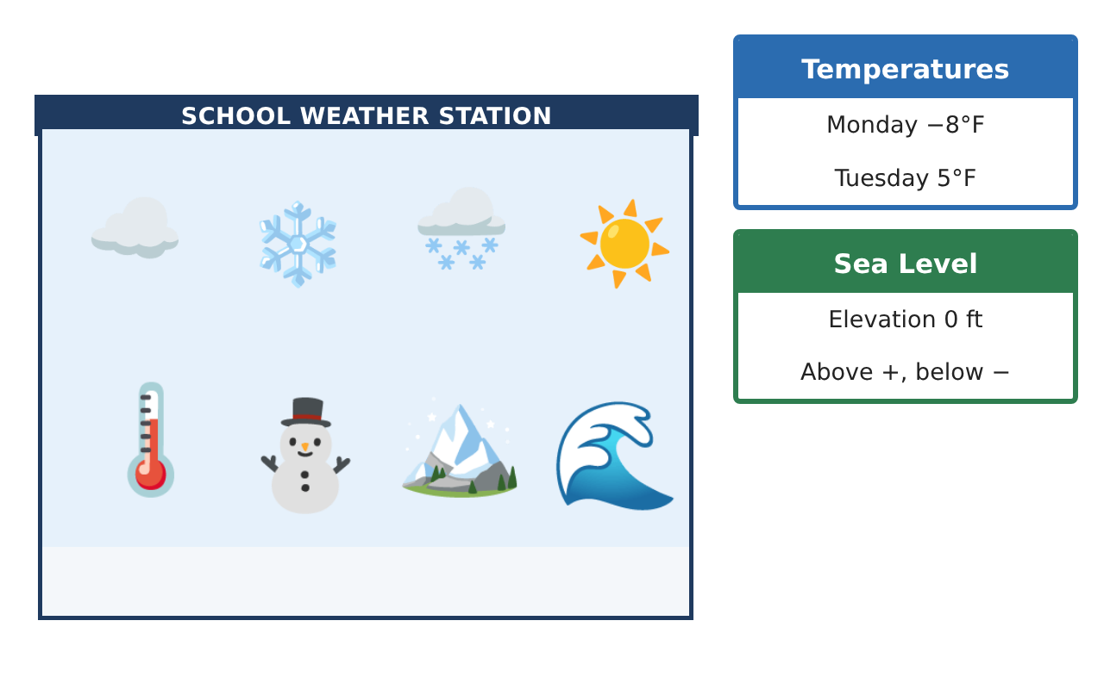
6TH GRADE MATH · UNIT 3: RATIONAL NUMBERS
Weather Station Watch
Track below-zero temperatures, elevations, and locations with rational numbers.
CP2 Project
2–3 class periods
Name: ______________________________ Group: ______________________________

Slide 2
The Scenario
CP2
Your class runs the school weather station for the winter. Temperatures drop below zero, nearby stations sit above and below sea level, and the storm tracker shows every station on a coordinate map.
You will use positive and negative numbers, absolute value, and the coordinate plane to report the weather to the school.
6th Grade Math · Unit 3: Rational Numbers · Weather Station Watch

Slide 3
Learning Goals & Timeline
CP2
Learning Goals
Timeline
• I can use positive and negative numbers to describe temperatures and elevations.
• I can compare and order rational numbers on a number line.
• I can plot points in all four quadrants.
Day 1
Read the Weather
Day 2
Distance from Zero
Day 3
Map the Stations
Final
Weather Station Report + reflection
6th Grade Math · Unit 3: Rational Numbers · Weather Station Watch

Slide 4
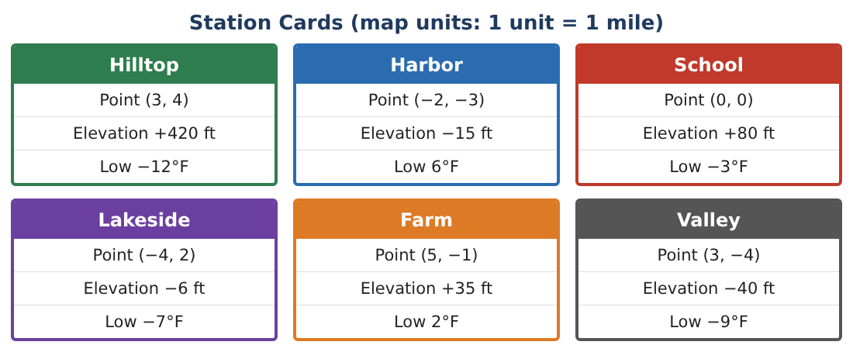
Part 1: Read the Weather
CP2
Day 1 · Use the Station Cards.
1. Write the low temperature of each station. Which station was coldest?
2. Order the six low temperatures from least to greatest.
3. Which stations are below sea level? How do you know?
4. What is the opposite of −7? Of 6?
6th Grade Math · Unit 3: Rational Numbers · Weather Station Watch

Slide 5
Part 2: Distance from Zero
CP2
Day 2 · Absolute value is the distance from 0.
5. Find |−12|, |6|, and |−40|.
Starter: |−12| = ___ because −12 is ___ units from 0.
6. Which station is farthest from sea level, up or down?
7. Valley is at −40 ft and Harbor is at −15 ft. Which is lower? How many feet apart are they?
8. The temperature went from −3°F to 5°F. How many degrees did it rise?
6th Grade Math · Unit 3: Rational Numbers · Weather Station Watch

Slide 6
Part 3: Map the Stations
CP2
Day 3 · Plot each station on the grid.
9. Plot all six stations on a coordinate grid. Label each one.
10. Which quadrant is each station in? (School is at the origin.)
11. Hilltop (3, 4) and Valley (3, −4) are on the same line. How many miles apart are they?
6th Grade Math · Unit 3: Rational Numbers · Weather Station Watch

Slide 7
Final Product: Weather Station Report
CP2
Your final product must include:
☐ Your station map with all six stations
☐ A number line of the low temperatures
☐ The coldest and warmest stations
☐ One distance found with absolute value
☐ A short weather report for the morning announcements
6th Grade Math · Unit 3: Rational Numbers · Weather Station Watch

Slide 8
Scoring Rubric
CP2
Criteria | 4 – Exceeds | 3 – Meets | 2 – Approaching | 1 – Beginning
Mathematical Accuracy | All calculations and solutions are correct; answers include units and are checked. | Nearly all work is correct; minor errors do not change conclusions. | Several errors; some conclusions are affected. | Many errors or missing work.
Reasoning & Justification | Clear, complete explanations connect every answer to the situation; uses precise vocabulary. | Explanations are mostly clear and connected to the situation. | Explanations are brief or partly unclear. | Little or no explanation.
Application & Design | Temperatures, elevations, and stations are ordered, compared, and mapped correctly with absolute value used for distances. Goes beyond the minimum with a creative, realistic choice. | Temperatures, elevations, and stations are ordered, compared, and mapped correctly with absolute value used for distances. | Design is incomplete or only partly uses the math from the unit. | Design is missing or unrelated to the unit math.
Communication & Presentation | Report includes the station map, ordered data, distance calculations, and a forecast. Polished, organized, and visually engaging. | Report includes the station map, ordered data, distance calculations, and a forecast. Organized and easy to follow. | Product is missing required parts or is hard to follow. | Product is mostly missing.
6th Grade Math · Unit 3: Rational Numbers · Weather Station Watch

Slide 9
Reflection
CP2
R1. Why is −12 less than −3 even though 12 is greater than 3?
R2. How does absolute value help describe distance?
6th Grade Math · Unit 3: Rational Numbers · Weather Station Watch

