Slide 1
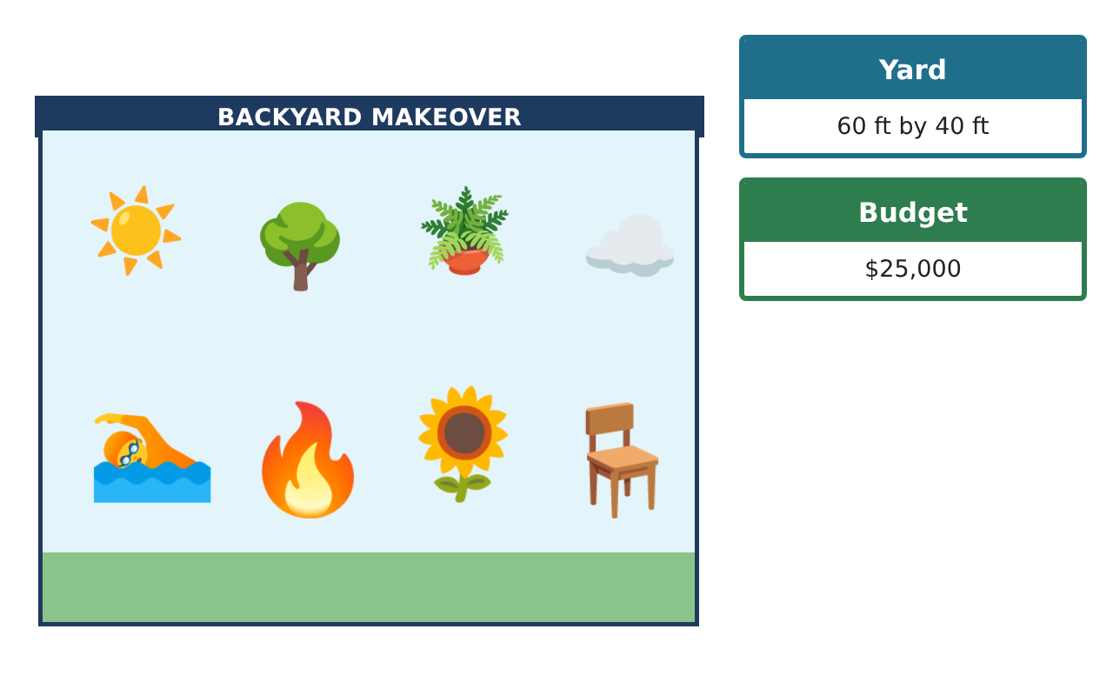
PRE-ALGEBRA (7TH) · UNIT 10: AREA AND VOLUME
Backyard Pool Makeover
Use area, surface area, and volume to design a backyard with a pool and patio.
CP2 Project
2–3 class periods
Name: ______________________________ Group: ______________________________

Slide 2
The Scenario
CP2
A family hired your design team to redo their backyard. They want a pool, a stone patio, a garden, and a fire pit, and they have a budget.
You will use area, surface area, and volume to choose shapes, calculate materials, and present your design.
Pre-Algebra (7th) · Unit 10: Area and Volume · Backyard Pool Makeover

Slide 3
Learning Goals & Timeline
CP2
Learning Goals
Timeline
• I can find the area of parallelograms, triangles, trapezoids, and circles.
• I can find the volume of prisms and cylinders.
• I can use measurements to find costs.
Day 1
Patio & Garden
Day 2
The Pool
Day 3
Fire Pit & Cost
Final
Backyard Design Proposal + reflection
Pre-Algebra (7th) · Unit 10: Area and Volume · Backyard Pool Makeover

Slide 4
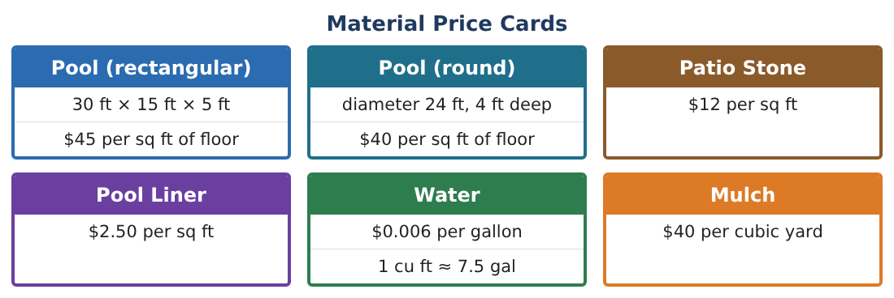
Part 1: Patio & Garden
CP2
Day 1 · Use the Material Price Cards. Use π ≈ 3.14.
1. The patio is a parallelogram with base 20 ft and height 12 ft. Find its area.
Starter: A = bh = ___ × ___
2. Find the cost of patio stone for the patio.
3. A triangle garden has base 10 ft and height 8 ft. Find its area.
4. A trapezoid flower bed has bases 6 ft and 10 ft and height 4 ft. Find its area.
Pre-Algebra (7th) · Unit 10: Area and Volume · Backyard Pool Makeover

Slide 5
Part 2: The Pool
CP2
Day 2 · Compare the two pool shapes.
5. Find the floor area of the rectangular pool (30 ft × 15 ft).
6. Find the floor area of the round pool (diameter 24 ft).
7. Find the volume of water in the rectangular pool (5 ft deep).
8. Find the volume of the round pool (4 ft deep).
Pre-Algebra (7th) · Unit 10: Area and Volume · Backyard Pool Makeover

Slide 6
Part 3: Fire Pit & Cost
CP2
Day 3 · The fire pit is a circle with radius 2 ft.
9. Find the area of the fire pit.
10. How many gallons of water fill the rectangular pool? (1 cu ft ≈ 7.5 gal)
11. Choose a pool and find the cost of its floor. Add the patio. Is it under $25,000?
Pre-Algebra (7th) · Unit 10: Area and Volume · Backyard Pool Makeover

Slide 7
Final Product: Backyard Design Proposal
CP2
Your final product must include:
☐ A yard drawing with every shape labeled
☐ Areas of the patio, garden, bed, and fire pit
☐ Pool volume and gallons
☐ Cost table
☐ Your recommendation
Pre-Algebra (7th) · Unit 10: Area and Volume · Backyard Pool Makeover

Slide 8
Scoring Rubric
CP2
Criteria | 4 – Exceeds | 3 – Meets | 2 – Approaching | 1 – Beginning
Mathematical Accuracy | All calculations and solutions are correct; answers include units and are checked. | Nearly all work is correct; minor errors do not change conclusions. | Several errors; some conclusions are affected. | Many errors or missing work.
Reasoning & Justification | Clear, complete explanations connect every answer to the situation; uses precise vocabulary. | Explanations are mostly clear and connected to the situation. | Explanations are brief or partly unclear. | Little or no explanation.
Application & Design | Areas, surface areas, and volumes are computed correctly and used to price and compare designs. Goes beyond the minimum with a creative, realistic choice. | Areas, surface areas, and volumes are computed correctly and used to price and compare designs. | Design is incomplete or only partly uses the math from the unit. | Design is missing or unrelated to the unit math.
Communication & Presentation | Proposal includes a labeled drawing, calculations, a cost table, and a recommendation. Polished, organized, and visually engaging. | Proposal includes a labeled drawing, calculations, a cost table, and a recommendation. Organized and easy to follow. | Product is missing required parts or is hard to follow. | Product is mostly missing.
Pre-Algebra (7th) · Unit 10: Area and Volume · Backyard Pool Makeover

Slide 9
Reflection
CP2
R1. Why is pool size measured with volume but the patio with area?
R2. How did you use the radius in the circle formulas?
Pre-Algebra (7th) · Unit 10: Area and Volume · Backyard Pool Makeover

