Slide 1
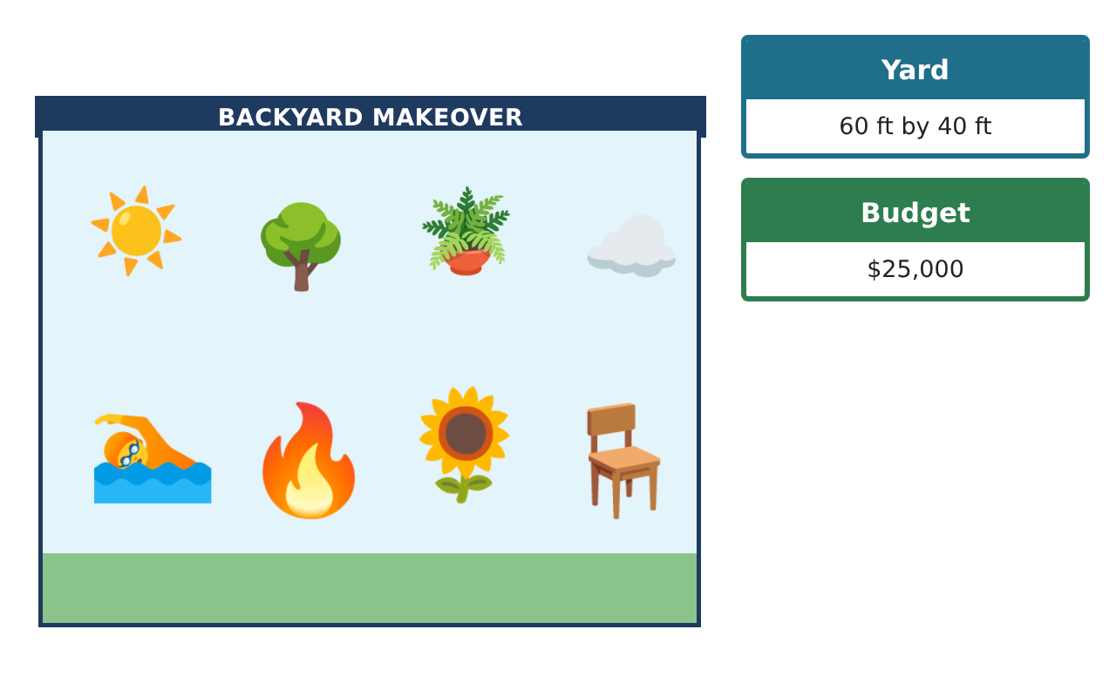
PRE-ALGEBRA (7TH) · UNIT 10: AREA AND VOLUME
Backyard Pool Makeover
Use area, surface area, and volume to design a backyard with a pool and patio.
Honors Project
2–3 class periods
Name: ______________________________ Group: ______________________________

Slide 2
The Scenario
Honors
A family hired your design team to redo their backyard. They want a pool, a stone patio, a garden, and a fire pit, and they have a budget.
You will use area, surface area, and volume to choose shapes, calculate materials, and present your design.
Pre-Algebra (7th) · Unit 10: Area and Volume · Backyard Pool Makeover

Slide 3
Learning Goals & Timeline
Honors
Learning Goals
Timeline
• I can solve area and volume problems with composite solids.
• I can compare designs using surface area to volume.
• I can optimize a design under a budget.
Day 1
Patio Design
Day 2
Pool Engineering
Day 3
Optimize
Final
Backyard Design Proposal + reflection
Pre-Algebra (7th) · Unit 10: Area and Volume · Backyard Pool Makeover

Slide 4
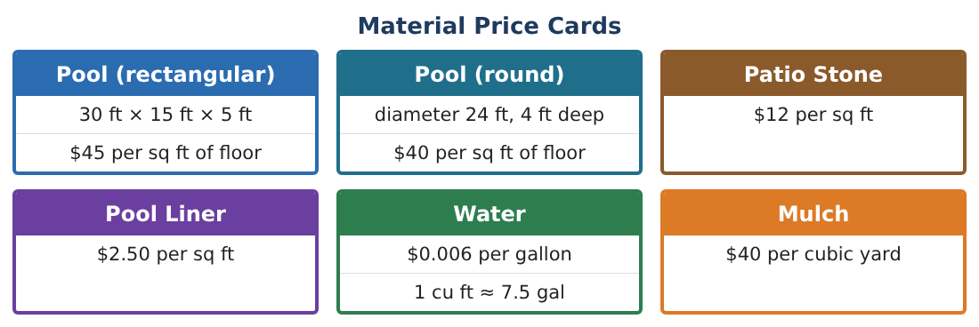
Part 1: Patio Design
Honors
Day 1 · Use π. The yard is 60 ft by 40 ft.
1. The patio is a 20 ft by 16 ft rectangle with a semicircle (diameter 16 ft) on one end. Find its area and cost of stone.
2. Find the perimeter of the patio for edging.
3. A fire pit is a cylinder ring: outer radius 2.5 ft, inner radius 2 ft, height 1.5 ft. Find the volume of stone in the ring.
4. How many cubic yards of concrete is that?
Pre-Algebra (7th) · Unit 10: Area and Volume · Backyard Pool Makeover

Slide 5
Part 2: Pool Engineering
Honors
Day 2 · Compare a rectangular pool (30 × 15 × 5 ft) and a round pool (d = 24 ft, 4 ft deep).
5. A sloped rectangular pool is 3 ft deep at one end and 8 ft at the other (length 30 ft, width 15 ft). Its side is a trapezoid. Find the volume.
6. Find the ratio of liner surface area to volume for the round pool and the flat rectangular pool. Which is more efficient?
7. What diameter would a 4-ft-deep round pool need to hold the same volume as the flat rectangular pool?
8. If every dimension of the round pool were doubled, how would its volume and liner area change?
Pre-Algebra (7th) · Unit 10: Area and Volume · Backyard Pool Makeover

Slide 6
Part 3: Optimize
Honors
Day 3 · Budget $25,000.
9. Write the total cost of a round pool with radius r (4 ft deep) including floor ($40/sq ft) and liner ($2.50/sq ft), as an expression in r.
10. With a $5,046 patio, find the largest whole-foot radius that keeps the total under $25,000.
11. Present your final design and justify each choice with a calculation.
Pre-Algebra (7th) · Unit 10: Area and Volume · Backyard Pool Makeover

Slide 7
Final Product: Backyard Design Proposal
Honors
Your final product must include:
☐ Composite patio area, perimeter, and cost
☐ Fire pit ring volume
☐ Sloped pool volume and efficiency comparison
☐ Cost expression and optimized radius
☐ Final proposal
Pre-Algebra (7th) · Unit 10: Area and Volume · Backyard Pool Makeover

Slide 8
Scoring Rubric
Honors
Criteria | 4 – Exceeds | 3 – Meets | 2 – Approaching | 1 – Beginning
Mathematical Accuracy | All calculations and solutions are correct; answers include units and are checked. | Nearly all work is correct; minor errors do not change conclusions. | Several errors; some conclusions are affected. | Many errors or missing work.
Reasoning & Justification | Clear, complete explanations connect every answer to the situation; uses precise vocabulary. | Explanations are mostly clear and connected to the situation. | Explanations are brief or partly unclear. | Little or no explanation.
Application & Design | Areas, surface areas, and volumes are computed correctly and used to price and compare designs. Goes beyond the minimum with a creative, realistic choice. | Areas, surface areas, and volumes are computed correctly and used to price and compare designs. | Design is incomplete or only partly uses the math from the unit. | Design is missing or unrelated to the unit math.
Communication & Presentation | Proposal includes a labeled drawing, calculations, a cost table, and a recommendation. Polished, organized, and visually engaging. | Proposal includes a labeled drawing, calculations, a cost table, and a recommendation. Organized and easy to follow. | Product is missing required parts or is hard to follow. | Product is mostly missing.
Pre-Algebra (7th) · Unit 10: Area and Volume · Backyard Pool Makeover

Slide 9
Reflection
Honors
R1. Why does doubling every dimension multiply volume by 8?
R2. What trade-offs did you face between pool size and budget?
Pre-Algebra (7th) · Unit 10: Area and Volume · Backyard Pool Makeover

