Slide 1
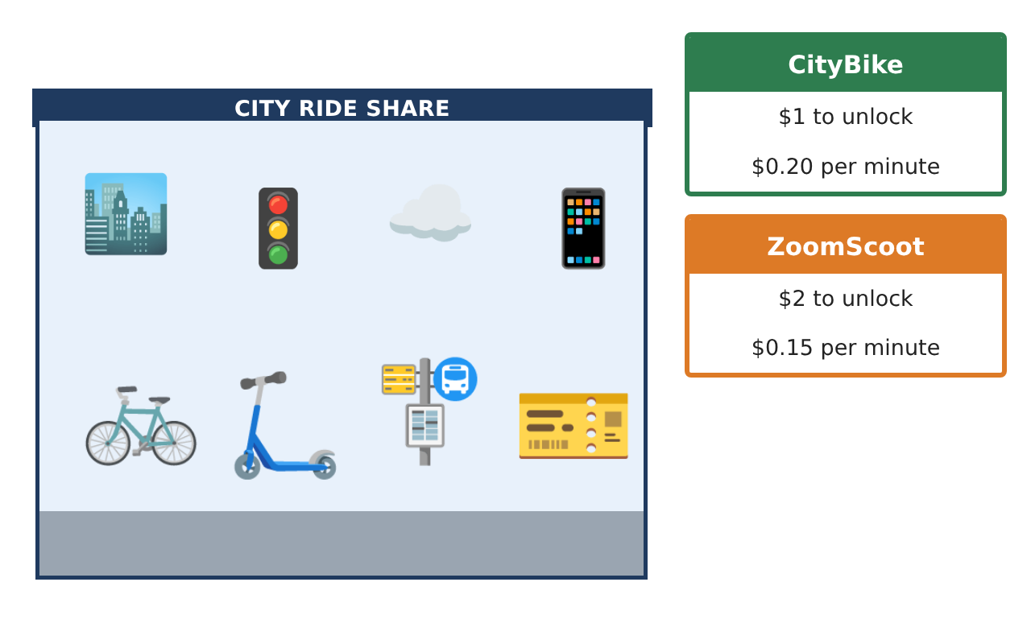
PRE-ALGEBRA (7TH) · UNIT 8: LINEAR FUNCTIONS AND GRAPHING
Bike Share Showdown
Graph linear functions to choose the best bike or scooter rental.
CP1 Project
2–3 class periods
Name: ______________________________ Group: ______________________________

Slide 2
The Scenario
CP1
Your city just launched three ways to get around downtown: a bike share, an electric scooter company, and a monthly pass. Each has a different starting fee and price per minute.
You will graph each option as a linear function, compare them, and write a guide that helps riders choose.
Pre-Algebra (7th) · Unit 8: Linear Functions and Graphing · Bike Share Showdown

Slide 3
Learning Goals & Timeline
CP1
Learning Goals
Timeline
• I can identify functions and represent them with tables, rules, and graphs.
• I can interpret slope and intercepts and fit a trend line.
• I can solve systems by graphing and graph linear inequalities.
Day 1
Functions & Data
Day 2
Three Options
Day 3
Budget
Final
Rental Comparison Guide + reflection
Pre-Algebra (7th) · Unit 8: Linear Functions and Graphing · Bike Share Showdown

Slide 4
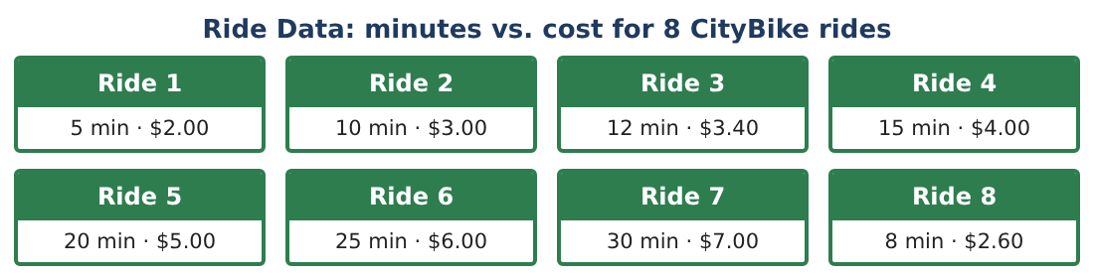
Part 1: Functions & Data
CP1
Day 1 · Use the Ride Data card.
1. Is the set of (minutes, cost) pairs a function? Could a different set of rides make it not a function? Explain.
2. Make a scatter plot of the ride data. Describe the correlation.
3. Find the slope using two rides and write the equation of the line.
4. Predict the cost of a 45-minute ride.
Pre-Algebra (7th) · Unit 8: Linear Functions and Graphing · Bike Share Showdown

Slide 5
Part 2: Three Options
CP1
Day 2 · ZoomScoot: $2 + $0.15 per minute. MonthPass: $30 per month, rides free.
5. Write rules for ZoomScoot and MonthPass for x total minutes in a month.
6. Graph CityBike, ZoomScoot, and MonthPass (for one long ride per month) on the same axes. Where do CityBike and ZoomScoot cross?
7. A rider takes 20 rides of 15 minutes each in a month. Find the monthly cost of each option.
8. Solve the system y = 0.20x + 1 and y = 0.15x + 2 algebraically to check your graph.
Pre-Algebra (7th) · Unit 8: Linear Functions and Graphing · Bike Share Showdown

Slide 6
Part 3: Budget
CP1
Day 3 · You have at most $12 per week for CityBike rides.
9. Let r be the number of rides and m the minutes per ride (same each time). Write the cost of r 10-minute rides and an inequality for the budget.
10. Graph y ≤ 0.20x + 1 for one ride. Which side is shaded and what does a point in the shaded region mean?
11. Write your Rider Guide: which option is best for (a) one short trip, (b) one long trip, (c) daily commuting? Use your graphs.
Pre-Algebra (7th) · Unit 8: Linear Functions and Graphing · Bike Share Showdown

Slide 7
Final Product: Rental Comparison Guide
CP1
Your final product must include:
☐ Scatter plot with trend line
☐ Rules and graphs for three options
☐ System solved by graphing and algebra
☐ Budget inequality
☐ Rider Guide with recommendations
Pre-Algebra (7th) · Unit 8: Linear Functions and Graphing · Bike Share Showdown

Slide 8
Scoring Rubric
CP1
Criteria | 4 – Exceeds | 3 – Meets | 2 – Approaching | 1 – Beginning
Mathematical Accuracy | All calculations and solutions are correct; answers include units and are checked. | Nearly all work is correct; minor errors do not change conclusions. | Several errors; some conclusions are affected. | Many errors or missing work.
Reasoning & Justification | Clear, complete explanations connect every answer to the situation; uses precise vocabulary. | Explanations are mostly clear and connected to the situation. | Explanations are brief or partly unclear. | Little or no explanation.
Application & Design | Linear functions, slopes, intercepts, systems, and inequalities are modeled and used correctly to compare options. Goes beyond the minimum with a creative, realistic choice. | Linear functions, slopes, intercepts, systems, and inequalities are modeled and used correctly to compare options. | Design is incomplete or only partly uses the math from the unit. | Design is missing or unrelated to the unit math.
Communication & Presentation | Rider Guide includes graphs, rules, intersection points, and a clear decision chart. Polished, organized, and visually engaging. | Rider Guide includes graphs, rules, intersection points, and a clear decision chart. Organized and easy to follow. | Product is missing required parts or is hard to follow. | Product is mostly missing.
Pre-Algebra (7th) · Unit 8: Linear Functions and Graphing · Bike Share Showdown

Slide 9
Reflection
CP1
R1. How do slope and y-intercept help you compare plans without graphing?
R2. Why is the intersection of two lines important here?
Pre-Algebra (7th) · Unit 8: Linear Functions and Graphing · Bike Share Showdown

