Slide 1
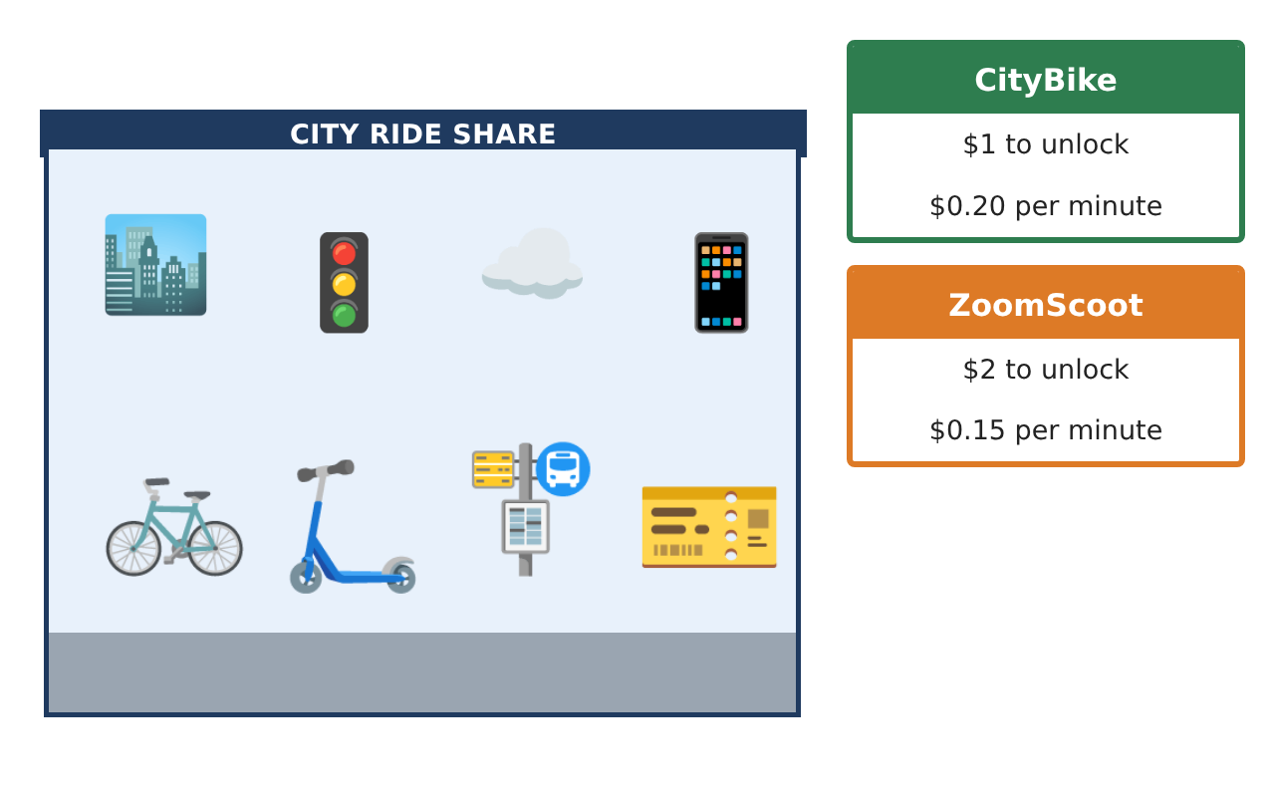
PRE-ALGEBRA (7TH) · UNIT 8: LINEAR FUNCTIONS AND GRAPHING
Bike Share Showdown
Graph linear functions to choose the best bike or scooter rental.
CP2 Project
2–3 class periods
Name: ______________________________ Group: ______________________________

Slide 2
The Scenario
CP2
Your city just launched three ways to get around downtown: a bike share, an electric scooter company, and a monthly pass. Each has a different starting fee and price per minute.
You will graph each option as a linear function, compare them, and write a guide that helps riders choose.
Pre-Algebra (7th) · Unit 8: Linear Functions and Graphing · Bike Share Showdown

Slide 3
Learning Goals & Timeline
CP2
Learning Goals
Timeline
• I can make a table and graph for a linear function.
• I can find the slope and y-intercept.
• I can compare two functions on a graph.
Day 1
Tables & Functions
Day 2
Slope & Intercept
Day 3
Compare
Final
Rental Comparison Guide + reflection
Pre-Algebra (7th) · Unit 8: Linear Functions and Graphing · Bike Share Showdown

Slide 4
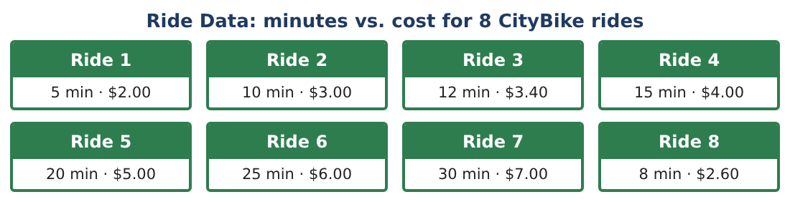
Part 1: Tables & Functions
CP2
Day 1 · CityBike: $1 to unlock and $0.20 per minute.
1. Complete a table of cost for 0, 5, 10, 15, and 20 minutes.
Starter: cost = 1 + 0.20 × minutes
2. Write a rule for the cost y after x minutes.
3. Is cost a function of minutes? Explain.
4. Graph the CityBike rule.
Pre-Algebra (7th) · Unit 8: Linear Functions and Graphing · Bike Share Showdown

Slide 5
Part 2: Slope & Intercept
CP2
Day 2 · Use the rules.
5. What is the slope of the CityBike line? What does it mean?
6. What is the y-intercept? What does it mean?
7. ZoomScoot costs $2 to unlock and $0.15 per minute. Write its rule.
8. Find the slope between (10, 3.50) and (20, 5) for ZoomScoot.
Pre-Algebra (7th) · Unit 8: Linear Functions and Graphing · Bike Share Showdown

Slide 6
Part 3: Compare
CP2
Day 3 · Graph both rules on the same axes.
9. Which is cheaper for a 10-minute ride? For a 30-minute ride?
10. At how many minutes do they cost the same? Use your graph or a table.
11. Write two sentences for your guide telling riders which to choose.
Pre-Algebra (7th) · Unit 8: Linear Functions and Graphing · Bike Share Showdown

Slide 7
Final Product: Rental Comparison Guide
CP2
Your final product must include:
☐ Tables and rules for both companies
☐ Both lines graphed on one set of axes
☐ Slope and y-intercept meanings
☐ The break-even point
☐ Rider guide
Pre-Algebra (7th) · Unit 8: Linear Functions and Graphing · Bike Share Showdown

Slide 8
Scoring Rubric
CP2
Criteria | 4 – Exceeds | 3 – Meets | 2 – Approaching | 1 – Beginning
Mathematical Accuracy | All calculations and solutions are correct; answers include units and are checked. | Nearly all work is correct; minor errors do not change conclusions. | Several errors; some conclusions are affected. | Many errors or missing work.
Reasoning & Justification | Clear, complete explanations connect every answer to the situation; uses precise vocabulary. | Explanations are mostly clear and connected to the situation. | Explanations are brief or partly unclear. | Little or no explanation.
Application & Design | Linear functions, slopes, intercepts, systems, and inequalities are modeled and used correctly to compare options. Goes beyond the minimum with a creative, realistic choice. | Linear functions, slopes, intercepts, systems, and inequalities are modeled and used correctly to compare options. | Design is incomplete or only partly uses the math from the unit. | Design is missing or unrelated to the unit math.
Communication & Presentation | Rider Guide includes graphs, rules, intersection points, and a clear decision chart. Polished, organized, and visually engaging. | Rider Guide includes graphs, rules, intersection points, and a clear decision chart. Organized and easy to follow. | Product is missing required parts or is hard to follow. | Product is mostly missing.
Pre-Algebra (7th) · Unit 8: Linear Functions and Graphing · Bike Share Showdown

Slide 9
Reflection
CP2
R1. What does a steeper line mean in this situation?
R2. Why do the two lines cross?
Pre-Algebra (7th) · Unit 8: Linear Functions and Graphing · Bike Share Showdown

