Slide 1
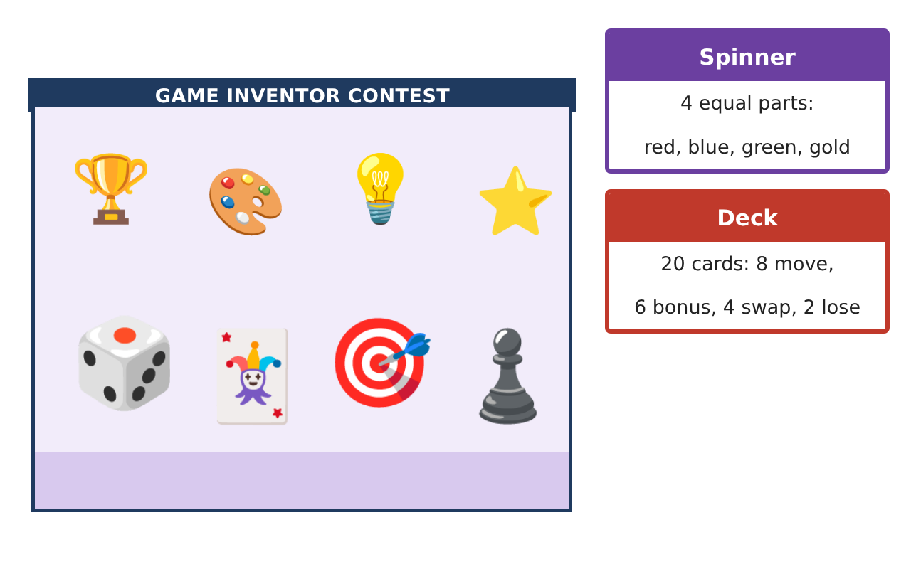
PRE-ALGEBRA (7TH) · UNIT 12: DATA ANALYSIS AND PROBABILITY
Board Game Inventor
Use probability, counting, and data to invent and test a fair board game.
CP2 Project
2–3 class periods
Name: ______________________________ Group: ______________________________

Slide 2
The Scenario
CP2
A game company is holding a contest for the best new family board game. Your game must use dice, a spinner, and a deck of cards, and it must be fair and fun.
You will use probability and data to design the rules, test the game, and prove it is fair.
Pre-Algebra (7th) · Unit 12: Data Analysis and Probability · Board Game Inventor

Slide 3
Learning Goals & Timeline
CP2
Learning Goals
Timeline
• I can find theoretical and experimental probability.
• I can count outcomes with a tree diagram or the counting principle.
• I can display data to test a game.
Day 1
Chance Basics
Day 2
Counting Outcomes
Day 3
Invent the Game
Final
Game Box & Rule Book + reflection
Pre-Algebra (7th) · Unit 12: Data Analysis and Probability · Board Game Inventor

Slide 4
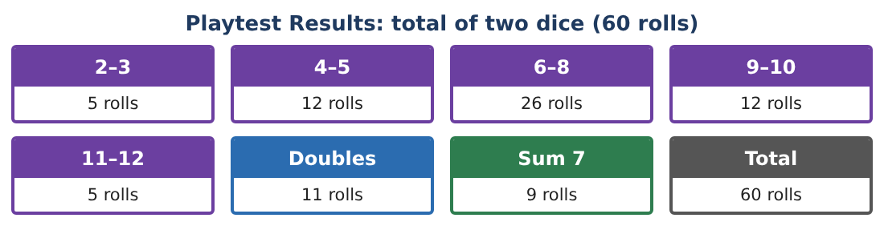
Part 1: Chance Basics
CP2
Day 1 · Use the spinner and deck shown on the first page.
1. What is the probability the spinner lands on gold?
2. What is the probability of drawing a bonus card?
3. What is the probability of NOT drawing a lose card?
4. Roll one die. What is the probability of rolling an even number?
Pre-Algebra (7th) · Unit 12: Data Analysis and Probability · Board Game Inventor

Slide 5
Part 2: Counting Outcomes
CP2
Day 2 · Make a tree diagram or use multiplication.
5. How many outcomes are there for one spin and one die roll?
Starter: spinner outcomes × die outcomes = ___ × ___
6. What is the probability of spinning red and rolling a 6?
7. How many outcomes are there for two dice? What is the probability of a sum of 7?
8. Compare: in the playtest, a sum of 7 came up 9 times in 60 rolls. What is the experimental probability?
Pre-Algebra (7th) · Unit 12: Data Analysis and Probability · Board Game Inventor

Slide 6
Part 3: Invent the Game
CP2
Day 3 · Write your rules.
9. Make a bar graph of the playtest results.
10. Write a rule that uses the spinner and the deck. Find the probability that your rule happens on a turn.
11. Draw your game board and write three rules.
Pre-Algebra (7th) · Unit 12: Data Analysis and Probability · Board Game Inventor

Slide 7
Final Product: Game Box & Rule Book
CP2
Your final product must include:
☐ Probability of each spinner color and card type
☐ Tree diagram or counting principle work
☐ Bar graph of the playtest
☐ Rules with probabilities
☐ Your game board
Pre-Algebra (7th) · Unit 12: Data Analysis and Probability · Board Game Inventor

Slide 8
Scoring Rubric
CP2
Criteria | 4 – Exceeds | 3 – Meets | 2 – Approaching | 1 – Beginning
Mathematical Accuracy | All calculations and solutions are correct; answers include units and are checked. | Nearly all work is correct; minor errors do not change conclusions. | Several errors; some conclusions are affected. | Many errors or missing work.
Reasoning & Justification | Clear, complete explanations connect every answer to the situation; uses precise vocabulary. | Explanations are mostly clear and connected to the situation. | Explanations are brief or partly unclear. | Little or no explanation.
Application & Design | Probabilities, counts, and playtest analysis are correct and used to make the game fair. Goes beyond the minimum with a creative, realistic choice. | Probabilities, counts, and playtest analysis are correct and used to make the game fair. | Design is incomplete or only partly uses the math from the unit. | Design is missing or unrelated to the unit math.
Communication & Presentation | Rule book includes probabilities, the board, playtest displays, and a fairness argument. Polished, organized, and visually engaging. | Rule book includes probabilities, the board, playtest displays, and a fairness argument. Organized and easy to follow. | Product is missing required parts or is hard to follow. | Product is mostly missing.
Pre-Algebra (7th) · Unit 12: Data Analysis and Probability · Board Game Inventor

Slide 9
Reflection
CP2
R1. Why might experimental probability be different from theoretical probability?
R2. What makes a game fair?
Pre-Algebra (7th) · Unit 12: Data Analysis and Probability · Board Game Inventor

