Slide 1
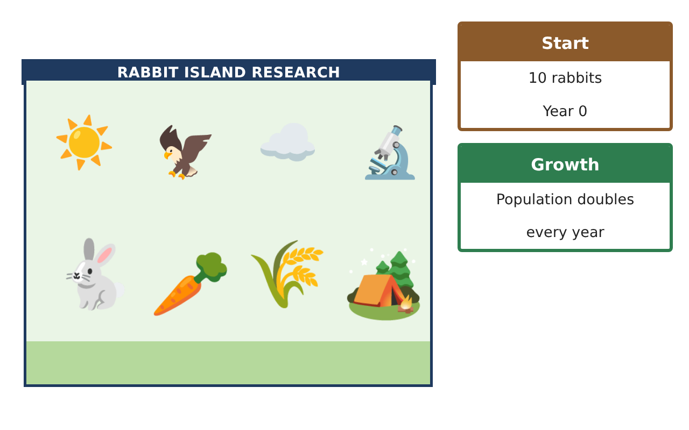
PRE-ALGEBRA (7TH) · UNIT 13: NONLINEAR FUNCTIONS AND POLYNOMIALS
Rabbit Island Population
Model a growing rabbit population with sequences, exponential functions, and polynomials.
CP2 Project
2–3 class periods
Name: ______________________________ Group: ______________________________

Slide 2
The Scenario
CP2
Ten rabbits were released on a small island with no predators. The population is growing fast, the grass is disappearing, and the wildlife office needs a plan.
You will use sequences, exponential models, and polynomials to predict the population and design habitats.
Pre-Algebra (7th) · Unit 13: Nonlinear Functions and Polynomials · Rabbit Island Population

Slide 3
Learning Goals & Timeline
CP2
Learning Goals
Timeline
• I can tell arithmetic and geometric sequences apart.
• I can extend a pattern and graph it.
• I can add and subtract polynomials.
Day 1
Patterns
Day 2
Graph It
Day 3
Habitat Fences
Final
Wildlife Management Report + reflection
Pre-Algebra (7th) · Unit 13: Nonlinear Functions and Polynomials · Rabbit Island Population

Slide 4
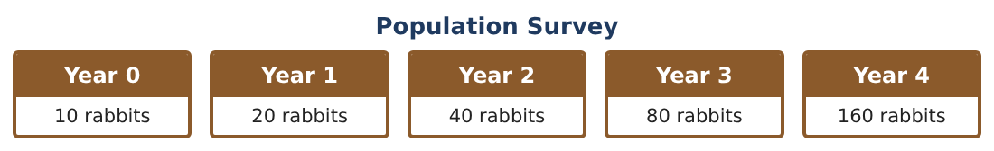
Part 1: Patterns
CP2
Day 1 · Use the Population Survey.
1. What do you multiply by each year?
2. Predict the population in years 5 and 6.
3. Grass patches drop by 15 each year: 200, 185, 170, … Is this arithmetic or geometric? What comes next?
4. In which year will the grass patches reach 50?
Pre-Algebra (7th) · Unit 13: Nonlinear Functions and Polynomials · Rabbit Island Population

Slide 5
Part 2: Graph It
CP2
Day 2 · Make a table and a graph.
5. Graph the population for years 0–4. Is the graph a line or a curve?
6. Graph the grass patches for years 0–4. Is it a line or a curve?
7. Write a rule for the population after n years.
Starter: P = 10 × 2^___
8. Use your rule to find the population in year 8.
Pre-Algebra (7th) · Unit 13: Nonlinear Functions and Polynomials · Rabbit Island Population

Slide 6
Part 3: Habitat Fences
CP2
Day 3 · A rectangular pen is x + 4 meters long and x meters wide.
9. Write and simplify the perimeter of the pen.
10. Add the perimeters of two pens: (4x + 8) + (2x + 6).
11. If x = 5, how much fence is needed for both pens?
Pre-Algebra (7th) · Unit 13: Nonlinear Functions and Polynomials · Rabbit Island Population

Slide 7
Final Product: Wildlife Management Report
CP2
Your final product must include:
☐ Population table and graph
☐ Grass pattern and when it runs low
☐ Your population rule
☐ Pen fence expressions
☐ Report to the wildlife office
Pre-Algebra (7th) · Unit 13: Nonlinear Functions and Polynomials · Rabbit Island Population

Slide 8
Scoring Rubric
CP2
Criteria | 4 – Exceeds | 3 – Meets | 2 – Approaching | 1 – Beginning
Mathematical Accuracy | All calculations and solutions are correct; answers include units and are checked. | Nearly all work is correct; minor errors do not change conclusions. | Several errors; some conclusions are affected. | Many errors or missing work.
Reasoning & Justification | Clear, complete explanations connect every answer to the situation; uses precise vocabulary. | Explanations are mostly clear and connected to the situation. | Explanations are brief or partly unclear. | Little or no explanation.
Application & Design | Sequences, exponential models, graphs, and polynomials are correct and used to make a management plan. Goes beyond the minimum with a creative, realistic choice. | Sequences, exponential models, graphs, and polynomials are correct and used to make a management plan. | Design is incomplete or only partly uses the math from the unit. | Design is missing or unrelated to the unit math.
Communication & Presentation | Report includes tables, graphs, models, habitat designs, and a recommendation. Polished, organized, and visually engaging. | Report includes tables, graphs, models, habitat designs, and a recommendation. Organized and easy to follow. | Product is missing required parts or is hard to follow. | Product is mostly missing.
Pre-Algebra (7th) · Unit 13: Nonlinear Functions and Polynomials · Rabbit Island Population

Slide 9
Reflection
CP2
R1. How is doubling different from adding the same number each year?
R2. Why can the rabbit population not keep doubling forever?
Pre-Algebra (7th) · Unit 13: Nonlinear Functions and Polynomials · Rabbit Island Population

