Slide 1
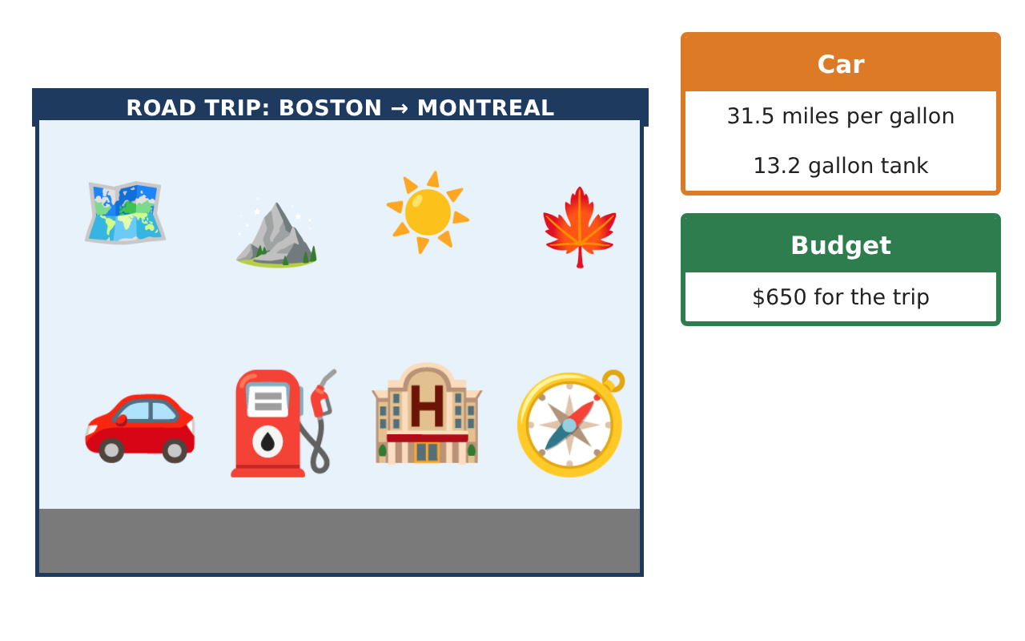
PRE-ALGEBRA (7TH) · UNIT 3: DECIMALS AND EQUATIONS
Road Trip Planner
Use decimals, formulas, and equations to plan a family road trip.
CP2 Project
2–3 class periods
Name: ______________________________ Group: ______________________________

Slide 2
The Scenario
CP2
Your family is driving from Boston to Montreal and back with stops along the way. Gas prices are in dollars and cents, speeds and times vary, and in Canada distances are in kilometers and gas is sold by the liter.
You will use decimals, formulas, and equations to plan the route, the budget, and the schedule.
Pre-Algebra (7th) · Unit 3: Decimals and Equations · Road Trip Planner

Slide 3
Learning Goals & Timeline
CP2
Learning Goals
Timeline
• I can round and estimate with decimals.
• I can use the formula d = rt.
• I can solve one-step equations with decimals.
Day 1
Estimate the Trip
Day 2
Distance, Rate, Time
Day 3
Canada Stop
Final
Road Trip Itinerary + reflection
Pre-Algebra (7th) · Unit 3: Decimals and Equations · Road Trip Planner

Slide 4
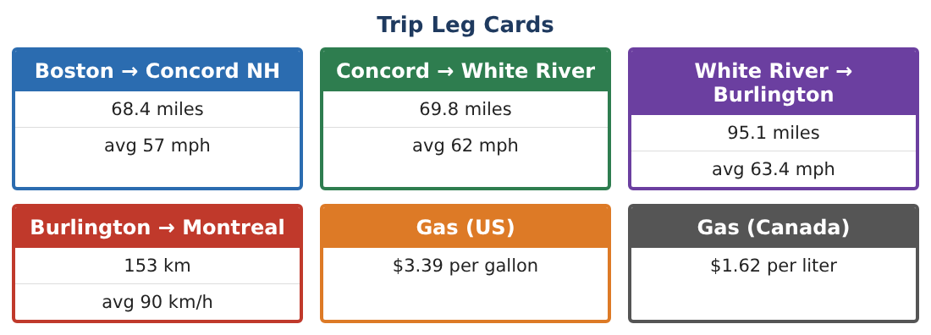
Part 1: Estimate the Trip
CP2
Day 1 · Use the Trip Leg Cards.
1. Round each US leg to the nearest mile. Estimate the total US distance.
2. Find the exact total of the three US legs.
3. Gas costs $3.39 per gallon. Estimate the cost of 10 gallons, then find it exactly.
4. Find the mean of the average speeds 57, 62, and 63.4 mph.
Pre-Algebra (7th) · Unit 3: Decimals and Equations · Road Trip Planner

Slide 5
Part 2: Distance, Rate, Time
CP2
Day 2 · Use d = rt.
5. How far do you drive in 1.5 hours at 62 mph?
Starter: d = r × t = 62 × ___
6. How long does the Boston → Concord leg take at 57 mph? Round to the nearest tenth of an hour.
7. Solve 31.5g = 233.3 to find the gallons of gas for the US legs. Round to the nearest tenth.
8. How much does that gas cost at $3.39 per gallon?
Pre-Algebra (7th) · Unit 3: Decimals and Equations · Road Trip Planner

Slide 6
Part 3: Canada Stop
CP2
Day 3 · 1 kilometer is about 0.62 mile. 1 gallon is about 3.79 liters.
9. Convert 153 km to miles.
10. Gas in Canada costs $1.62 per liter. About how much is that per gallon?
11. Make a table of each leg with distance (miles) and time. Find the total driving time.
Pre-Algebra (7th) · Unit 3: Decimals and Equations · Road Trip Planner

Slide 7
Final Product: Road Trip Itinerary
CP2
Your final product must include:
☐ A map or list of the route
☐ Estimated and exact distances
☐ Times found with d = rt
☐ Gas needed and cost
☐ Your trip itinerary with stops
Pre-Algebra (7th) · Unit 3: Decimals and Equations · Road Trip Planner

Slide 8
Scoring Rubric
CP2
Criteria | 4 – Exceeds | 3 – Meets | 2 – Approaching | 1 – Beginning
Mathematical Accuracy | All calculations and solutions are correct; answers include units and are checked. | Nearly all work is correct; minor errors do not change conclusions. | Several errors; some conclusions are affected. | Many errors or missing work.
Reasoning & Justification | Clear, complete explanations connect every answer to the situation; uses precise vocabulary. | Explanations are mostly clear and connected to the situation. | Explanations are brief or partly unclear. | Little or no explanation.
Application & Design | Distances, times, costs, and conversions are computed correctly and used to build a realistic itinerary. Goes beyond the minimum with a creative, realistic choice. | Distances, times, costs, and conversions are computed correctly and used to build a realistic itinerary. | Design is incomplete or only partly uses the math from the unit. | Design is missing or unrelated to the unit math.
Communication & Presentation | Itinerary includes a leg table, times, fuel and money plans, and conversions. Polished, organized, and visually engaging. | Itinerary includes a leg table, times, fuel and money plans, and conversions. Organized and easy to follow. | Product is missing required parts or is hard to follow. | Product is mostly missing.
Pre-Algebra (7th) · Unit 3: Decimals and Equations · Road Trip Planner

Slide 9
Reflection
CP2
R1. When is an estimate good enough, and when do you need the exact answer?
R2. How do you choose whether to multiply or divide with d = rt?
Pre-Algebra (7th) · Unit 3: Decimals and Equations · Road Trip Planner

