Slide 1
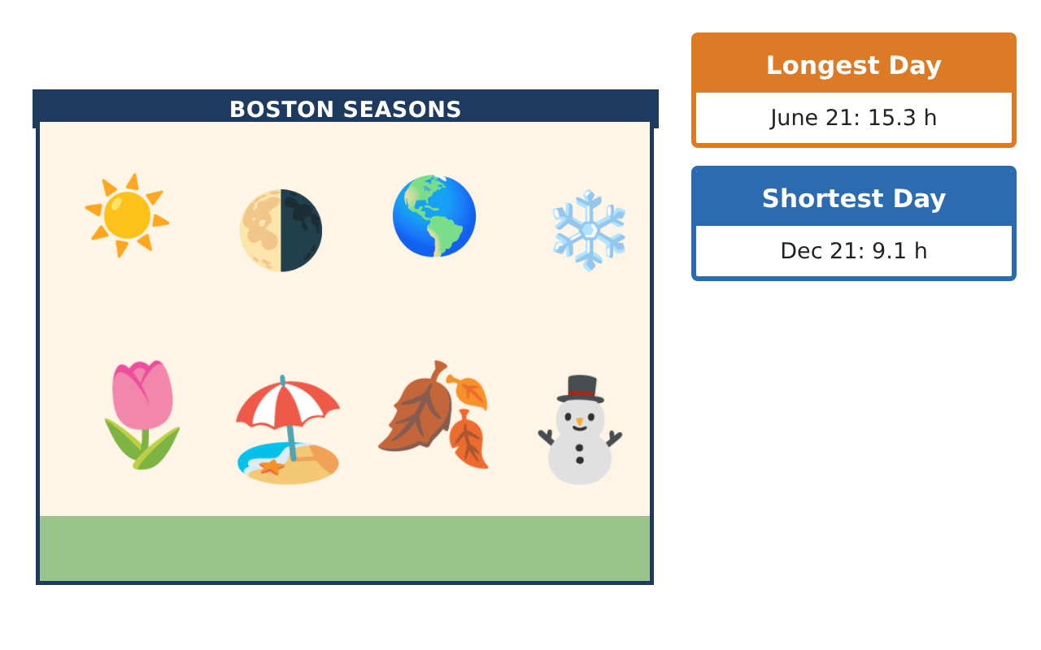
PRECALCULUS · UNIT 4: TRIGONOMETRIC FUNCTIONS
Daylight and Seasons
Model hours of daylight and temperatures with sinusoidal functions.
CP1 Project
2–3 class periods
Name: ______________________________ Group: ______________________________

Slide 2
The Scenario
CP1
The parks department wants to schedule outdoor events when there is plenty of daylight and comfortable weather. Daylight and temperature rise and fall every year in a repeating pattern.
You will use the unit circle and sinusoidal functions to model the seasons and recommend event dates.
Precalculus · Unit 4: Trigonometric Functions · Daylight and Seasons

Slide 3
Learning Goals & Timeline
CP1
Learning Goals
Timeline
• I can use radians and the unit circle to evaluate trig functions.
• I can build sinusoidal models with amplitude, period, phase shift, and midline.
• I can solve trigonometric equations in context.
Day 1
Unit Circle
Day 2
Build the Models
Day 3
Solve for Dates
Final
Seasonal Planning Report + reflection
Precalculus · Unit 4: Trigonometric Functions · Daylight and Seasons

Slide 4
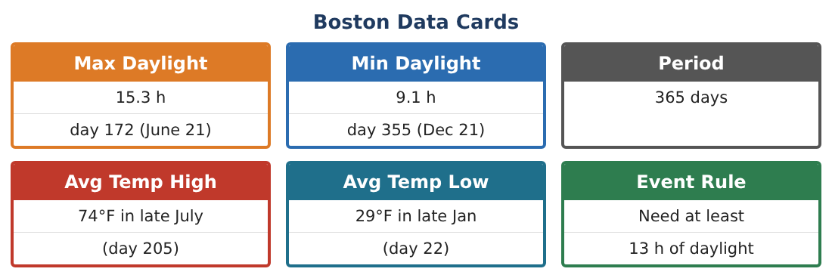
Part 1: Unit Circle
CP1
Day 1 · Use radians.
1. Through what angle in radians does Earth travel in 73 days?
2. Find the exact values of sin 2π⁄3, cos 7π⁄6, and tan 5π⁄4.
3. A point on Earth’s orbit (radius 1 AU) is at angle 5π⁄3. Find its coordinates.
4. Explain why sin θ = sin(π − θ) using the unit circle.
Precalculus · Unit 4: Trigonometric Functions · Daylight and Seasons

Slide 5
Part 2: Build the Models
CP1
Day 2 · Use the Boston Data Cards.
5. Write a cosine model for daylight with its maximum on day 172.
6. Write a cosine model for average high temperature (max 74°F on day 205, min 29°F).
7. Find D(100) and T(100).
8. Why do the daylight and temperature models have different phase shifts?
Precalculus · Unit 4: Trigonometric Functions · Daylight and Seasons

Slide 6
Part 3: Solve for Dates
CP1
Day 3 · Need at least 13 h of daylight and a temperature of at least 60°F.
9. Solve D(t) = 13 for the two days in the year.
10. Solve T(t) = 60 for the two days.
11. Find the event window where both conditions hold, and give it as calendar dates.
Precalculus · Unit 4: Trigonometric Functions · Daylight and Seasons

Slide 7
Final Product: Seasonal Planning Report
CP1
Your final product must include:
☐ Unit-circle work
☐ Daylight and temperature models
☐ Predictions
☐ Solutions of trig equations
☐ Event window recommendation
Precalculus · Unit 4: Trigonometric Functions · Daylight and Seasons

Slide 8
Scoring Rubric
CP1
Criteria | 4 – Exceeds | 3 – Meets | 2 – Approaching | 1 – Beginning
Mathematical Accuracy | All calculations and solutions are correct; answers include units and are checked. | Nearly all work is correct; minor errors do not change conclusions. | Several errors; some conclusions are affected. | Many errors or missing work.
Reasoning & Justification | Clear, complete explanations connect every answer to the situation; uses precise vocabulary. | Explanations are mostly clear and connected to the situation. | Explanations are brief or partly unclear. | Little or no explanation.
Application & Design | Sinusoidal models are built from data and used correctly to predict and solve for event dates. Goes beyond the minimum with a creative, realistic choice. | Sinusoidal models are built from data and used correctly to predict and solve for event dates. | Design is incomplete or only partly uses the math from the unit. | Design is missing or unrelated to the unit math.
Communication & Presentation | Report includes models, graphs, solutions, and a clear recommendation. Polished, organized, and visually engaging. | Report includes models, graphs, solutions, and a clear recommendation. Organized and easy to follow. | Product is missing required parts or is hard to follow. | Product is mostly missing.
Precalculus · Unit 4: Trigonometric Functions · Daylight and Seasons

Slide 9
Reflection
CP1
R1. How did you find the phase shift from the data?
R2. Why does a trig equation have two solutions in a year?
Precalculus · Unit 4: Trigonometric Functions · Daylight and Seasons

