Slide 1
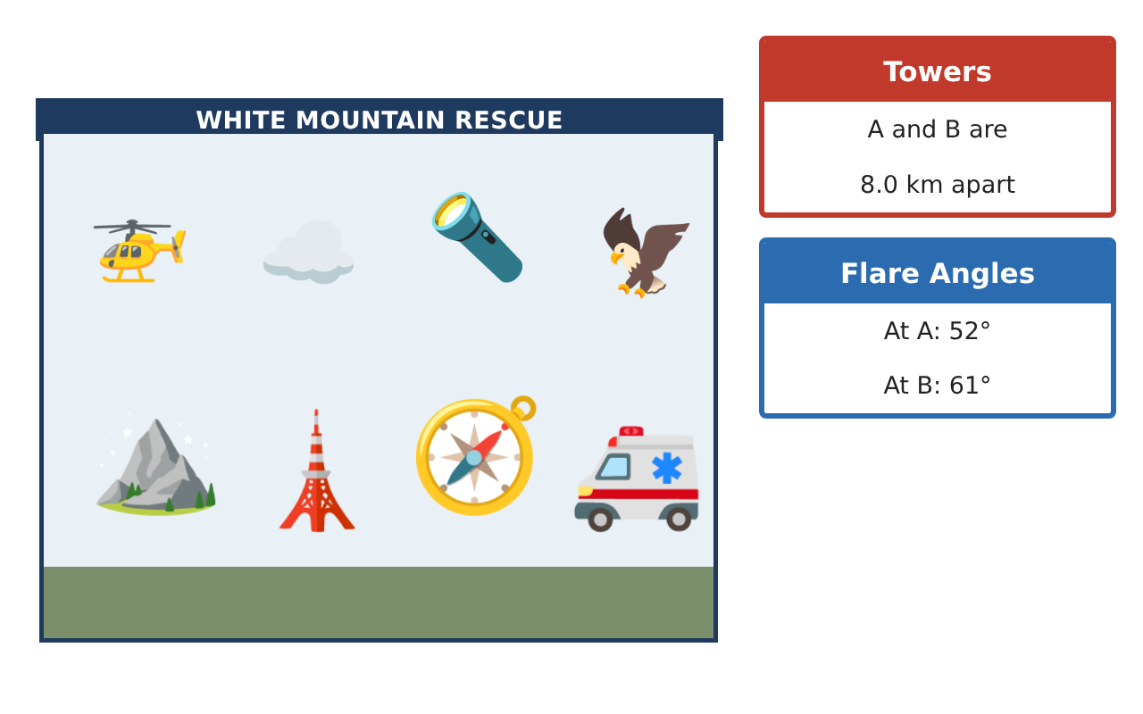
PRECALCULUS · UNIT 5: TRIGONOMETRY OF GENERAL TRIANGLES
Search and Rescue
Use the Laws of Sines and Cosines and bearings to locate a lost hiker.
CP2 Project
2–3 class periods
Name: ______________________________ Group: ______________________________

Slide 2
The Scenario
CP2
A hiker is lost in the White Mountains. Two ranger towers spot a signal flare, a helicopter is on the way, and search teams need to know how far to travel and how much area each team must cover.
You will use the trigonometry of all triangles, not just right triangles, to find the hiker and plan the search.
Precalculus · Unit 5: Trigonometry of General Triangles · Search and Rescue

Slide 3
Learning Goals & Timeline
CP2
Learning Goals
Timeline
• I can use right-triangle trig to find heights and distances.
• I can use the Law of Sines to find a missing side.
• I can use the Law of Cosines to find a distance.
Day 1
Tower Heights
Day 2
Find the Flare
Day 3
Team Distances
Final
Rescue Operations Brief + reflection
Precalculus · Unit 5: Trigonometry of General Triangles · Search and Rescue

Slide 4
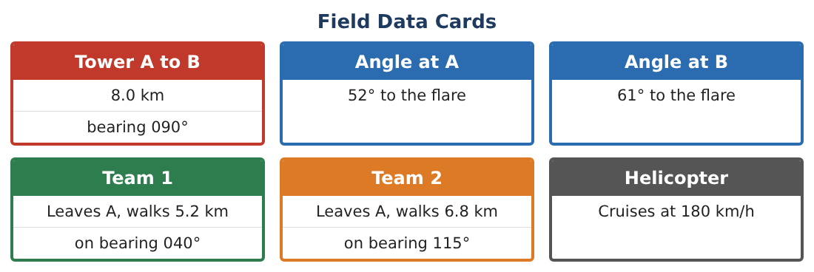
Part 1: Tower Heights
CP2
Day 1 · Use SOH-CAH-TOA.
1. From 200 m away, the angle of elevation to the top of Tower A is 14°. How tall is the tower?
Starter: tan 14° = h⁄200
2. A ranger in Tower A (50 m up) sees a tent at an angle of depression of 5°. How far away is the tent horizontally?
3. A rope from the top of a 30 m cliff to the ground makes a 62° angle with the ground. How long is the rope?
4. Explain the difference between angles of elevation and depression.
Precalculus · Unit 5: Trigonometry of General Triangles · Search and Rescue

Slide 5
Part 2: Find the Flare
CP2
Day 2 · Towers A and B are 8.0 km apart. The flare F makes 52° at A and 61° at B.
5. Find the angle at the flare.
6. Use the Law of Sines to find the distance from Tower A to the flare.
Starter: AF⁄(sin 61°) = 8⁄(sin 67°)
7. Find the distance from Tower B to the flare.
8. Which tower should send its team? Why?
Precalculus · Unit 5: Trigonometry of General Triangles · Search and Rescue

Slide 6
Part 3: Team Distances
CP2
Day 3 · Use the Law of Cosines: c² = a² + b² − 2ab cos C.
9. Two teams leave camp. One walks 5 km and the other 7 km, with 60° between their paths. How far apart are they?
10. Find the area of the triangle formed by the camp and the two teams. Use ¹⁄₂ab sin C.
11. Draw and label a map of the search with all distances you found.
Precalculus · Unit 5: Trigonometry of General Triangles · Search and Rescue

Slide 7
Final Product: Rescue Operations Brief
CP2
Your final product must include:
☐ Tower and rope calculations
☐ Flare location with the Law of Sines
☐ Team distance with the Law of Cosines
☐ Search area
☐ Labeled rescue map
Precalculus · Unit 5: Trigonometry of General Triangles · Search and Rescue

Slide 8
Scoring Rubric
CP2
Criteria | 4 – Exceeds | 3 – Meets | 2 – Approaching | 1 – Beginning
Mathematical Accuracy | All calculations and solutions are correct; answers include units and are checked. | Nearly all work is correct; minor errors do not change conclusions. | Several errors; some conclusions are affected. | Many errors or missing work.
Reasoning & Justification | Clear, complete explanations connect every answer to the situation; uses precise vocabulary. | Explanations are mostly clear and connected to the situation. | Explanations are brief or partly unclear. | Little or no explanation.
Application & Design | Triangles are solved correctly with the appropriate law, and results locate the hiker and divide the search. Goes beyond the minimum with a creative, realistic choice. | Triangles are solved correctly with the appropriate law, and results locate the hiker and divide the search. | Design is incomplete or only partly uses the math from the unit. | Design is missing or unrelated to the unit math.
Communication & Presentation | Brief includes a labeled map, calculations, bearings, and team assignments. Polished, organized, and visually engaging. | Brief includes a labeled map, calculations, bearings, and team assignments. Organized and easy to follow. | Product is missing required parts or is hard to follow. | Product is mostly missing.
Precalculus · Unit 5: Trigonometry of General Triangles · Search and Rescue

Slide 9
Reflection
CP2
R1. When do you need the Law of Sines or Cosines instead of SOH-CAH-TOA?
R2. Why did you find the third angle first?
Precalculus · Unit 5: Trigonometry of General Triangles · Search and Rescue

