Slide 1
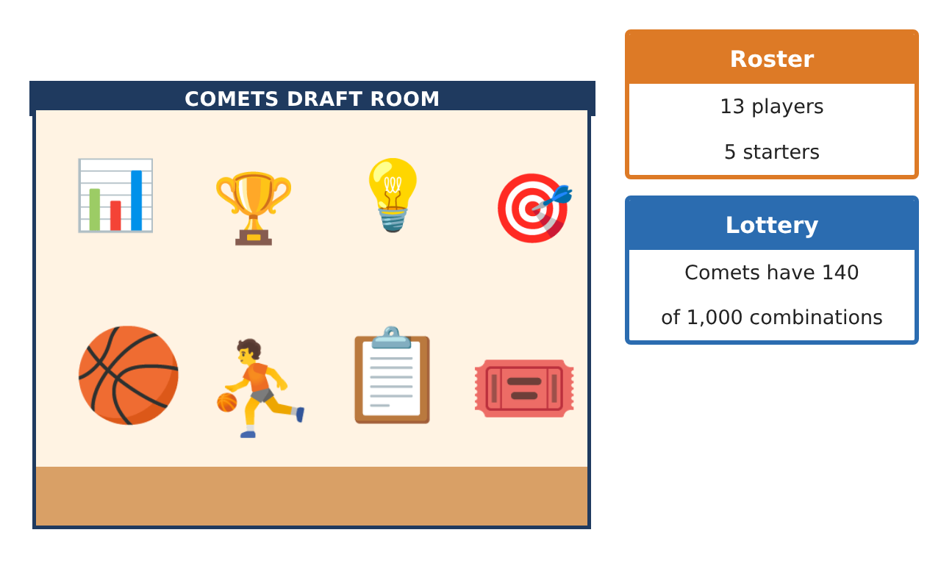
PRECALCULUS · UNIT 8: PROBABILITY
Sports Draft Analytics
Use counting, conditional probability, and expected value to run a basketball team’s draft room.
CP2 Project
2–3 class periods
Name: ______________________________ Group: ______________________________

Slide 2
The Scenario
CP2
The Boston Comets just hired you as their lead analyst. The coach needs lineups, the general manager wants to know the team’s draft lottery odds, and the owner wants to know whether a trade is worth it.
You will use probability and counting to give data-driven answers.
Precalculus · Unit 8: Probability · Sports Draft Analytics

Slide 3
Learning Goals & Timeline
CP2
Learning Goals
Timeline
• I can count outcomes with the counting principle, permutations, and combinations.
• I can find simple and conditional probabilities from data.
• I can compute expected value.
Day 1
Count the Options
Day 2
Draft Data
Day 3
Expected Value
Final
Draft Room Report + reflection
Precalculus · Unit 8: Probability · Sports Draft Analytics

Slide 4
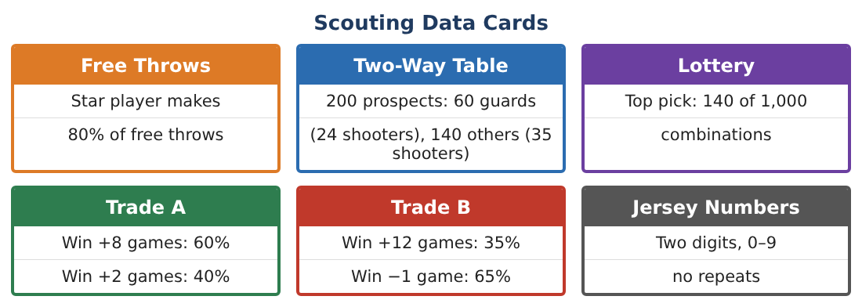
Part 1: Count the Options
CP2
Day 1 · The roster has 13 players.
1. How many two-digit jersey numbers with no repeated digit are possible (first digit can be 0)?
Starter: ___ choices × ___ choices
2. In how many ways can the coach choose 5 starters from 13 players (order does not matter)?
3. In how many ways can the coach choose a captain and a co-captain from 13 players?
4. Explain why the captains question is a permutation and the starters question is a combination.
Precalculus · Unit 8: Probability · Sports Draft Analytics

Slide 5
Part 2: Draft Data
CP2
Day 2 · Use the Two-Way Table card.
5. Make a two-way table: guards/others and shooters/non-shooters.
6. What is P(shooter)?
7. What is P(shooter | guard)?
8. What is the probability that the Comets win the top pick in the lottery?
Precalculus · Unit 8: Probability · Sports Draft Analytics

Slide 6
Part 3: Expected Value
CP2
Day 3 · Use the Trade cards.
9. Find the expected extra wins for Trade A.
10. Find the expected extra wins for Trade B.
11. Which trade would you recommend? Why?
Precalculus · Unit 8: Probability · Sports Draft Analytics

Slide 7
Final Product: Draft Room Report
CP2
Your final product must include:
☐ Counting results with explanations
☐ Two-way table and probabilities
☐ Lottery probability
☐ Expected value of each trade
☐ Draft room report
Precalculus · Unit 8: Probability · Sports Draft Analytics

Slide 8
Scoring Rubric
CP2
Criteria | 4 – Exceeds | 3 – Meets | 2 – Approaching | 1 – Beginning
Mathematical Accuracy | All calculations and solutions are correct; answers include units and are checked. | Nearly all work is correct; minor errors do not change conclusions. | Several errors; some conclusions are affected. | Many errors or missing work.
Reasoning & Justification | Clear, complete explanations connect every answer to the situation; uses precise vocabulary. | Explanations are mostly clear and connected to the situation. | Explanations are brief or partly unclear. | Little or no explanation.
Application & Design | Counts, probabilities, and expected values are correct and used to support draft and trade decisions. Goes beyond the minimum with a creative, realistic choice. | Counts, probabilities, and expected values are correct and used to support draft and trade decisions. | Design is incomplete or only partly uses the math from the unit. | Design is missing or unrelated to the unit math.
Communication & Presentation | Report includes tables, calculations, and clear recommendations. Polished, organized, and visually engaging. | Report includes tables, calculations, and clear recommendations. Organized and easy to follow. | Product is missing required parts or is hard to follow. | Product is mostly missing.
Precalculus · Unit 8: Probability · Sports Draft Analytics

Slide 9
Reflection
CP2
R1. How is P(shooter | guard) different from P(shooter)?
R2. What does expected value tell the owner?
Precalculus · Unit 8: Probability · Sports Draft Analytics

