Slide 1
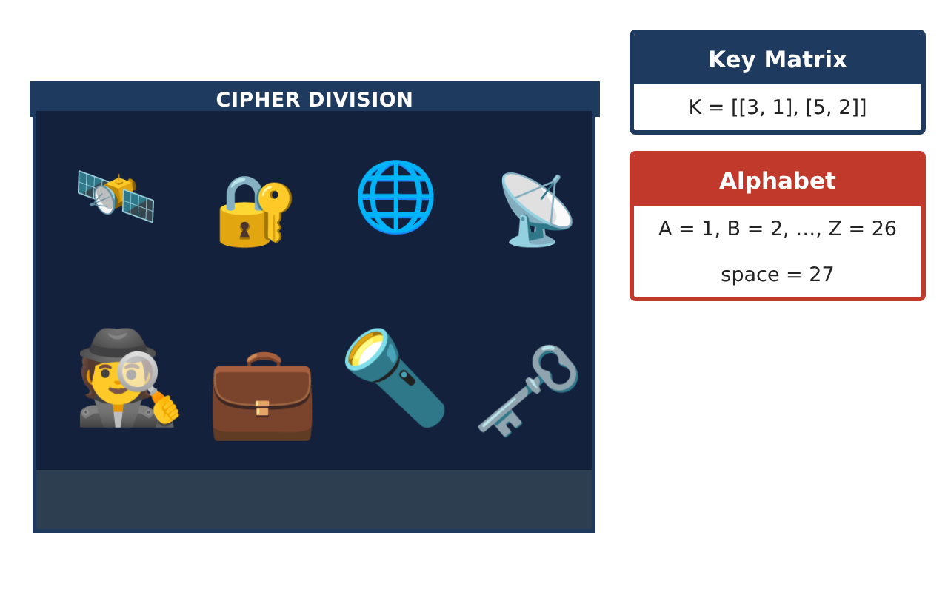
PRECALCULUS · UNIT 6: MATRICES
Spy Agency Codes
Use matrices to manage inventory, encode secret messages, and solve systems.
CP1 Project
2–3 class periods
Name: ______________________________ Group: ______________________________

Slide 2
The Scenario
CP1
Welcome to the Cipher Division. Agents carry gadgets from three warehouses, field reports must be encoded so enemies cannot read them, and supply problems arrive as systems of equations.
You will use matrices to track gadgets, encode and decode messages, and solve supply problems.
Precalculus · Unit 6: Matrices · Spy Agency Codes

Slide 3
Learning Goals & Timeline
CP1
Learning Goals
Timeline
• I can perform matrix operations in context.
• I can find determinants and inverses of 2 × 2 matrices.
• I can encode, decode, and solve systems with matrices.
Day 1
Inventory & Value
Day 2
Encode & Decode
Day 3
Supply Systems
Final
Agent Mission File + reflection
Precalculus · Unit 6: Matrices · Spy Agency Codes

Slide 4
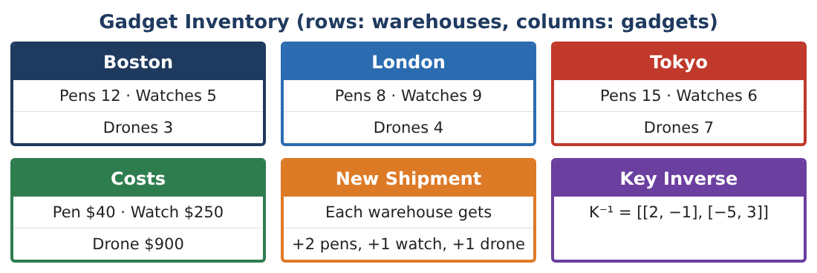
Part 1: Inventory & Value
CP1
Day 1 · Use the Gadget Inventory.
1. Find I + S and the value of each warehouse after the shipment.
2. Prices rise 10%. Write the new cost matrix and find the new Tokyo value for the original inventory.
3. Is I · C the same as C · I? Explain using dimensions.
4. Find the total of each gadget across all warehouses using [1, 1, 1] · I.
Precalculus · Unit 6: Matrices · Spy Agency Codes

Slide 5
Part 2: Encode & Decode
CP1
Day 2 · Key K = [[3, 1], [5, 2]], A = 1, …, Z = 26, space = 27.
5. Find det K and K⁻¹.
6. Encode the message GO NOW in pairs (GO, _N, OW).
7. Decode the message [58, 97], [23, 40].
8. Why must the key have a nonzero determinant?
Precalculus · Unit 6: Matrices · Spy Agency Codes

Slide 6
Part 3: Supply Systems
CP1
Day 3 · Use inverse matrices to solve.
9. A shipment of pens and watches has 30 items and costs $3,510. Write a matrix equation and solve it with an inverse matrix.
10. Check your answer by substitution.
11. Write your mission file with inventory, a coded message for a partner, and the system you solved.
Precalculus · Unit 6: Matrices · Spy Agency Codes

Slide 7
Final Product: Agent Mission File
CP1
Your final product must include:
☐ Inventory operations and values
☐ Determinant and inverse
☐ Encoded message and decoding
☐ Matrix system solved and checked
☐ Mission file
Precalculus · Unit 6: Matrices · Spy Agency Codes

Slide 8
Scoring Rubric
CP1
Criteria | 4 – Exceeds | 3 – Meets | 2 – Approaching | 1 – Beginning
Mathematical Accuracy | All calculations and solutions are correct; answers include units and are checked. | Nearly all work is correct; minor errors do not change conclusions. | Several errors; some conclusions are affected. | Many errors or missing work.
Reasoning & Justification | Clear, complete explanations connect every answer to the situation; uses precise vocabulary. | Explanations are mostly clear and connected to the situation. | Explanations are brief or partly unclear. | Little or no explanation.
Application & Design | Matrix operations, inverses, and determinants are correct and used for inventory, codes, and systems. Goes beyond the minimum with a creative, realistic choice. | Matrix operations, inverses, and determinants are correct and used for inventory, codes, and systems. | Design is incomplete or only partly uses the math from the unit. | Design is missing or unrelated to the unit math.
Communication & Presentation | Mission file includes matrices, coded messages, solved systems, and explanations. Polished, organized, and visually engaging. | Mission file includes matrices, coded messages, solved systems, and explanations. Organized and easy to follow. | Product is missing required parts or is hard to follow. | Product is mostly missing.
Precalculus · Unit 6: Matrices · Spy Agency Codes

Slide 9
Reflection
CP1
R1. What does the determinant tell you about a matrix?
R2. How is solving AX = B with an inverse like solving ax = b?
Precalculus · Unit 6: Matrices · Spy Agency Codes

