Slide 1
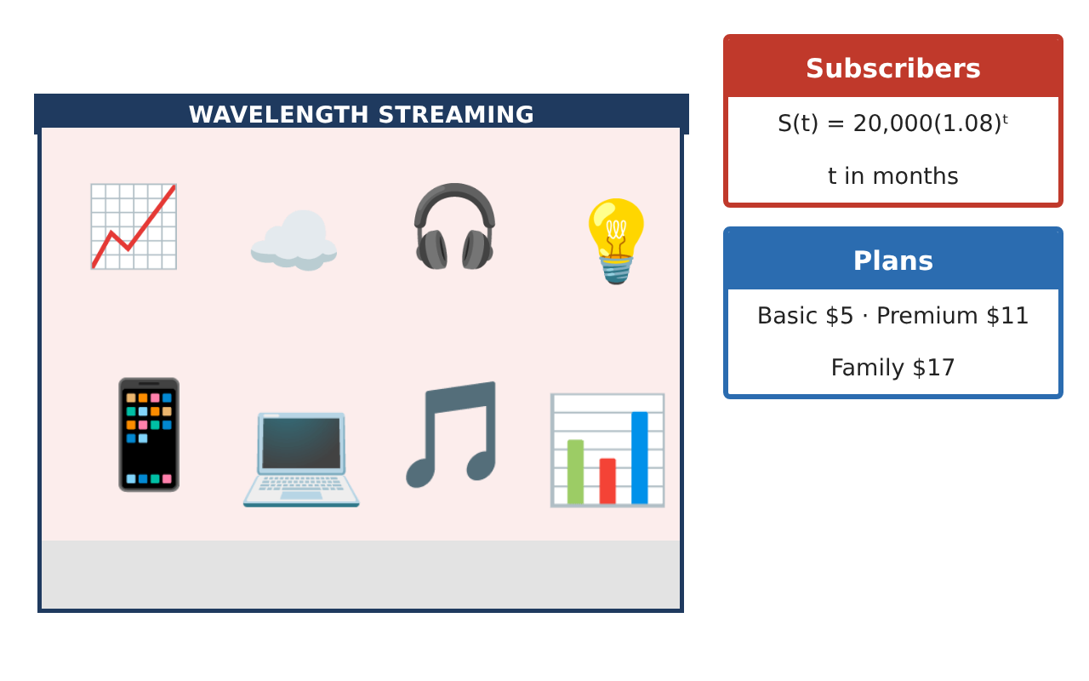
PRECALCULUS · UNIT 2: FUNCTIONS
Streaming Service Analyst
Use function families, transformations, compositions, and inverses to analyze a streaming business.
CP2 Project
2–3 class periods
Name: ______________________________ Group: ______________________________

Slide 2
The Scenario
CP2
You are a data analyst at Wavelength, a new music streaming service. Leadership wants to know how pricing plans work, how fast subscribers are growing, and when the company will reach its goals.
You will use functions to model the business and present your findings.
Precalculus · Unit 2: Functions · Streaming Service Analyst

Slide 3
Learning Goals & Timeline
CP2
Learning Goals
Timeline
• I can identify domain and range and evaluate functions.
• I can describe transformations of a graph.
• I can use exponential models to make predictions.
Day 1
Plans as Functions
Day 2
Transformations
Day 3
Growth
Final
Analyst Briefing + reflection
Precalculus · Unit 2: Functions · Streaming Service Analyst

Slide 4
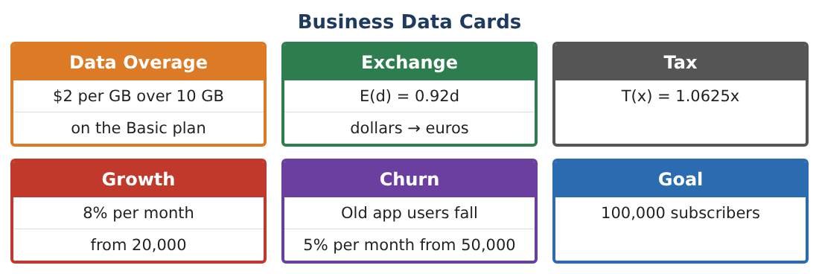
Part 1: Plans as Functions
CP2
Day 1 · Basic costs $5 per month plus $2 for each GB over 10 GB.
1. Write the cost C(g) for g GB if g ≤ 10 and if g > 10.
2. Find C(6), C(10), and C(14).
3. What is a sensible domain and range for C?
4. Is C a function? Explain.
Precalculus · Unit 2: Functions · Streaming Service Analyst

Slide 5
Part 2: Transformations
CP2
Day 2 · The parent graph is y = x².
5. Describe how y = (x − 3)² + 2 is related to y = x².
6. Describe y = −2x².
7. Write the equation of y = |x| shifted left 4 and down 1.
8. Basic’s price rises $1 per month. How does the graph of C change?
Precalculus · Unit 2: Functions · Streaming Service Analyst

Slide 6
Part 3: Growth
CP2
Day 3 · S(t) = 20,000(1.08)ᵗ.
9. Find S(6) and S(12). Round to the nearest subscriber.
10. Use a table to find the first month the subscribers reach 100,000.
11. Is this growth linear or exponential? How do you know?
Precalculus · Unit 2: Functions · Streaming Service Analyst

Slide 7
Final Product: Analyst Briefing
CP2
Your final product must include:
☐ Piecewise plan cost with a graph
☐ Transformation descriptions
☐ Subscriber predictions
☐ Month the goal is reached
☐ One-page briefing
Precalculus · Unit 2: Functions · Streaming Service Analyst

Slide 8
Scoring Rubric
CP2
Criteria | 4 – Exceeds | 3 – Meets | 2 – Approaching | 1 – Beginning
Mathematical Accuracy | All calculations and solutions are correct; answers include units and are checked. | Nearly all work is correct; minor errors do not change conclusions. | Several errors; some conclusions are affected. | Many errors or missing work.
Reasoning & Justification | Clear, complete explanations connect every answer to the situation; uses precise vocabulary. | Explanations are mostly clear and connected to the situation. | Explanations are brief or partly unclear. | Little or no explanation.
Application & Design | Functions, transformations, compositions, inverses, and exponential models are built and interpreted correctly. Goes beyond the minimum with a creative, realistic choice. | Functions, transformations, compositions, inverses, and exponential models are built and interpreted correctly. | Design is incomplete or only partly uses the math from the unit. | Design is missing or unrelated to the unit math.
Communication & Presentation | Briefing includes models, graphs, calculations, and a recommendation. Polished, organized, and visually engaging. | Briefing includes models, graphs, calculations, and a recommendation. Organized and easy to follow. | Product is missing required parts or is hard to follow. | Product is mostly missing.
Precalculus · Unit 2: Functions · Streaming Service Analyst

Slide 9
Reflection
CP2
R1. How does a piecewise function model a real price plan?
R2. Why does exponential growth start slow and then speed up?
Precalculus · Unit 2: Functions · Streaming Service Analyst

