Slide 1
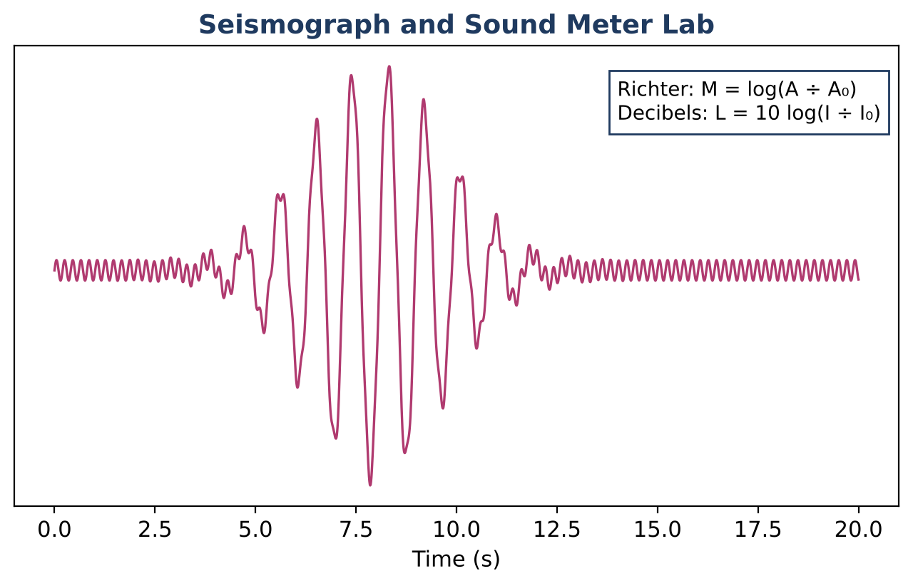
ALGEBRA 2 · UNIT 6: EXPONENTIAL & LOGARITHMIC FUNCTIONS
Earthquake & Sound Lab
Use logarithms and exponential models to compare earthquakes, sounds, and ancient bones.
CP1 Project
2–3 class periods
Name: ______________________ Group: ______________________

Slide 2
The Scenario
CP1
Scientists measure huge ranges of values: tiny tremors and enormous earthquakes, whispers and jet engines. Logarithmic scales squeeze these ranges into small numbers.
You will compare quakes and sounds, date ancient bones with carbon-14, model cooling, and present what you learn on a safety poster.
Algebra 2 · Unit 6: Exponential & Logarithmic Functions · Earthquake & Sound Lab

Slide 3
Learning Goals & Timeline
CP1
Learning Goals
Timeline
• I can solve exponential equations using logarithms.
• I can use log properties to rewrite expressions.
• I can model with exponential decay and Newton's law of cooling.
Day 1
Log Scales
Day 2
Solve with Logs
Day 3
Safety Poster
Final
Science Safety Poster + reflection
Algebra 2 · Unit 6: Exponential & Logarithmic Functions · Earthquake & Sound Lab

Slide 4
Part 1: Log Scales
CP1
Day 1 · Use the formulas on the hero image.
1. Compare the amplitudes of magnitude 6.8 and 5.3 quakes.
2. Each increase of 1 in magnitude multiplies the energy by about 10¹·⁵ ≈ 31.6. About how many times more energy does a magnitude 7 release than a magnitude 5?
3. Condense log 2 + log 50 and expand log(100x³).
Algebra 2 · Unit 6: Exponential & Logarithmic Functions · Earthquake & Sound Lab

Slide 5
Part 2: Solve with Logs
CP1
Day 2 · Carbon-14: A = A₀(0.5)ⁿ, where n = t ÷ 5730 is the number of half-lives.
4. A fossil has 30% of its carbon-14 left. Solve for its age with logarithms.
5. Coffee cools by T = 70 + 130e⁻⁰·⁰⁸ᵗ (°F, minutes). When will it reach 100°F?
6. Solve 2ˣ⁺³ = 50.
Algebra 2 · Unit 6: Exponential & Logarithmic Functions · Earthquake & Sound Lab

Slide 6
Part 3: Safety Poster
CP1
Day 3 · Create a poster with log comparisons and one model.
7. Compare three events with log scales.
8. Include one exponential model solved with logs.
9. Write a safety message for the public.
Algebra 2 · Unit 6: Exponential & Logarithmic Functions · Earthquake & Sound Lab

Slide 7
Final Product: Science Safety Poster
CP1
Your final product must include:
☐ Log-scale comparisons
☐ Solved exponential equations
☐ Poster
Algebra 2 · Unit 6: Exponential & Logarithmic Functions · Earthquake & Sound Lab

Slide 8
Scoring Rubric
CP1
Criteria | 4 – Exceeds | 3 – Meets | 2 – Approaching | 1 – Beginning
Mathematical Accuracy | All calculations and solutions are correct; answers include units and are checked. | Nearly all work is correct; minor errors do not change conclusions. | Several errors; some conclusions are affected. | Many errors or missing work.
Reasoning & Justification | Clear, complete explanations connect every answer to the situation; uses precise vocabulary. | Explanations are mostly clear and connected to the situation. | Explanations are brief or partly unclear. | Little or no explanation.
Application & Design | Comparisons and models are correct and explained in plain language for the public. Goes beyond the minimum with a creative, realistic choice. | Comparisons and models are correct and explained in plain language for the public. | Design is incomplete or only partly uses the math from the unit. | Design is missing or unrelated to the unit math.
Communication & Presentation | Poster shows the log scales, at least three comparisons with work, and an exponential model solved with logarithms. Polished, organized, and visually engaging. | Poster shows the log scales, at least three comparisons with work, and an exponential model solved with logarithms. Organized and easy to follow. | Product is missing required parts or is hard to follow. | Product is mostly missing.
Algebra 2 · Unit 6: Exponential & Logarithmic Functions · Earthquake & Sound Lab

Slide 9
Reflection
CP1
R1. How do logarithms undo exponents?
R2. Why does the coffee never cool below 70°F in the model?
Algebra 2 · Unit 6: Exponential & Logarithmic Functions · Earthquake & Sound Lab

