Slide 1
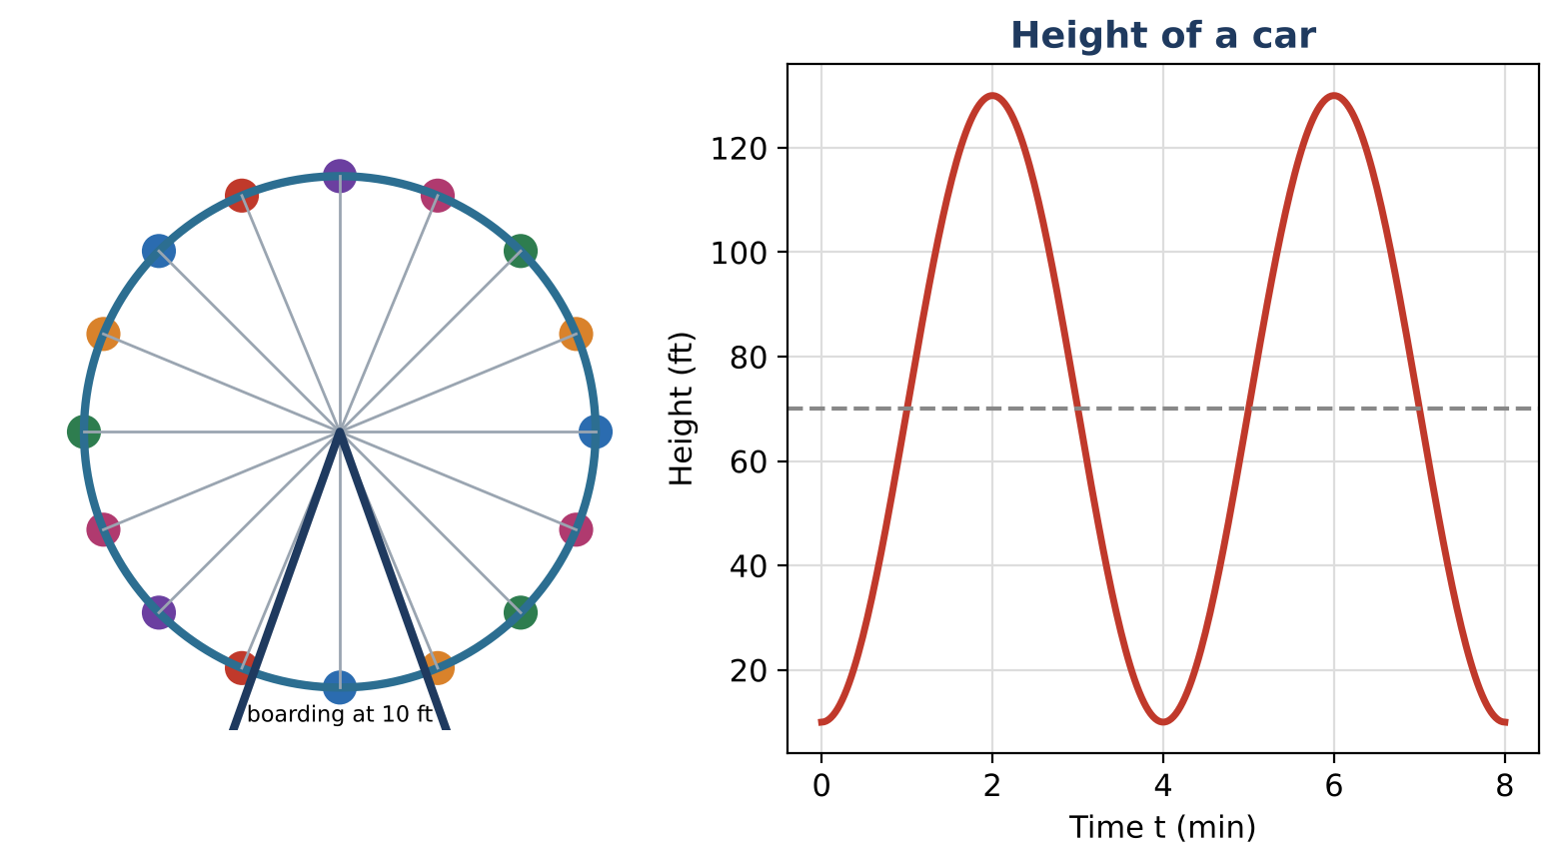
ALGEBRA 2 · UNIT 10: TRIGONOMETRIC FUNCTIONS
Ferris Wheel & Tides
Model a Ferris wheel ride and ocean tides with sine and cosine functions.
CP1 Project
2–3 class periods
Name: ______________________ Group: ______________________

Slide 2
The Scenario
CP1
The Bayside Fair has a Ferris wheel 120 ft across with its center 70 ft above the ground. It turns once every 4 minutes, and riders board at the bottom, 10 ft up.
Next to the fair, the harbor's depth rises and falls with the tide. Both repeat in cycles, so both can be modeled with sine and cosine.
Algebra 2 · Unit 10: Trigonometric Functions · Ferris Wheel & Tides

Slide 3
Learning Goals & Timeline
CP1
Learning Goals
Timeline
• I can write sinusoidal models from descriptions.
• I can solve trig equations in context.
• I can interpret parameters.
Day 1
The Wheel
Day 2
Tides
Day 3
Design a Ride
Final
Ride & Harbor Report + reflection
Algebra 2 · Unit 10: Trigonometric Functions · Ferris Wheel & Tides

Slide 4
Part 1: The Wheel
CP1
Day 1 · Diameter 120 ft, center 70 ft, one turn every 4 minutes, boarding at the bottom.
1. Write h(t) and explain each number. Why is B = ½π?
2. Find h(0.5) and h(1.5) exactly.
3. For how long during each turn is a rider above 100 ft? Solve 70 − 60 cos(½πt) = 100.
Algebra 2 · Unit 10: Trigonometric Functions · Ferris Wheel & Tides

Slide 5
Part 2: Tides
CP1
Day 2 · d(t) = 4 sin(⅙πt) + 10 (feet, hours after midnight).
4. A boat needs at least 8 ft of water. Solve d(t) = 8 for 0 ≤ t ≤ 12.
5. When can the boat use the harbor during the first 12 hours?
6. Rewrite the model if high tide were at 5 a.m. instead (same amplitude, midline, and period).
Algebra 2 · Unit 10: Trigonometric Functions · Ferris Wheel & Tides

Slide 6
Part 3: Design a Ride
CP1
Day 3 · Design a wheel with at least 20 s above 80% of its maximum height each turn.
7. Write your model.
8. Solve for the time above 80% of the maximum height.
9. Present the design.
Algebra 2 · Unit 10: Trigonometric Functions · Ferris Wheel & Tides

Slide 7
Final Product: Ride & Harbor Report
CP1
Your final product must include:
☐ Equation with explanation
☐ Solved timing questions
☐ Tide window
☐ Design
Algebra 2 · Unit 10: Trigonometric Functions · Ferris Wheel & Tides

Slide 8
Scoring Rubric
CP1
Criteria | 4 – Exceeds | 3 – Meets | 2 – Approaching | 1 – Beginning
Mathematical Accuracy | All calculations and solutions are correct; answers include units and are checked. | Nearly all work is correct; minor errors do not change conclusions. | Several errors; some conclusions are affected. | Many errors or missing work.
Reasoning & Justification | Clear, complete explanations connect every answer to the situation; uses precise vocabulary. | Explanations are mostly clear and connected to the situation. | Explanations are brief or partly unclear. | Little or no explanation.
Application & Design | Designed ride's function matches its description, and timing answers are found by solving trig equations. Goes beyond the minimum with a creative, realistic choice. | Designed ride's function matches its description, and timing answers are found by solving trig equations. | Design is incomplete or only partly uses the math from the unit. | Design is missing or unrelated to the unit math.
Communication & Presentation | Report includes both models with amplitude, midline, and period explained, a graph, and solved timing questions. Polished, organized, and visually engaging. | Report includes both models with amplitude, midline, and period explained, a graph, and solved timing questions. Organized and easy to follow. | Product is missing required parts or is hard to follow. | Product is mostly missing.
Algebra 2 · Unit 10: Trigonometric Functions · Ferris Wheel & Tides

Slide 9
Reflection
CP1
R1. How do you get B from the period?
R2. Why do trig equations have many solutions?
Algebra 2 · Unit 10: Trigonometric Functions · Ferris Wheel & Tides

