Slide 1
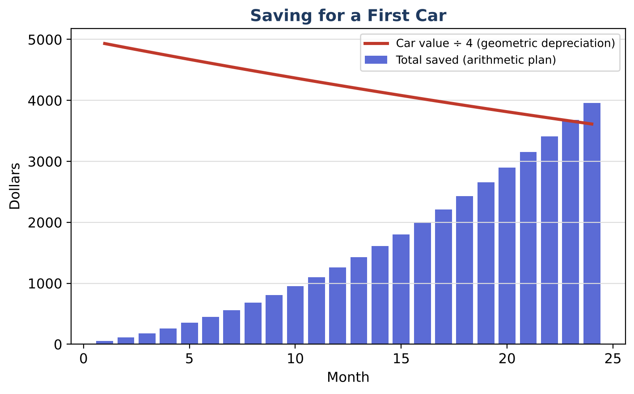
ALGEBRA 2 · UNIT 8: SEQUENCES & SERIES
First Car Savings Plan
Plan savings and payments for a first car with sequences and series.
CP1 Project
2–3 class periods
Name: ______________________ Group: ______________________

Slide 2
The Scenario
CP1
You want to buy a used car in two years. You can save a little more each month, your bank pays interest, and the car you want loses value every year.
Arithmetic sequences describe steady increases, geometric sequences describe percent changes, and series add them up. You will build a complete plan.
Algebra 2 · Unit 8: Sequences & Series · First Car Savings Plan

Slide 3
Learning Goals & Timeline
CP1
Learning Goals
Timeline
• I can use arithmetic and geometric series formulas and sigma notation.
• I can solve for the number of terms.
• I can compare financial plans.
Day 1
Saving Up
Day 2
Cars & Bounces
Day 3
Your Plan
Final
Car Buying Plan + reflection
Algebra 2 · Unit 8: Sequences & Series · First Car Savings Plan

Slide 4
Part 1: Saving Up
CP1
Day 1 · Plan A: $50 the first month, increasing by $10 each month.
1. Write the total for 24 months in sigma notation and evaluate it.
2. After how many months will the total first reach $5,000?
3. Plan B: deposit $200 each month into an account that pays 0.5% per month. After 24 months, the value is 200(1.005²⁴ − 1) ÷ 0.005. Evaluate it and explain why it is a geometric series.
Algebra 2 · Unit 8: Sequences & Series · First Car Savings Plan

Slide 5
Part 2: Cars & Bounces
CP1
Day 2 · Geometric models.
4. The car loses 15% per year from $20,000. In which year is it first worth less than $10,000?
5. Write the depreciation as a recursive rule.
6. Find the total distance traveled by a ball dropped from 6 ft that rebounds to 60% each bounce.
Algebra 2 · Unit 8: Sequences & Series · First Car Savings Plan

Slide 6
Part 3: Your Plan
CP1
Day 3 · Compare Plan A and Plan B and choose a car.
7. Compare the two plans after 24 months.
8. Choose a car and year and decide which plan (or combination) works.
9. Write the plan with sigma notation for one total.
Algebra 2 · Unit 8: Sequences & Series · First Car Savings Plan

Slide 7
Final Product: Car Buying Plan
CP1
Your final product must include:
☐ Sigma notation and totals
☐ Months-to-goal solution
☐ Plan comparison
☐ Car plan
Algebra 2 · Unit 8: Sequences & Series · First Car Savings Plan

Slide 8
Scoring Rubric
CP1
Criteria | 4 – Exceeds | 3 – Meets | 2 – Approaching | 1 – Beginning
Mathematical Accuracy | All calculations and solutions are correct; answers include units and are checked. | Nearly all work is correct; minor errors do not change conclusions. | Several errors; some conclusions are affected. | Many errors or missing work.
Reasoning & Justification | Clear, complete explanations connect every answer to the situation; uses precise vocabulary. | Explanations are mostly clear and connected to the situation. | Explanations are brief or partly unclear. | Little or no explanation.
Application & Design | Models are correct sequences or series, and the decision uses the totals correctly. Goes beyond the minimum with a creative, realistic choice. | Models are correct sequences or series, and the decision uses the totals correctly. | Design is incomplete or only partly uses the math from the unit. | Design is missing or unrelated to the unit math.
Communication & Presentation | Plan includes savings and depreciation models, totals using series, and a final decision with a timeline. Polished, organized, and visually engaging. | Plan includes savings and depreciation models, totals using series, and a final decision with a timeline. Organized and easy to follow. | Product is missing required parts or is hard to follow. | Product is mostly missing.
Algebra 2 · Unit 8: Sequences & Series · First Car Savings Plan

Slide 9
Reflection
CP1
R1. Why does Plan B's total come from a geometric series?
R2. When does an infinite geometric series have a sum?
Algebra 2 · Unit 8: Sequences & Series · First Car Savings Plan

