Slide 1
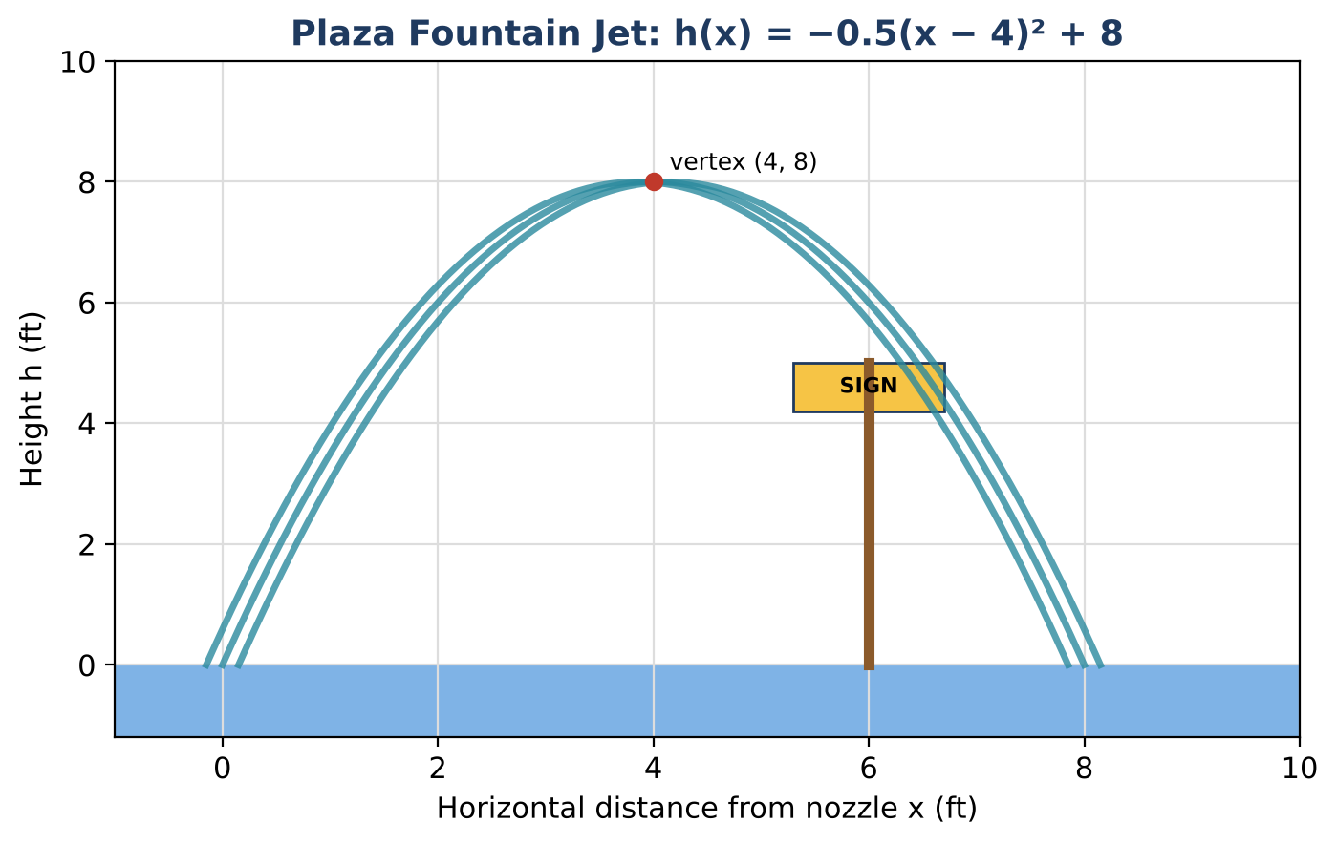
ALGEBRA 2 · UNIT 3: QUADRATIC FUNCTIONS & COMPLEX NUMBERS
Fountain Designer
Design plaza fountains with quadratic functions, inequalities, and complex numbers.
Honors Project
2–3 class periods
Name: ______________________ Group: ______________________

Slide 2
The Scenario
Honors
The town is building a plaza fountain, and the design firm has asked students to plan the water jets. Each jet of water follows a parabola.
Designers need to know how high the water goes, where it lands, whether it clears a sign, and when it can never reach a certain height. Some answers will turn out to be complex numbers, and you will learn what that means.
Algebra 2 · Unit 3: Quadratic Functions & Complex Numbers · Fountain Designer

Slide 3
Learning Goals & Timeline
Honors
Learning Goals
Timeline
• I can solve quadratic systems and compound quadratic inequalities.
• I can describe complex solutions as functions of a parameter.
• I can design under several constraints and justify it.
Day 1
Two Crossing Jets
Day 2
Complex Heights
Day 3
Design a Two-Jet Fountain
Final
Fountain Design Proposal + reflection
Algebra 2 · Unit 3: Quadratic Functions & Complex Numbers · Fountain Designer

Slide 4
Part 1: Two Crossing Jets
Honors
Day 1 · h(x) = −0.5(x − 4)² + 8 and g(x) = −0.5(x − 6)² + 8.
1. Find where the two jets cross and the height there.
2. Find where both jets are above 7 ft at the same time.
3. Write g(x) as a transformation of h(x).
Algebra 2 · Unit 3: Quadratic Functions & Complex Numbers · Fountain Designer

Slide 5
Part 2: Complex Heights
Honors
Day 2 · Let k be a target height.
4. Solve h(x) = k for x in terms of k.
5. For which k are the solutions real and different, equal, or complex? Interpret each case.
6. For k = 10, find the solutions and verify that their sum and product match the coefficients of the equation.
7. Simplify (3 − 2i) ÷ (1 + i) by multiplying by the conjugate.
Algebra 2 · Unit 3: Quadratic Functions & Complex Numbers · Fountain Designer

Slide 6
Part 3: Design a Two-Jet Fountain
Honors
Day 3 · Two jets start 12 ft apart, cross at a height of at least 6 ft, and never exceed 10 ft.
8. Write both jets and find where they cross.
9. Prove the max-height rule with a discriminant.
10. Present the design with a graph.
Algebra 2 · Unit 3: Quadratic Functions & Complex Numbers · Fountain Designer

Slide 7
Final Product: Fountain Design Proposal
Honors
Your final product must include:
☐ Crossing point and the overlap interval
☐ Complex solutions in terms of k
☐ Two-jet design with proofs
☐ Proposal
Algebra 2 · Unit 3: Quadratic Functions & Complex Numbers · Fountain Designer

Slide 8
Scoring Rubric
Honors
Criteria | 4 – Exceeds | 3 – Meets | 2 – Approaching | 1 – Beginning
Mathematical Accuracy | All calculations and solutions are correct; answers include units and are checked. | Nearly all work is correct; minor errors do not change conclusions. | Several errors; some conclusions are affected. | Many errors or missing work.
Reasoning & Justification | Clear, complete explanations connect every answer to the situation; uses precise vocabulary. | Explanations are mostly clear and connected to the situation. | Explanations are brief or partly unclear. | Little or no explanation.
Application & Design | Fountain design meets every requirement, with complex or real solutions interpreted correctly. Goes beyond the minimum with a creative, realistic choice. | Fountain design meets every requirement, with complex or real solutions interpreted correctly. | Design is incomplete or only partly uses the math from the unit. | Design is missing or unrelated to the unit math.
Communication & Presentation | Proposal includes each jet's equation in two forms, the key features, and solutions to the design questions. Polished, organized, and visually engaging. | Proposal includes each jet's equation in two forms, the key features, and solutions to the design questions. Organized and easy to follow. | Product is missing required parts or is hard to follow. | Product is mostly missing.
Algebra 2 · Unit 3: Quadratic Functions & Complex Numbers · Fountain Designer

Slide 9
Reflection
Honors
R1. How does the vertex form show that complex solutions start exactly at the maximum height?
R2. Why do the jets cross exactly halfway between their peaks?
Algebra 2 · Unit 3: Quadratic Functions & Complex Numbers · Fountain Designer

