Slide 1
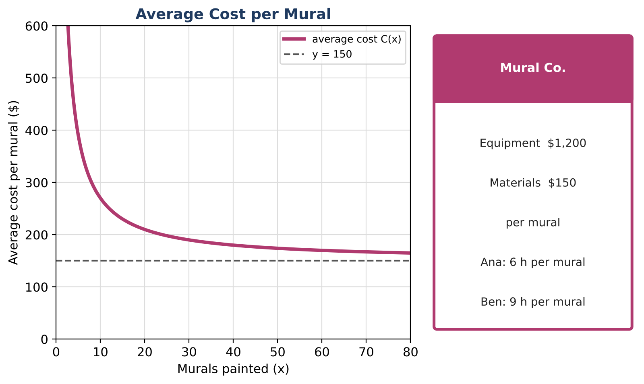
ALGEBRA 2 · UNIT 7: RATIONAL FUNCTIONS
Mural Business
Run a mural-painting business with rational functions, work rates, and rational equations.
CP2 Project
2–3 class periods
Name: ______________________ Group: ______________________

Slide 2
The Scenario
CP2
You and your friends are starting a mural business. Equipment costs $1,200 once, and materials cost $150 per mural. The more murals you paint, the lower your average cost per mural.
You will also schedule painters who work at different speeds and plan your travel. Every question leads to a rational function or equation.
Algebra 2 · Unit 7: Rational Functions · Mural Business

Slide 3
Learning Goals & Timeline
CP2
Learning Goals
Timeline
• I can evaluate and graph a rational function and interpret its asymptote.
• I can solve work-rate problems.
• I can use inverse variation.
Day 1
Average Cost
Day 2
Painters & Rates
Day 3
Business Plan
Final
Business Plan + reflection
Algebra 2 · Unit 7: Rational Functions · Mural Business

Slide 4
Part 1: Average Cost
CP2
Day 1 · Average cost per mural: C(x) = (1200 + 150x) ÷ x.
1. Complete the table.
2. What value does C(x) get close to as x gets large? Why does that make sense?
3. How many murals must you paint for the average cost to be $190?
4. Why is x = 0 not in the domain?
Murals x | 1 | 5 | 10 | 30 | 60
C(x) ($)
Algebra 2 · Unit 7: Rational Functions · Mural Business

Slide 5
Part 2: Painters & Rates
CP2
Day 2 · Ana paints a mural in 6 hours, so she paints ⅙ of a mural per hour. Ben takes 9 hours.
5. What fraction of a mural does Ben paint per hour?
6. Working together, how long do Ana and Ben take? Solve ⅙ + ⅑ = 1 ÷ t.
7. With Cara, all three finish in 2.4 hours. How long would Cara take alone?
8. A big wall takes 24 painter-days: days = 24 ÷ (painters). How many days with 4 painters? With 6?
Algebra 2 · Unit 7: Rational Functions · Mural Business

Slide 6
Part 3: Business Plan
CP2
Day 3 · Plan your first season.
9. Choose a price per mural. How many murals do you need so that the price is at least $50 more than the average cost?
10. Choose a team and find how long one mural takes together.
11. Write a short business plan.
Algebra 2 · Unit 7: Rational Functions · Mural Business

Slide 7
Final Product: Business Plan
CP2
Your final product must include:
☐ Average cost graph with the asymptote labeled
☐ Team schedule
☐ Price and goal
☐ Business plan
Algebra 2 · Unit 7: Rational Functions · Mural Business

Slide 8
Scoring Rubric
CP2
Criteria | 4 – Exceeds | 3 – Meets | 2 – Approaching | 1 – Beginning
Mathematical Accuracy | All calculations and solutions are correct; answers include units and are checked. | Nearly all work is correct; minor errors do not change conclusions. | Several errors; some conclusions are affected. | Many errors or missing work.
Reasoning & Justification | Clear, complete explanations connect every answer to the situation; uses precise vocabulary. | Explanations are mostly clear and connected to the situation. | Explanations are brief or partly unclear. | Little or no explanation.
Application & Design | Prices and schedules are based on correctly solved rational equations, with extraneous solutions rejected. Goes beyond the minimum with a creative, realistic choice. | Prices and schedules are based on correctly solved rational equations, with extraneous solutions rejected. | Design is incomplete or only partly uses the math from the unit. | Design is missing or unrelated to the unit math.
Communication & Presentation | Plan includes the average cost function with asymptotes, work-rate schedules, and a pricing decision supported by equations. Polished, organized, and visually engaging. | Plan includes the average cost function with asymptotes, work-rate schedules, and a pricing decision supported by equations. Organized and easy to follow. | Product is missing required parts or is hard to follow. | Product is mostly missing.
Algebra 2 · Unit 7: Rational Functions · Mural Business

Slide 9
Reflection
CP2
R1. Why can the average cost never reach $150?
R2. Why do we add rates and not times?
Algebra 2 · Unit 7: Rational Functions · Mural Business

