Slide 1
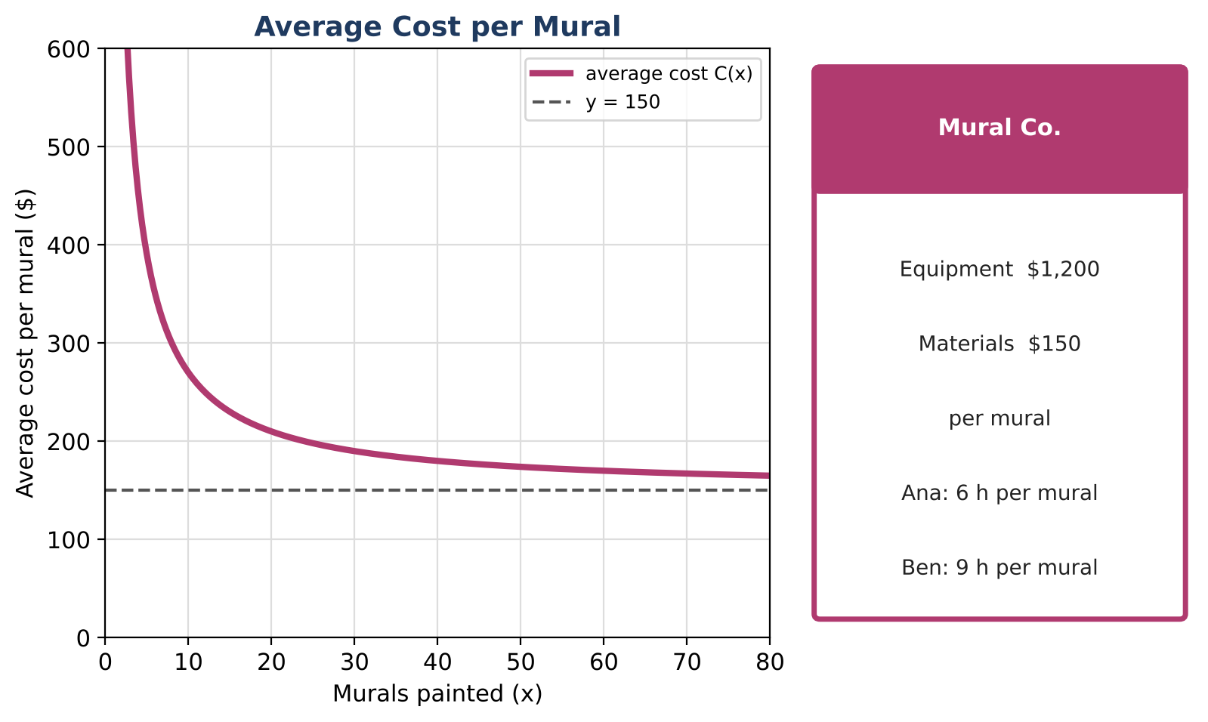
ALGEBRA 2 · UNIT 7: RATIONAL FUNCTIONS
Mural Business
Run a mural-painting business with rational functions, work rates, and rational equations.
Honors Project
2–3 class periods
Name: ______________________ Group: ______________________

Slide 2
The Scenario
Honors
You and your friends are starting a mural business. Equipment costs $1,200 once, and materials cost $150 per mural. The more murals you paint, the lower your average cost per mural.
You will also schedule painters who work at different speeds and plan your travel. Every question leads to a rational function or equation.
Algebra 2 · Unit 7: Rational Functions · Mural Business

Slide 3
Learning Goals & Timeline
Honors
Learning Goals
Timeline
• I can solve rational equations and inequalities in context.
• I can analyze rational functions completely.
• I can design a pricing model with a rational function.
Day 1
Cost Analysis
Day 2
Hard Equations
Day 3
Design a Pricing Model
Final
Business Plan + reflection
Algebra 2 · Unit 7: Rational Functions · Mural Business

Slide 4
Part 1: Cost Analysis
Honors
Day 1 · C(x) = (1200 + 150x) ÷ x and a larger studio C₂(x) = (3000 + 120x) ÷ x.
1. Solve C(x) < 175 and interpret the answer.
2. Find where C(x) = C₂(x) and explain which studio to choose for different seasons.
3. Graph both and describe all asymptotes, intercepts, and end behavior.
Algebra 2 · Unit 7: Rational Functions · Mural Business

Slide 5
Part 2: Hard Equations
Honors
Day 2 · Check every solution.
4. One painter takes 5 hours longer than another. Together they finish in 6 hours. Find each painter's time.
5. Solve 60 ÷ r + 60 ÷ (r + 10) = 2.7 and interpret both roots.
6. Solve x ÷ (x − 3) − 3 ÷ (x + 3) = 18 ÷ (x² − 9).
Algebra 2 · Unit 7: Rational Functions · Mural Business

Slide 6
Part 3: Design a Pricing Model
Honors
Day 3 · Offer a discount: price per mural P(x) = 400 − 600 ÷ (x + 2) for an order of x murals.
7. Find the profit per mural, P(x) − C(x), and simplify into one rational expression.
8. For what order sizes is the profit per mural at least $100? (Use a table or solve.)
9. Write your recommendation.
Algebra 2 · Unit 7: Rational Functions · Mural Business

Slide 7
Final Product: Business Plan
Honors
Your final product must include:
☐ Inequality and comparison analysis
☐ Solved equations with extraneous solutions identified
☐ Profit-per-mural model
☐ Recommendation
Algebra 2 · Unit 7: Rational Functions · Mural Business

Slide 8
Scoring Rubric
Honors
Criteria | 4 – Exceeds | 3 – Meets | 2 – Approaching | 1 – Beginning
Mathematical Accuracy | All calculations and solutions are correct; answers include units and are checked. | Nearly all work is correct; minor errors do not change conclusions. | Several errors; some conclusions are affected. | Many errors or missing work.
Reasoning & Justification | Clear, complete explanations connect every answer to the situation; uses precise vocabulary. | Explanations are mostly clear and connected to the situation. | Explanations are brief or partly unclear. | Little or no explanation.
Application & Design | Prices and schedules are based on correctly solved rational equations, with extraneous solutions rejected. Goes beyond the minimum with a creative, realistic choice. | Prices and schedules are based on correctly solved rational equations, with extraneous solutions rejected. | Design is incomplete or only partly uses the math from the unit. | Design is missing or unrelated to the unit math.
Communication & Presentation | Plan includes the average cost function with asymptotes, work-rate schedules, and a pricing decision supported by equations. Polished, organized, and visually engaging. | Plan includes the average cost function with asymptotes, work-rate schedules, and a pricing decision supported by equations. Organized and easy to follow. | Product is missing required parts or is hard to follow. | Product is mostly missing.
Algebra 2 · Unit 7: Rational Functions · Mural Business

Slide 9
Reflection
Honors
R1. Why might a rational equation produce an extraneous solution?
R2. How do asymptotes guide business decisions?
Algebra 2 · Unit 7: Rational Functions · Mural Business

