Slide 1
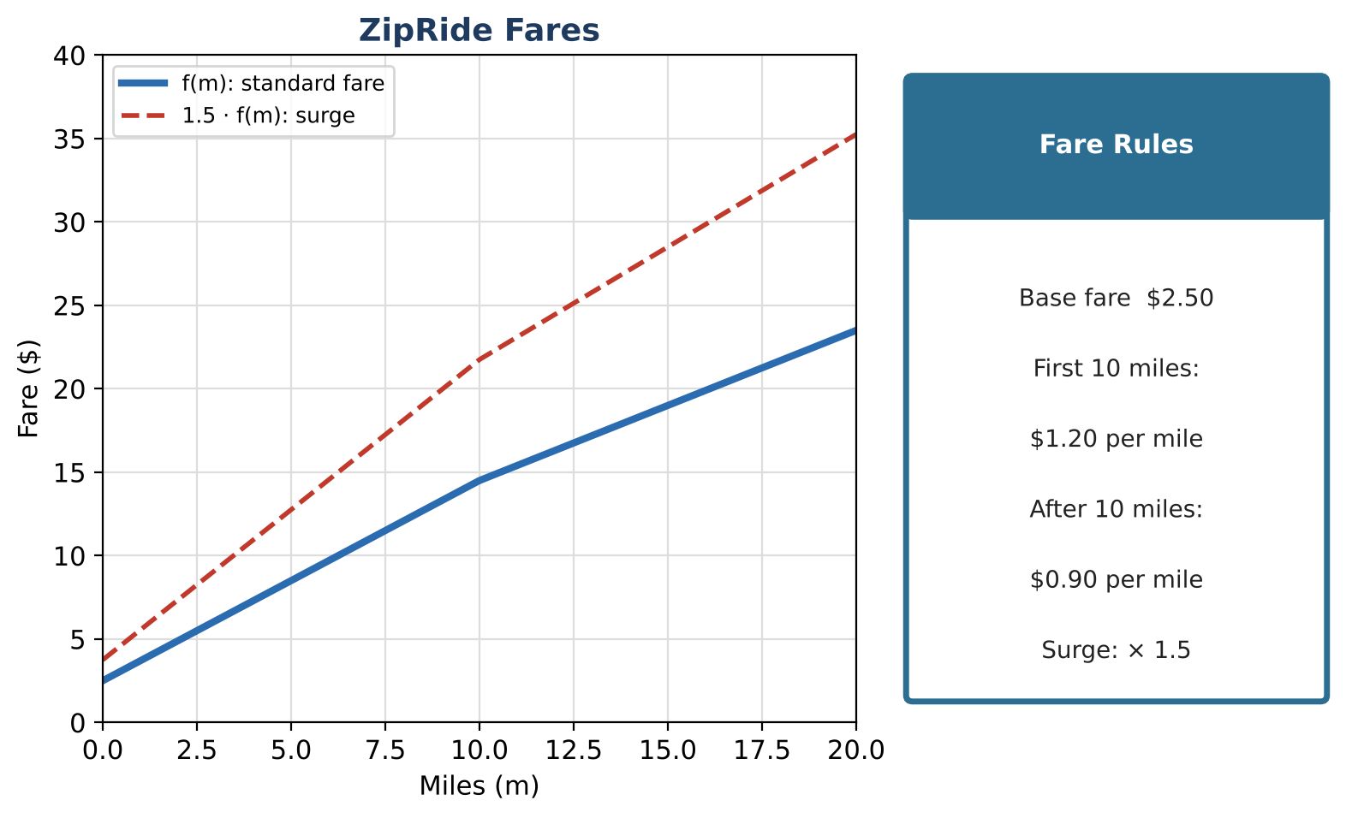
ALGEBRA 2 · UNIT 1: FUNCTIONS & TRANSFORMATIONS
Ride-Share Pricing Lab
Model ride fares with piecewise functions, transformations, composition, and inverses.
CP1 Project
2–3 class periods
Name: ______________________ Group: ______________________

Slide 2
The Scenario
CP1
ZipRide is a new ride-share app in town. Its fare depends on miles traveled, but the rate changes after 10 miles, during busy times there is a surge multiplier, and the app is considering a booking fee.
Every one of these rules is a function idea: piecewise definitions, transformations, composition, and inverses. You will analyze ZipRide and then design a plan for a competitor.
Algebra 2 · Unit 1: Functions & Transformations · Ride-Share Pricing Lab

Slide 3
Learning Goals & Timeline
CP1
Learning Goals
Timeline
• I can write and graph piecewise functions.
• I can apply transformations and compositions.
• I can find inverses of piecewise functions.
Day 1
The Fare Function
Day 2
Compose & Invert
Day 3
Design a Competitor
Final
Pricing Plan Pitch + reflection
Algebra 2 · Unit 1: Functions & Transformations · Ride-Share Pricing Lab

Slide 4
Part 1: The Fare Function
CP1
Day 1 · Use the Fare Rules card.
1. Write f(m) as a piecewise function and simplify the second piece to the form am + b.
2. Show that the two pieces meet at m = 10 (the function is continuous).
3. Find the average rate of change from m = 5 to m = 15.
4. Graph f and the surge function 1.5 · f on one set of axes. What changes and what stays the same?
Algebra 2 · Unit 1: Functions & Transformations · Ride-Share Pricing Lab

Slide 5
Part 2: Compose & Invert
CP1
Day 2 · Write rules, not just values.
5. With m(t) = 0.4t, write f(m(t)) for the first 25 minutes. What does the slope mean?
6. Find f⁻¹(c) for each piece and state the domain of each piece of the inverse.
7. Use f⁻¹ to find how far a rider can go for $19.00 and for $11.50.
8. A competitor charges g(m) = 3.00 + 1.10m for any distance. For which trip lengths is the competitor cheaper?
Algebra 2 · Unit 1: Functions & Transformations · Ride-Share Pricing Lab

Slide 6
Part 3: Design a Competitor
CP1
Day 3 · Design a two-piece plan that is cheaper than ZipRide for long trips only.
9. Write your piecewise function and show it is continuous.
10. Find exactly where your plan becomes cheaper than ZipRide.
11. Find the inverse of your function's second piece and use it for a customer question.
Algebra 2 · Unit 1: Functions & Transformations · Ride-Share Pricing Lab

Slide 7
Final Product: Pricing Plan Pitch
CP1
Your final product must include:
☐ Continuous piecewise plan with graph
☐ Break-even distance
☐ Inverse and composition used for customer questions
☐ Pitch
Algebra 2 · Unit 1: Functions & Transformations · Ride-Share Pricing Lab

Slide 8
Scoring Rubric
CP1
Criteria | 4 – Exceeds | 3 – Meets | 2 – Approaching | 1 – Beginning
Mathematical Accuracy | All calculations and solutions are correct; answers include units and are checked. | Nearly all work is correct; minor errors do not change conclusions. | Several errors; some conclusions are affected. | Many errors or missing work.
Reasoning & Justification | Clear, complete explanations connect every answer to the situation; uses precise vocabulary. | Explanations are mostly clear and connected to the situation. | Explanations are brief or partly unclear. | Little or no explanation.
Application & Design | Pricing plan is a correct piecewise function with a correct inverse or composition used to answer a customer question. Goes beyond the minimum with a creative, realistic choice. | Pricing plan is a correct piecewise function with a correct inverse or composition used to answer a customer question. | Design is incomplete or only partly uses the math from the unit. | Design is missing or unrelated to the unit math.
Communication & Presentation | Pitch shows the piecewise fare function, its graph, transformations for fees or surges, and a comparison with ZipRide. Polished, organized, and visually engaging. | Pitch shows the piecewise fare function, its graph, transformations for fees or surges, and a comparison with ZipRide. Organized and easy to follow. | Product is missing required parts or is hard to follow. | Product is mostly missing.
Algebra 2 · Unit 1: Functions & Transformations · Ride-Share Pricing Lab

Slide 9
Reflection
CP1
R1. Why does a surge stretch the graph instead of shifting it?
R2. How does an inverse switch the input and output?
Algebra 2 · Unit 1: Functions & Transformations · Ride-Share Pricing Lab

