Slide 1
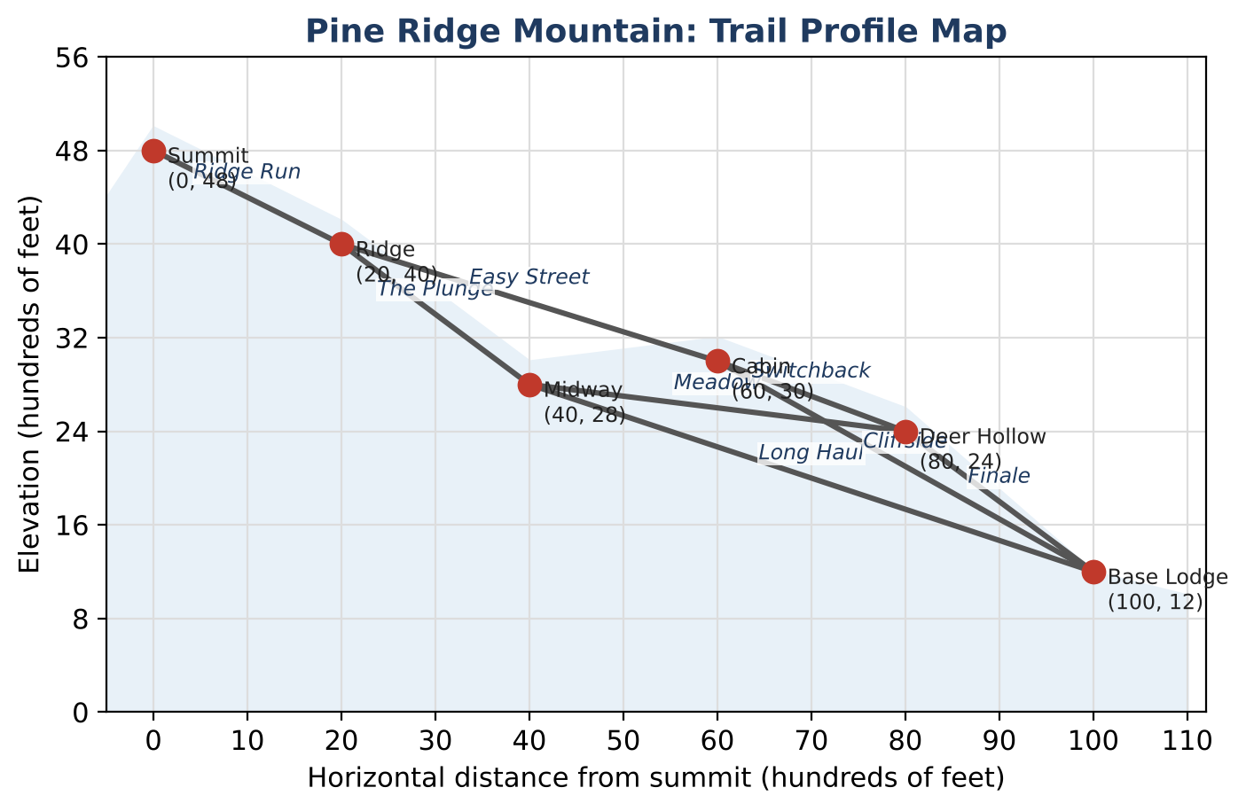
ALGEBRA 1 · UNIT 5: LINEAR FUNCTIONS AND GRAPHING
Mountain Trail Designer
Rate ski trails by slope and design a new run for Pine Ridge Mountain.
Honors Project
2–3 class periods
Name: ______________________ Group: ______________________

Slide 2
The Scenario
Honors
Pine Ridge Mountain is opening for the season, and the resort needs every trail rated before skiers arrive. Ratings depend on how steep a trail is, and steepness is slope!
The profile map shows each trail as a line segment between two points. The x-coordinate is the horizontal distance from the summit and the y-coordinate is the elevation, both in hundreds of feet. Your job: rate the trails, write their equations, and design a new trail.
Algebra 1 · Unit 5: Linear Functions and Graphing · Mountain Trail Designer

Slide 3
Learning Goals & Timeline
Honors
Learning Goals
Timeline
• I can express slope ratings as absolute value inequalities and percent grades.
• I can write equations in slope-intercept, point-slope, and standard form.
• I can design a route by solving inequalities for an unknown coordinate.
Day 1
Ratings as Inequalities
Day 2
Equations & Relationships
Day 3
Engineer an All-Blue Route
Final
New Trail Map + reflection
Algebra 1 · Unit 5: Linear Functions and Graphing · Mountain Trail Designer

Slide 4
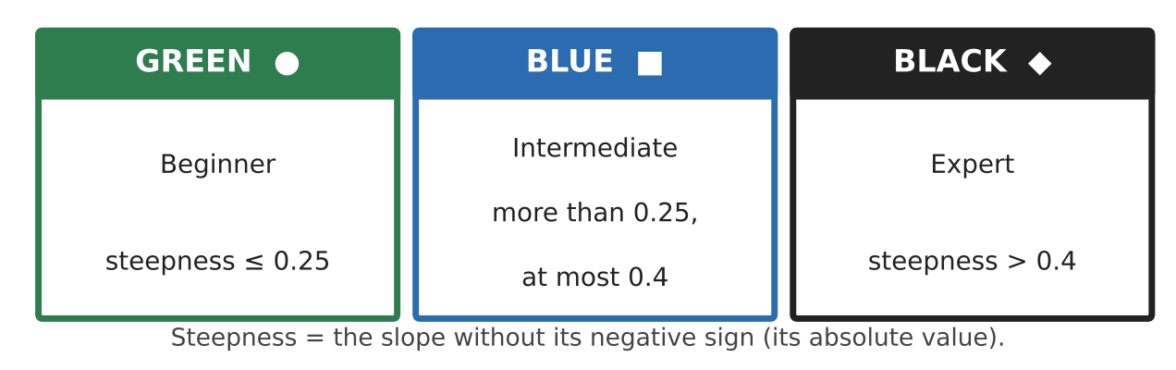
Part 1: Ratings as Inequalities
Honors
Day 1 · Use the map and rating card. Let m be the slope of a trail.
1. Write each rating as an inequality using |m|.
2. Find the slope and rating of every trail. Record them in the table.
3. Ski resorts often give the grade as a percent: grade = 100|m|%. Find the grade of the steepest and least steep trails.
4. Prove that no all-green-or-blue route exists from the Summit to the Base Lodge.
Trail | Slope | Steepness | Rating
Ridge Run
The Plunge
Long Haul
Easy Street
Cliffside
Meadow
Switchback
Finale
Algebra 1 · Unit 5: Linear Functions and Graphing · Mountain Trail Designer

Slide 5
Part 2: Equations & Relationships
Honors
Day 2 · Use exact values.
5. Write the equation of the chairlift in slope-intercept form and in standard form Ax + By = C (A, B, and C integers).
6. Show that the Ridge Run line and the Midway-to-Deer Hollow line are not parallel, and find where the two lines (extended) intersect.
7. A snow fence through the Cabin (60, 30) must be perpendicular to Cliffside. Write its equation in standard form.
8. The groomer's elevation is a linear function of time with f(2) = 1,320 and f(14) = 2,040. Write f(t) and find the time when f(t) = 4,800.
Algebra 1 · Unit 5: Linear Functions and Graphing · Mountain Trail Designer

Slide 6
Part 3: Engineer an All-Blue Route
Honors
Day 3 · The resort will add a new point E at x = 60 so that Ridge (20, 40) → E → Base Lodge (100, 12) is a route of blue trails.
9. Let E = (60, y). Write a compound inequality for the steepness of Ridge-to-E so that it is blue, and solve for y.
10. Do the same for E-to-Base Lodge.
11. Find all values of y that make both trails blue. Choose one value, write both trail equations, and add the route to your map with a recommendation.
Algebra 1 · Unit 5: Linear Functions and Graphing · Mountain Trail Designer

Slide 7
Final Product: New Trail Map
Honors
Your final product must include:
☐ Rating inequalities and the complete slope table with percent grades
☐ Equations in multiple forms (chairlift, snow fence, groomer)
☐ The intersection of the two extended trail lines
☐ The compound inequality for E and your chosen design
☐ A labeled map with the new all-blue route
Algebra 1 · Unit 5: Linear Functions and Graphing · Mountain Trail Designer

Slide 8
Scoring Rubric
Honors
Criteria | 4 – Exceeds | 3 – Meets | 2 – Approaching | 1 – Beginning
Mathematical Accuracy | All calculations and solutions are correct; answers include units and are checked. | Nearly all work is correct; minor errors do not change conclusions. | Several errors; some conclusions are affected. | Many errors or missing work.
Reasoning & Justification | Clear, complete explanations connect every answer to the situation; uses precise vocabulary. | Explanations are mostly clear and connected to the situation. | Explanations are brief or partly unclear. | Little or no explanation.
Application & Design | New trail meets the rating requirements, with slopes and equations shown. Goes beyond the minimum with a creative, realistic choice. | New trail meets the rating requirements, with slopes and equations shown. | Design is incomplete or only partly uses the math from the unit. | Design is missing or unrelated to the unit math.
Communication & Presentation | Trail map is labeled with points, slopes, ratings, and equations. Polished, organized, and visually engaging. | Trail map is labeled with points, slopes, ratings, and equations. Organized and easy to follow. | Product is missing required parts or is hard to follow. | Product is mostly missing.
Algebra 1 · Unit 5: Linear Functions and Graphing · Mountain Trail Designer

Slide 9
Reflection
Honors
R1. How did solving for y in Part 3 turn a design problem into an inequality problem?
R2. When is standard form more useful than slope-intercept form?
Algebra 1 · Unit 5: Linear Functions and Graphing · Mountain Trail Designer

