Slide 1
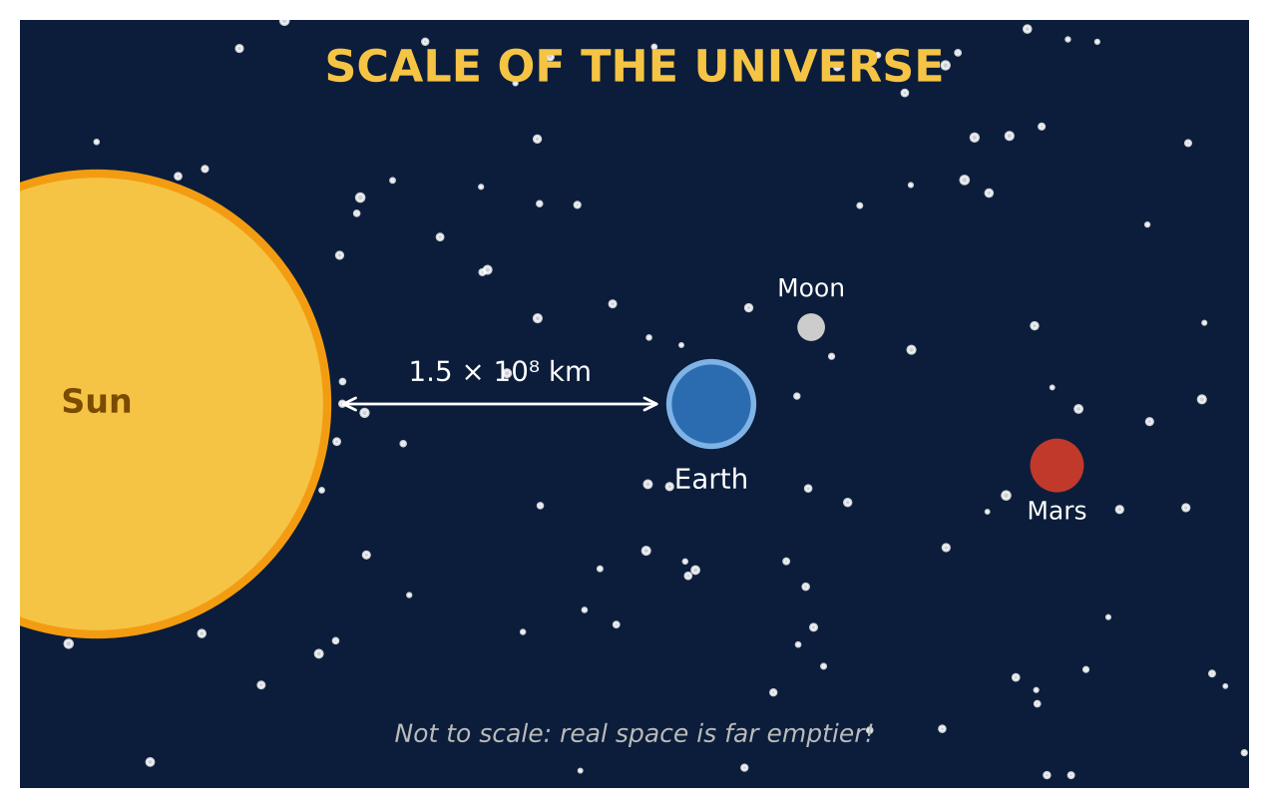
ALGEBRA 1 · UNIT 7: EXPONENTS AND SCIENTIFIC NOTATION
Scale of the Universe
Use scientific notation and exponent rules from viruses to stars.
CP1 Project
2–3 class periods
Name: ______________________ Group: ______________________

Slide 2
The Scenario
CP1
NASA has asked students to help explain space to younger kids. The problem: space is enormous, and the things inside our bodies are tiny. Numbers like 150,000,000 km and 0.00008 m are hard to picture.
You will use scientific notation and exponent rules to compare sizes, compute travel times, and then design a scale model of the solar system for your school hallway.
Algebra 1 · Unit 7: Exponents and Scientific Notation · Scale of the Universe

Slide 3
Learning Goals & Timeline
CP1
Learning Goals
Timeline
• I can multiply and divide numbers in scientific notation and write answers correctly.
• I can use exponent rules with negative exponents.
• I can create and use a scale with powers of ten.
Day 1
Big & Small
Day 2
Light & Travel
Day 3
Design a Hallway Model
Final
Scale Model Plan + reflection
Algebra 1 · Unit 7: Exponents and Scientific Notation · Scale of the Universe

Slide 4
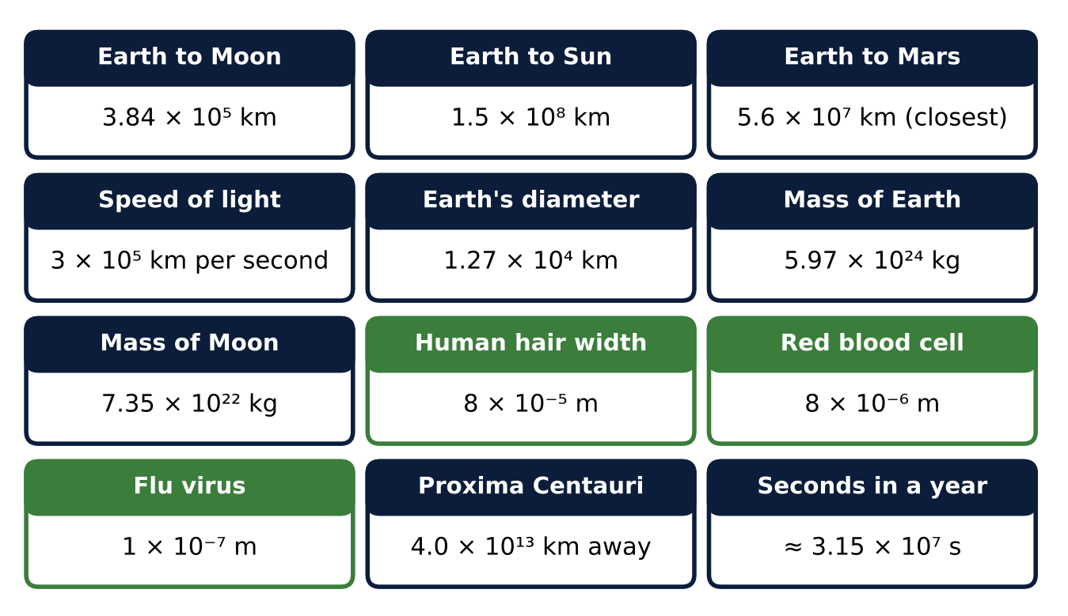
Part 1: Big & Small
CP1
Day 1 · Use the data cards. Write every answer in scientific notation.
1. How many flu viruses would fit side by side across a red blood cell? Across a human hair?
2. How many times larger is Earth's diameter than a human hair? (Convert to the same units first: 1 km = 10³ m.)
3. Simplify (6 × 10⁻³)(4 × 10⁸). Write the answer in scientific notation.
4. Explain why 24 × 10⁵ is not in scientific notation, and fix it.
Algebra 1 · Unit 7: Exponents and Scientific Notation · Scale of the Universe

Slide 5
Part 2: Light & Travel
CP1
Day 2 · Light travels 3 × 10⁵ km per second.
5. Find the light travel time from the Sun to Earth and from Earth to Mars (closest). Give each in seconds and minutes.
6. A light-year is the distance light travels in one year. Use 3.15 × 10⁷ seconds per year to find a light-year in km.
7. How many light-years away is Proxima Centauri?
8. A spacecraft travels 6 × 10⁴ km per hour. How many years would it take to reach Proxima Centauri? (1 year ≈ 8.76 × 10³ hours)
Algebra 1 · Unit 7: Exponents and Scientific Notation · Scale of the Universe

Slide 6
Part 3: Design a Hallway Model
CP1
Day 3 · Your hallway is about 50 meters long. Choose your own scale.
9. Choose a scale (1 m in the model = ? km) so that the Sun-to-Earth distance fits with room to spare. Write the scale in scientific notation.
10. Mars averages 2.28 × 10⁸ km from the Sun. Find the model distances for Earth and Mars.
11. At your scale, how big would Earth's diameter be? Could you see it? Explain.
Algebra 1 · Unit 7: Exponents and Scientific Notation · Scale of the Universe

Slide 7
Final Product: Scale Model Plan
CP1
Your final product must include:
☐ Size comparisons in scientific notation
☐ Travel-time calculations including light-years
☐ Your scale and model distances
☐ A labeled hallway diagram
☐ A paragraph explaining what the model shows and what it can't show
Algebra 1 · Unit 7: Exponents and Scientific Notation · Scale of the Universe

Slide 8
Scoring Rubric
CP1
Criteria | 4 – Exceeds | 3 – Meets | 2 – Approaching | 1 – Beginning
Mathematical Accuracy | All calculations and solutions are correct; answers include units and are checked. | Nearly all work is correct; minor errors do not change conclusions. | Several errors; some conclusions are affected. | Many errors or missing work.
Reasoning & Justification | Clear, complete explanations connect every answer to the situation; uses precise vocabulary. | Explanations are mostly clear and connected to the situation. | Explanations are brief or partly unclear. | Little or no explanation.
Application & Design | Model fits the chosen space and every scaled distance is calculated correctly. Goes beyond the minimum with a creative, realistic choice. | Model fits the chosen space and every scaled distance is calculated correctly. | Design is incomplete or only partly uses the math from the unit. | Design is missing or unrelated to the unit math.
Communication & Presentation | Scale model plan shows the scale, every converted distance in scientific notation, and a labeled diagram. Polished, organized, and visually engaging. | Scale model plan shows the scale, every converted distance in scientific notation, and a labeled diagram. Organized and easy to follow. | Product is missing required parts or is hard to follow. | Product is mostly missing.
Algebra 1 · Unit 7: Exponents and Scientific Notation · Scale of the Universe

Slide 9
Reflection
CP1
R1. Explain the rule for dividing powers of ten with the same base. Use an example from the project.
R2. Why does a scale model of space have to choose between showing distances and showing sizes?
Algebra 1 · Unit 7: Exponents and Scientific Notation · Scale of the Universe

