Slide 1
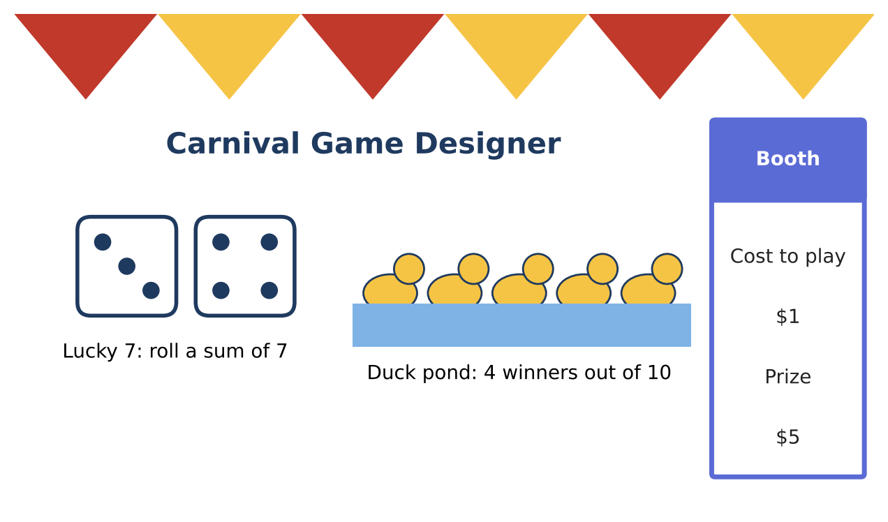
ALGEBRA 2 · UNIT 11: PROBABILITY & STATISTICS
Carnival Game Designer
Design a carnival booth that is fun for players and fair (but profitable) for the school.
Honors Project
2–3 class periods
Name: ______________________ Group: ______________________

Slide 2
The Scenario
Honors
The school carnival raises money for clubs, and your team is designing a booth. Players should feel they have a real chance to win, but the booth should still raise money over many plays.
Probability tells you how often players win, and expected value tells you how much the booth earns per play. You will analyze classic games and design your own.
Algebra 2 · Unit 11: Probability & Statistics · Carnival Game Designer

Slide 3
Learning Goals & Timeline
Honors
Learning Goals
Timeline
• I can use binomial probability and expected value.
• I can analyze variability in earnings.
• I can design and justify a game with simulation.
Day 1
Repeated Plays
Day 2
Profit & Risk
Day 3
Design & Simulate
Final
Booth Proposal + reflection
Algebra 2 · Unit 11: Probability & Statistics · Carnival Game Designer

Slide 4
Part 1: Repeated Plays
Honors
Day 1 · A player plays Lucky 7 five times (P(win) = ⅙ each time).
1. Find the probability of winning at least once.
2. Find the probability of exactly 2 wins.
3. Find the expected number of wins in 5 plays.
Algebra 2 · Unit 11: Probability & Statistics · Carnival Game Designer

Slide 5
Part 2: Profit & Risk
Honors
Day 2 · The booth charges $1 and pays $5 for a win.
4. Find the expected booth profit per play and for 300 plays.
5. Find the standard deviation of the booth's profit per play. (Values +$1 or −$4.)
6. Use the normal approximation: about how likely is the booth to lose money over 300 plays? (Total profit has mean 300μ and standard deviation √300 · σ.)
Algebra 2 · Unit 11: Probability & Statistics · Carnival Game Designer

Slide 6
Part 3: Design & Simulate
Honors
Day 3 · Design a game with an expected booth profit of $0.25 to $0.50 per play and at least a 20% chance of winning.
7. Write the probability model and expected value.
8. Simulate 50 plays (dice, cards, or a random-number generator). Compare with your model.
9. Write the proposal with the risk analysis.
Algebra 2 · Unit 11: Probability & Statistics · Carnival Game Designer

Slide 7
Final Product: Booth Proposal
Honors
Your final product must include:
☐ Binomial analysis
☐ Profit mean and standard deviation
☐ Risk estimate
☐ Simulated design and proposal
Algebra 2 · Unit 11: Probability & Statistics · Carnival Game Designer

Slide 8
Scoring Rubric
Honors
Criteria | 4 – Exceeds | 3 – Meets | 2 – Approaching | 1 – Beginning
Mathematical Accuracy | All calculations and solutions are correct; answers include units and are checked. | Nearly all work is correct; minor errors do not change conclusions. | Several errors; some conclusions are affected. | Many errors or missing work.
Reasoning & Justification | Clear, complete explanations connect every answer to the situation; uses precise vocabulary. | Explanations are mostly clear and connected to the situation. | Explanations are brief or partly unclear. | Little or no explanation.
Application & Design | Designed game has a correct probability model, and its expected value meets the target. Goes beyond the minimum with a creative, realistic choice. | Designed game has a correct probability model, and its expected value meets the target. | Design is incomplete or only partly uses the math from the unit. | Design is missing or unrelated to the unit math.
Communication & Presentation | Proposal includes the game rules, probabilities, expected value per play, and predicted earnings. Polished, organized, and visually engaging. | Proposal includes the game rules, probabilities, expected value per play, and predicted earnings. Organized and easy to follow. | Product is missing required parts or is hard to follow. | Product is mostly missing.
Algebra 2 · Unit 11: Probability & Statistics · Carnival Game Designer

Slide 9
Reflection
Honors
R1. Why can a booth with a positive expected value still lose money on a given night?
R2. How does the number of plays affect the risk?
Algebra 2 · Unit 11: Probability & Statistics · Carnival Game Designer

